Slide 1
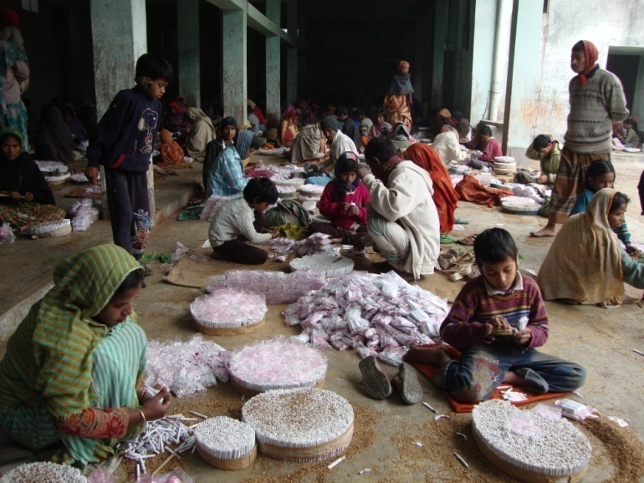
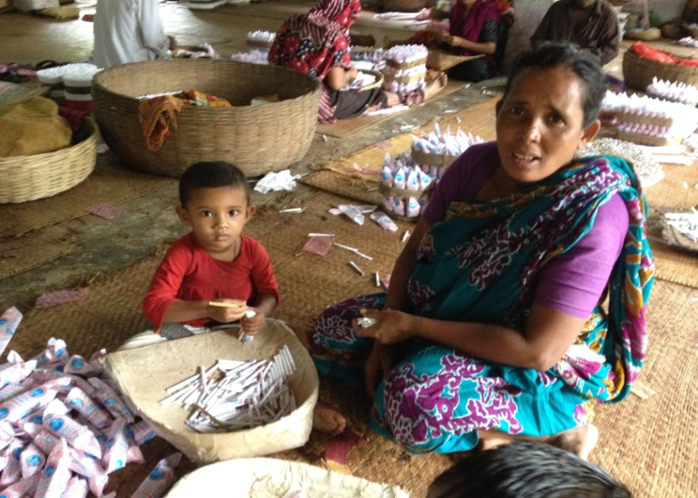
Child Labor in Bidi Factories: Current Situation and Way Forward
Sushanta Kumar Singha
Senior Report, Jamuna Television
sinhasmp@yahoo.com

Slide 2
a single minute with sound of war

Slide 3
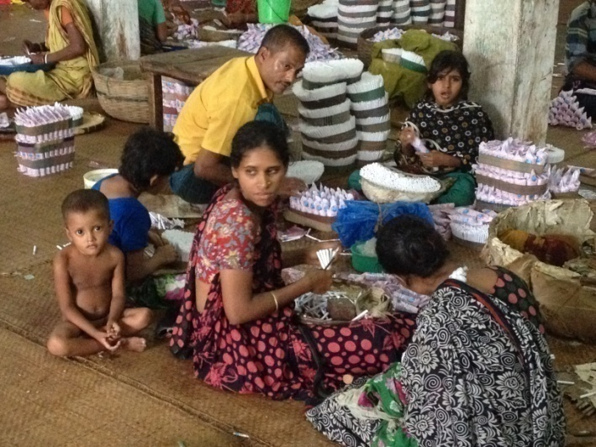
Background and rationale of the study
About 65,000 labors along with 2,20,000 associate labor in 117 Bidi factories in Bangladesh, a significant proportion of these workers are child.

Slide 4
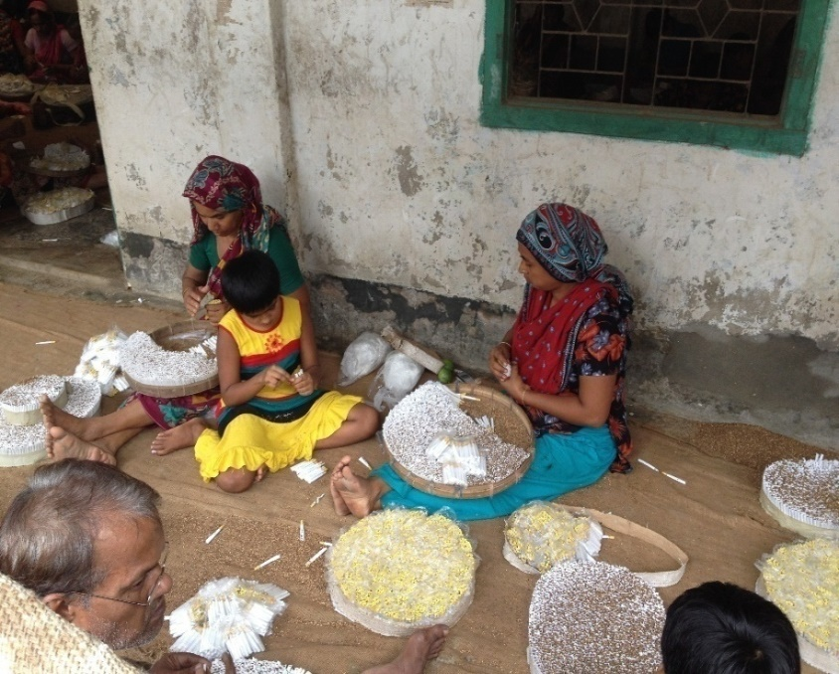
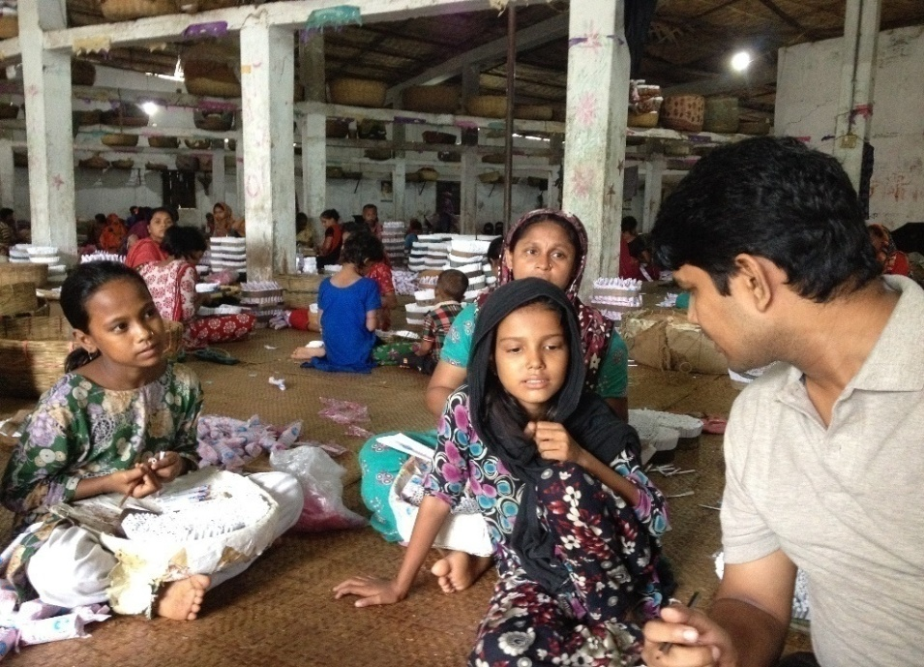
Background continued
In this context, it is important to explore the child labor situation in bidi factories to highlight the need for regulating this harmful sector and to stop child labor.

Slide 5
Objectives
The overall goal - to reveal the child labor situation in bidi factories in Bangladesh and recommend ways to regulate the sector through stopping child labor.
Specific objectives:
To collect information about the current scenario of child labor in bidi factories of Bangladesh;
To examine the factors behind child labor
To collect information on Education, Economic and health status
To recommend policy measures for regulating bidi factories through stopping child labor.

Slide 6
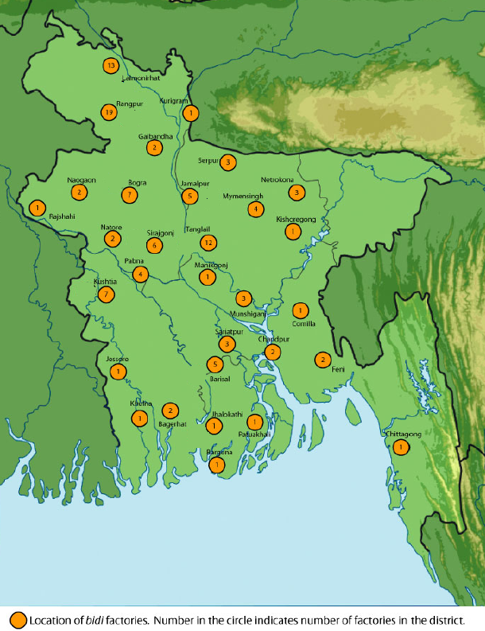
Methodology
Study Area
Study Area:
4 areas with the highest concentration of Bidi factories selected –
Rangpur, Kushtia,
Tangail and Barisal
8 Bidi factories from 4 areas selected randomly from the list.

Slide 7
Methodology
Mix of quantitative and qualitative methods:
Questionnaire Survey: Total 320
160 child labor aged 7-14 years: 40 from each region
160 caregivers or parents of them : 40 from each region
Selected conveniently based on availability at their household area.
In-depth interviews: Total 28
8 from Bidi factory management
16 senior Bidi worker who has been working minimum 10 years.
4 doctors or health professionals.

Slide 8
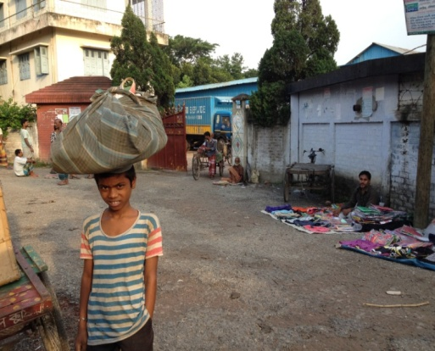
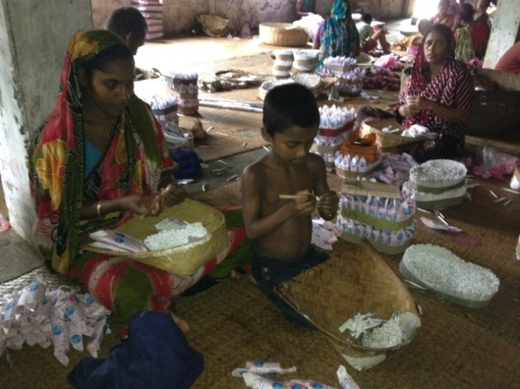
Findings – demography
The surveyed child is 58 % Boys and 42% Girls.
68% of the child is aged 11-14 yrs.
70% of the parents of the child laborers was fund to be illiterate;
78% of the child labors belong to households having 4-6 members.

Slide 9
Findings – household income
About half of the households have monthly incomes of less than 5,000 Tk or 62 USD per month which is close to the poverty line defined by the World Bank (2015)
Another 34% earn between 5,001-10,000 Tk or $ 62-125 USD

Slide 10
Findings – work status
Near about half of the child are working for 2 to 4 years.
And 26% were working for 5 to 7 years.
Number of working days
In Rangpur Tangail & Barisal mostly work 1/2 days/week.
In Kushtia it found 6 days/week.
68% Child work during the first half of the day, which is usually the school time.
Working hour:
42% child work for more than 6 hours/day.
Another 37% work 3-6 hours/day
Not a single Child worker use safety measures like gloves/musk.

Slide 11
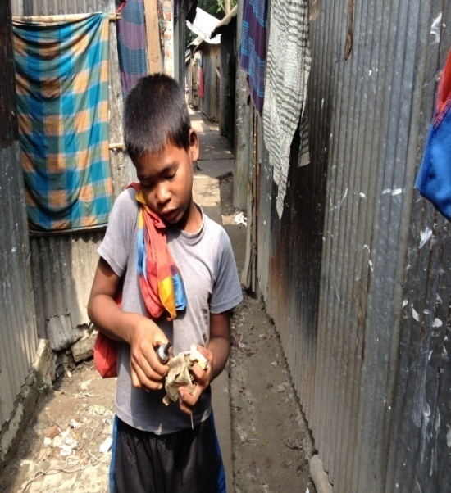
Findings - wage
Bidi laborers are among the least paid workers in Country
46% child earned less than 30 Tk, not half a Dollar per day
Around 61% child get less then 50 Tk (65 cents) per day.
9 out of 10 of the child workers contribute their
income to their families.

Slide 12
Findings - reason behind child labor
Factors behind prevalence of child labor in bidi factories
low wage rate and employment of only 1-2 days/week have made the work less attractive for adults.
Lack of awareness about the adverse health impact of working in bidi factories
Child start working at factories with their parents.
Trade union is found to be an important factor limiting child labor in bidi factories.
Lack of law enforcement may aggravated the situation.

Slide 13
Findings – effects on children
Effect on education of child workers
24% working child are out of school – some have dropped out.
74% pointed out work in industry to be the reason.
Effect on health of child workers
8 out of 10 child workers have reported to feel sick during their work in bidi factories including vomiting, breathing problem, headache, cough, waist pain, fever, abdominal pains, etc.
More than half of the child who felt sick face headache and over a quarter of such child faced breathing problem.
76% of the child to quit from the bidi factory work.

Slide 14
Policy Recommendations
Special social safety net programs can be introduced for in areas where bidi factories are highly concentrated.
Necessary policy measures and enforcement of existing laws and regulations is vital to prevent child labor in bidi factories.
Parents need to be aware of the adverse effects of working at bidi factories.
Government, media, development partners should work side by side to stop child labor at bidi factories.
Detailed survey on bidi producing sector should be carried out to establish solid database of the bidi factories.

Slide 15
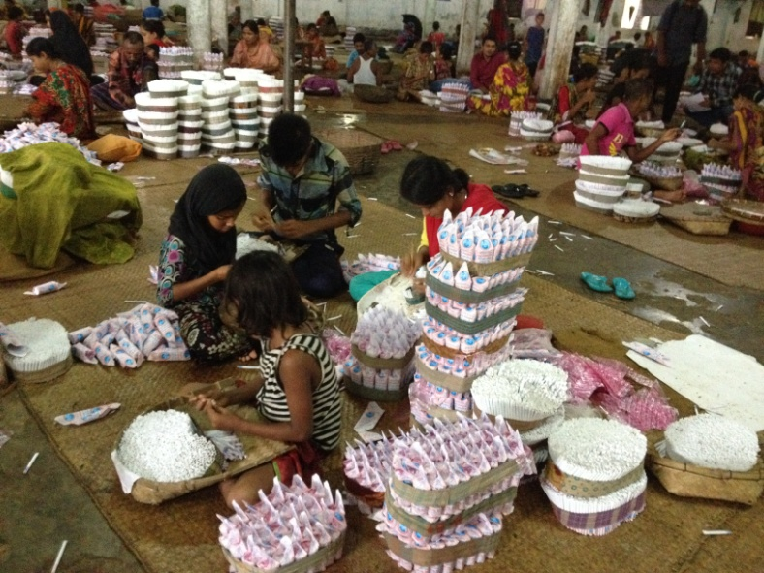
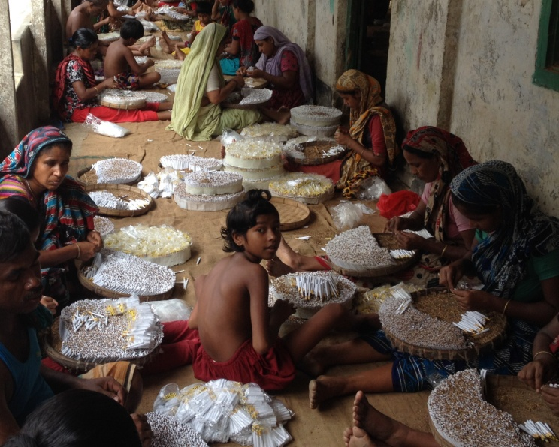
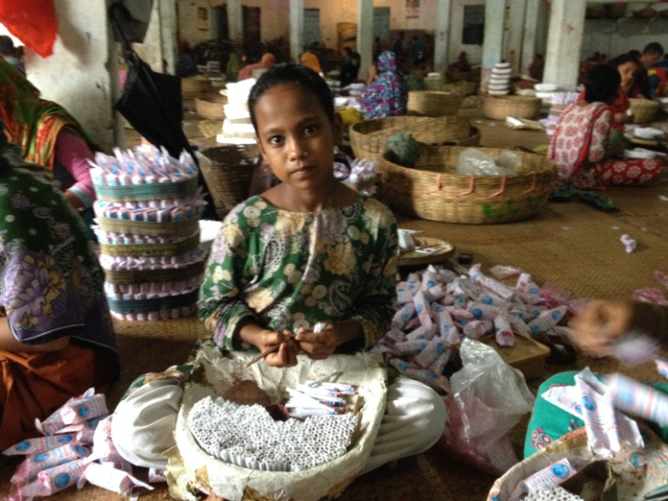
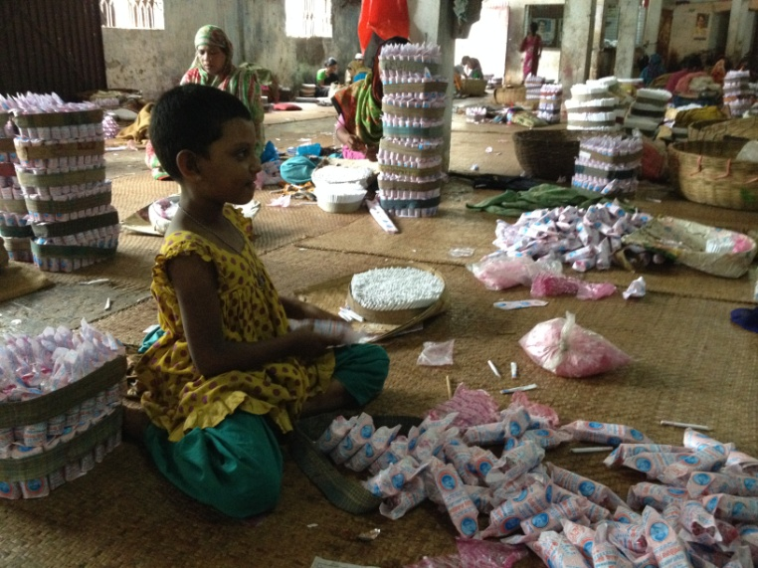
Thank you!

