Slide 1
Tobacco Tax: A tool for protecting public health
Syed Mahbubul Alam,LL.M
Technical Advisor, The Union

Slide 2
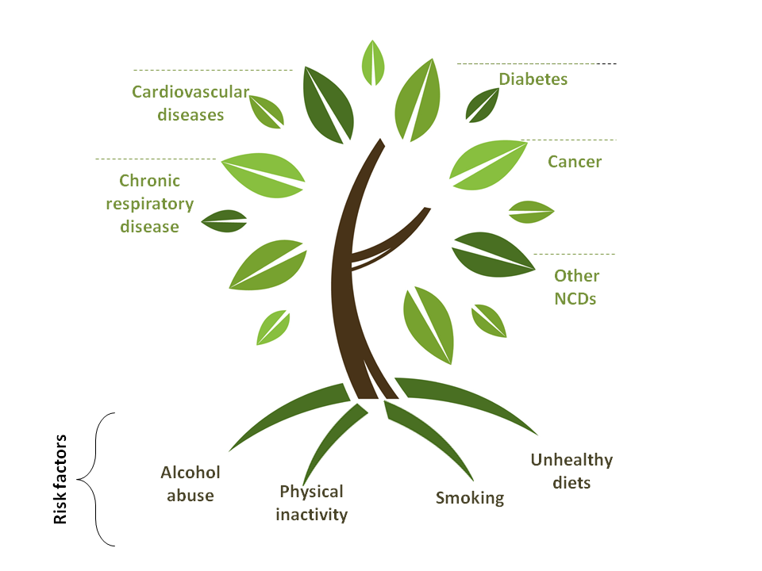

Slide 3
Non Communicable Diseases (NCDs)
According to NCD Risk factor Survey Bangladesh 2010
About 98.7% have at least one risk factor,
77.4% had two or more risk factors and
28.3% had 3 or more Risk Factor

Slide 4
Cancer, Diabetes, Tobacco
According to WHO estimation, there are about 12 lakh cancer patients in the country.
Every year two lakh people new cases add
1.5 lakh people die of cancer in Bangladesh every year (http://nicrhbd.org/)
Cancer will account for 12.7 per cent of the country’s total deaths by 2030.
7 million Bangladeshi suffer from diabetes in Bangladesh
Over 57,000 people die from tobacco-related diseases

Slide 5
Global Target

Slide 6
Initiative for NCDs Control
Excise tax increases
Smoke-free indoor workplaces and public places
Health warnings
Bans on advertising and promotion
MINISTRIES
Health,
Agriculture,
Finance,
Transport,
Trade and Industry
Education,
Labour,
Urban planning,
Justice
OTHER STAKEHOLDE
Civil society,
NGOs,
Academia,
Private sector,
Donor, development
partners
Tobacco use
Ministries including
Health
Agriculture
Finance
Transport
Trade and Industry
Education
Labour
Urban planning
Justice
Other stakeholders including
Industry
Civil society
NGOs
Academia
Harmful use of alcohol
Excise tax increases on alcoholic beverages
Comprehensive restrictions and bans on alcohol marketing
Restrictions on the availability of retailed alcohol
Unhealthy diet and physical inactivity
Salt reduction through mass media campaigns and reduced salt content in processed foods
Replacement of trans-fats with polyunsaturated fats
Public awareness programme about diet and physical activity
Ensure Physical activities facilities and health food.
Regulate Unhealthy food.

Slide 7
FCTC support
Article 6 recommends dedicating revenue to support TC and other health promotion programs
Article 26 requires all parties to secure and provide financial support for implementation of tobacco control

Slide 8
Why sustainable funding important?
Burden of disease from tobacco use/NCDs: health, econ, social costs
Need for comprehensive, long-term measures
Limitations of short-term funding
Lack of government priority to prevention
Taxes themselves an important tool
Sustainable Funding for NCD and Tobacco
Health Promotion Foundation
is the best solution

Slide 9
Tax sources: real and potential
1% surcharge on cigarettes
Surcharge on mobile phone
SSB: sugar-sweetened beverages
Cars
TV
Bottled water

Slide 10
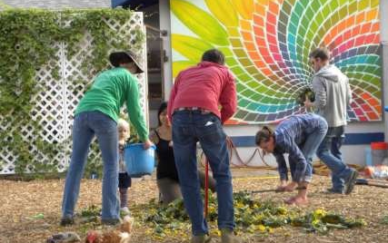
Usual focus
NCDs
Physical activity
Healthy diet
Tobacco & alcohol control incl. implementation of FCTC (sometimes addiction services and alternative crops/other tobacco-related employment)
Other areas
Road safety
Healthy lifestyles/workplaces/communities/cities
Nutrition/help for underprivileged
Healthy aging

Slide 11
Health promotion foundations
VicHealth, Healthway in Australia
ThaiHealth
Mongolia
Tonga
Malaysia
Vietnam
…more each year…

Slide 12
Some roles to consider
Implements programs
Builds leadership & capacity
Advocates to influence health policy
Facilitates networks/partnerships
Plan/implement programs
Carry out research
Only acts as funder
Fund research
Replace sponsorships

Slide 13
Health Development Surcharge
In 2014-15 financial budgets, 1% surcharges on all tobacco products is a milestone initiative of the Government of Bangladesh to protect public health.
In 1st July 2014 National Board of Revenue (NBR) pass passed rules to collect surcharge from all tobacco products

Slide 14
Govt. Initiative
Ministry of Health and Family Welfare formed a committee to prepared draft proposal to use of health development surcharge.
Committee members are
Additional Secretary, (Public Health & WHO) MOH
Deputy Secretary ( WHO) MOH
Deputy Secretary, MOPA & MOCAT
Deputy Secretary, (Budget) MOH
Representative, NCDC Line Director.
Representative, WHO
Representative, The Union
Representation, CTFK
Committee reviewed of different law, policies and formation of existing foundations in Bangladesh. Prepared a initial draft document.

Slide 15
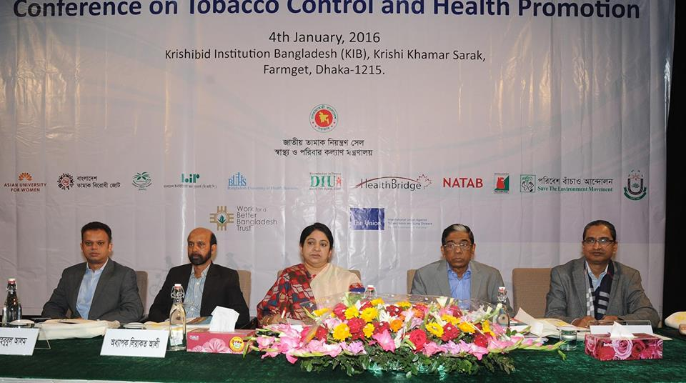
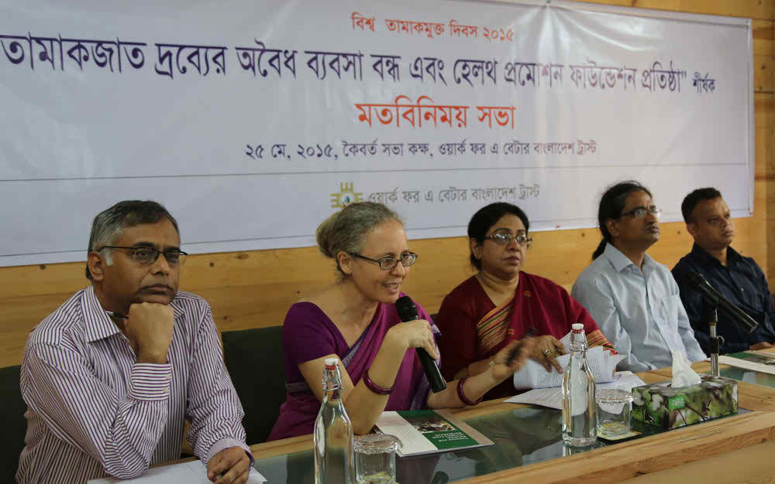
Capacity Building
Around 210 NGOs’ representative are highly orientated about the Sustainable funning issues during the 7 Divisional workshops organized by WBB Trust
Organize National Level Conference on Sustainable Funding.

Slide 16
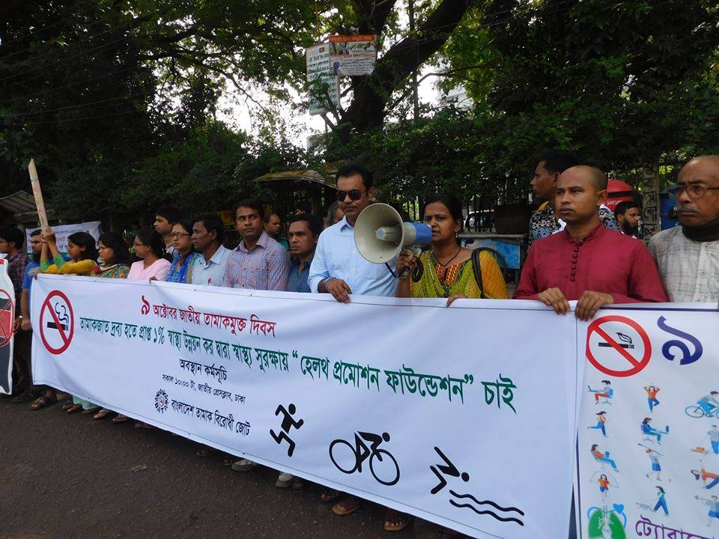
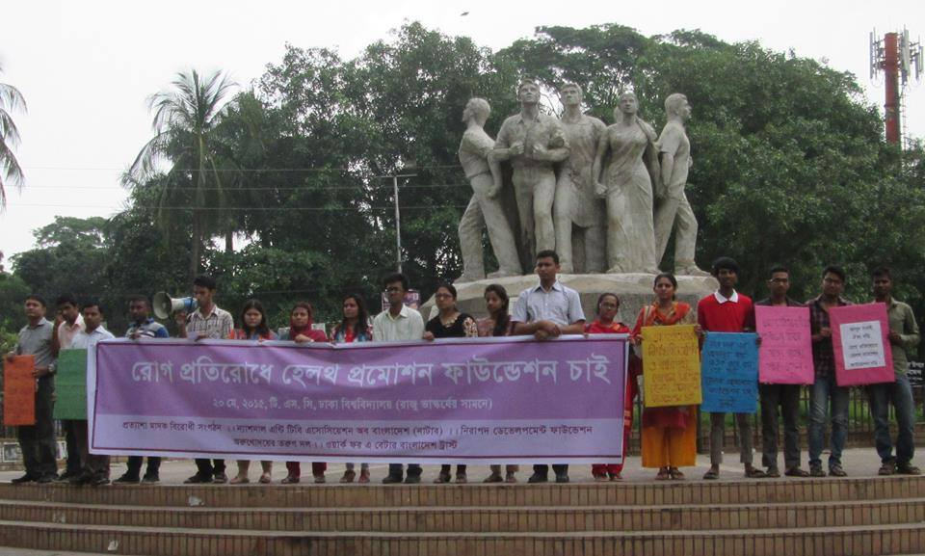
Public Support Campaign
During WNTD 2015, over 60 organizations organized various programs and demanded to establish a Health Promotion Foundation to ensure sustainable funding for TC.

Slide 17
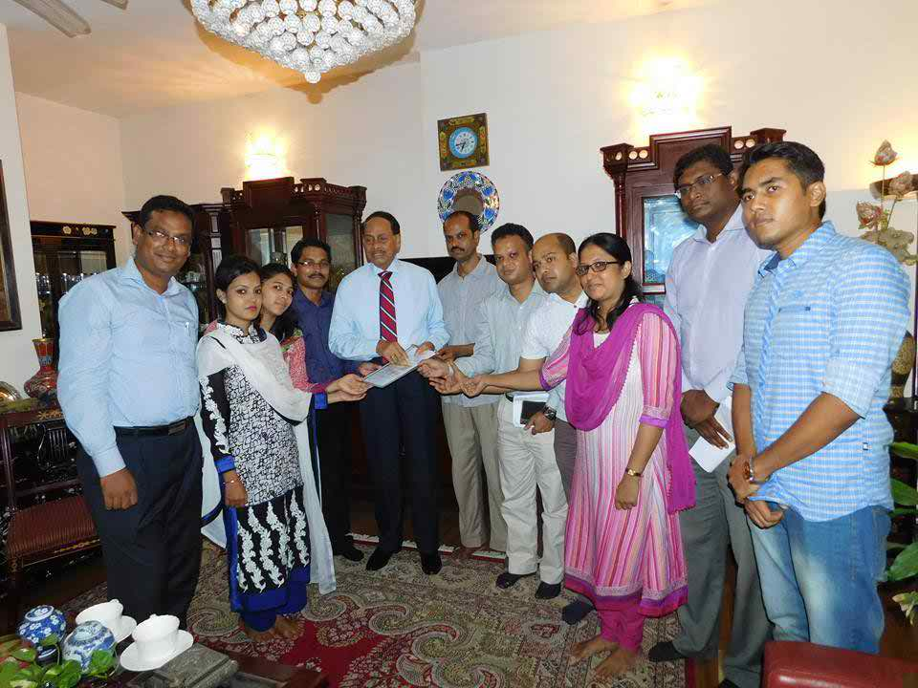
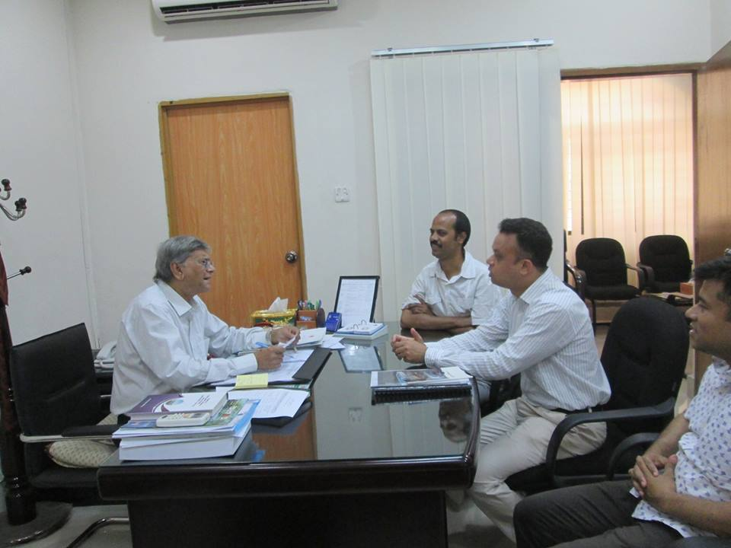
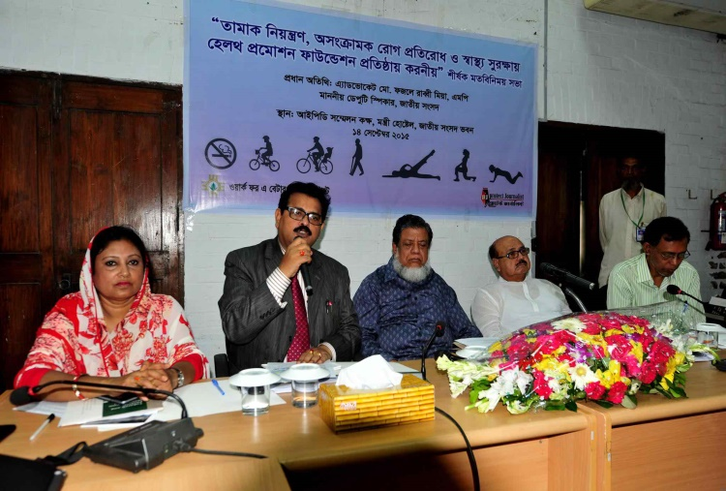
Sensitize Policy Makers
Parliamentary members and policy makers has sensitized about sustainable funding issues

Slide 18
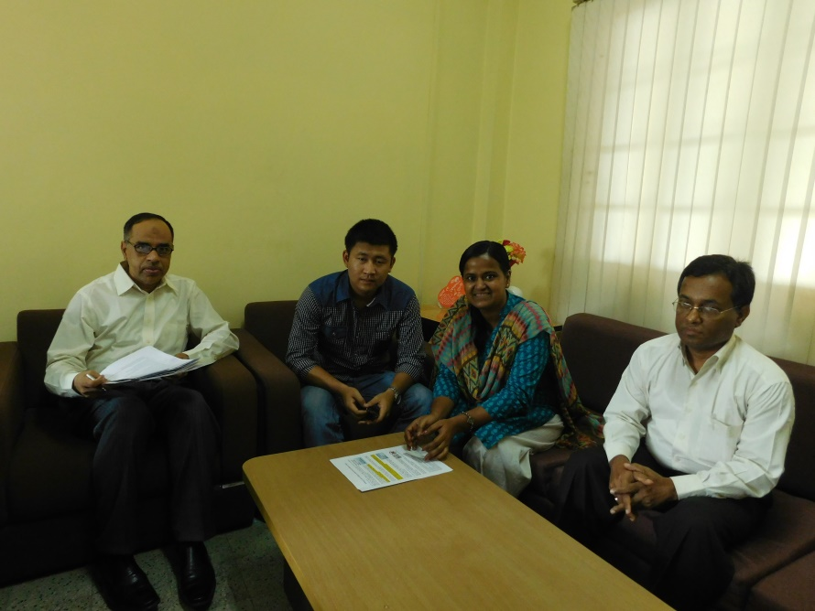
Govt. Institution
Sharing meeting with government organizations

Slide 19
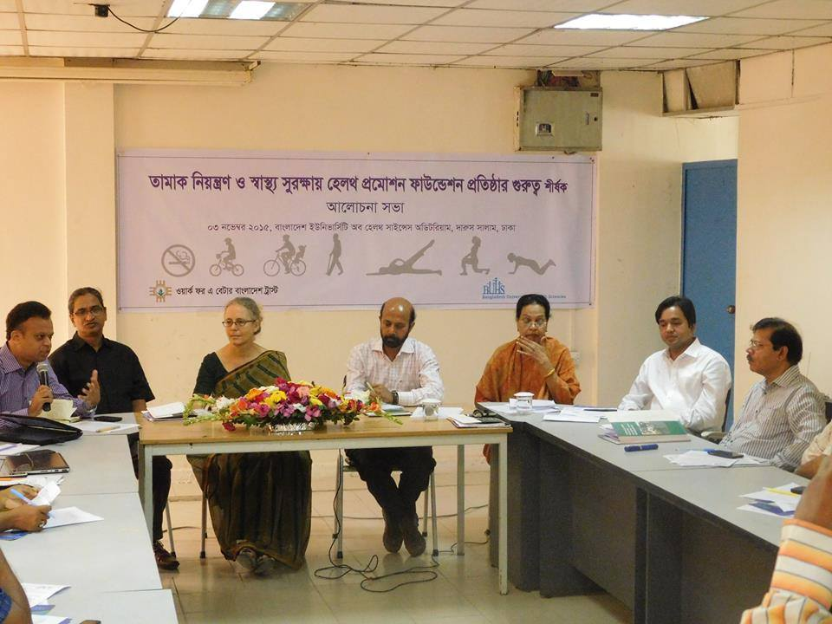
CSO and Academy
Leading CSO such as POBA, BAPA, Public Health Foundation support to establish a institute for sustainable funding.
Bangladesh University and Health Science and Dhaka International University actively working on HPF issue.

Slide 20
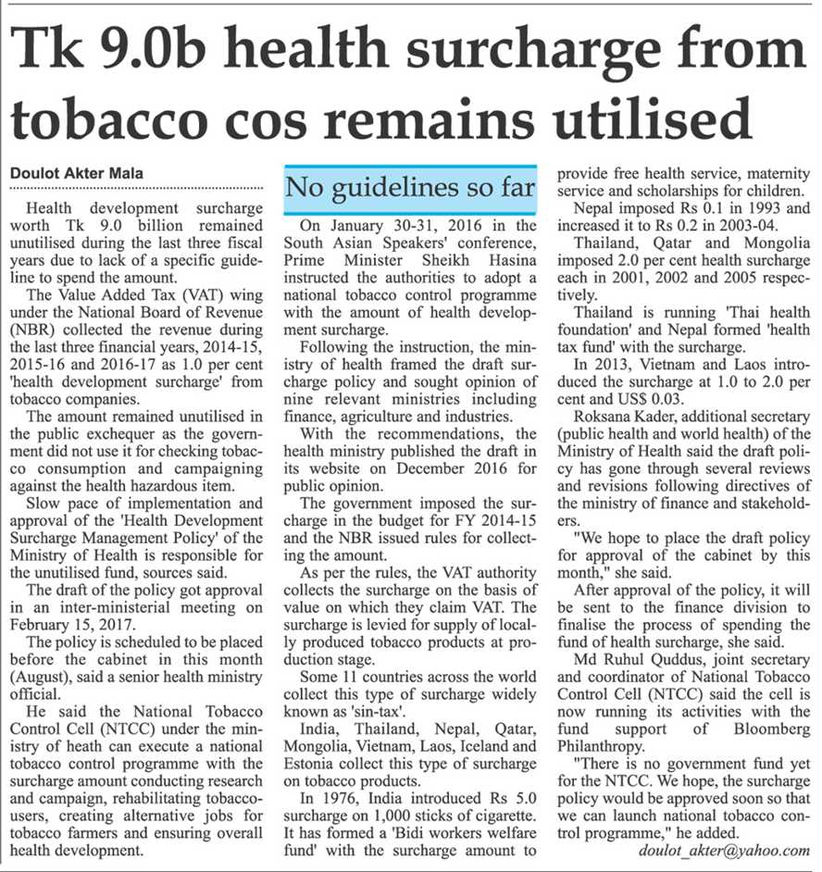
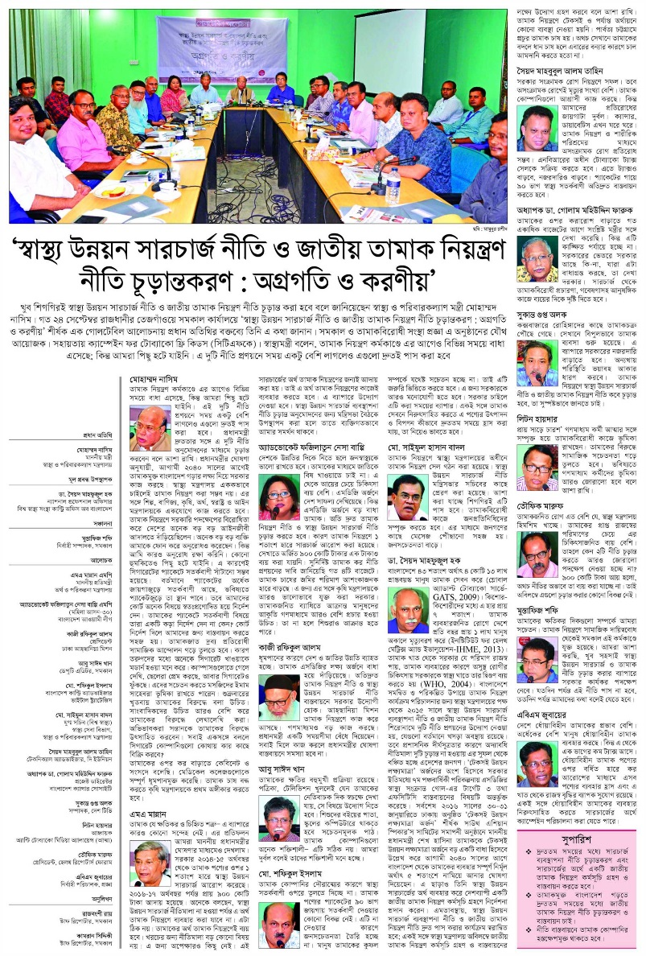
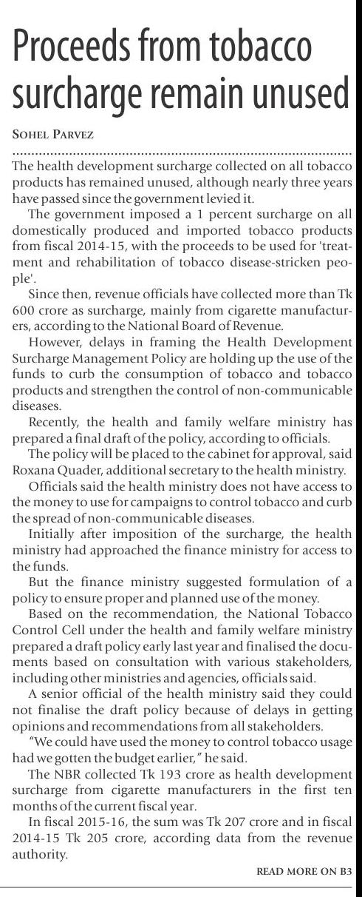
Media Advocacy

Slide 21
Achievement
Finally Cabinet approved the HDS Management Policy 2017 on 16th October 2017 and issued notification on 8th November 2017
The policy identified 14 areas for the utilization of the funds generated as HDS
Administering national tobacco control programs
Mass media campaign
Raising mass awareness
Operation of Tobacco Tax Cell (TTC) under NBR
Research
Operation of quit line
Assisting in preventing tobacco related NCD
Inspiring tobacco farmers in alternative crop cultivation
Capacity building of stakeholders
“We did it all together “

Slide 22
Management of HDS:
A committee in the following criteria Shall be formed with a view to ensuring the utilization of the fund collected from Health Development Surcharge:
Minister; Health and family welfare ministry President
Secretary; Health and family welfare ministry Vice- President
Additional Secretary; Ministry of Health Member
Additional Secretary; (Budget Wing) Ministry of Health Member
Additional Secretary/ JS Finance Ministry Member
Additional Secretary/ JS Education Ministry Member
Additional Secretary/ JS Ministry of Public Administration Member
Additional Secretary/ JS Ministry of Home Member
Additional Secretary/JS Ministry of Agriculture Member
Member, National Tax Board Member
Line Director; Health Bureau Member
Representative from Tobacco Control Organization Member
Executive officer; National Tobacco Control Cell Member Secretary

Slide 23
The sectors to spend the fund.
This fund is to be used for reducing of supply and demand side of Tobacco. Again the committee may change or add the thing evaluating the priority. The following sectors shall be considered specifically prior;
To fund the activities of National Tobacco Control Cell.
Funding to the national tobacco control program.
To support Tobacco control Taskforce for implementation of TC law.
To work for creating awareness using mess media.
Capacity Building of the stakeholders relation to tobacco control.
To conduct research on the harmfulness of the tobacco.
To examine and evaluate the tobacco control activities.
To take initiative to add the topic in the training syllabus of the govt. Cadre in different steps.
To campaign on tobacco control in the community basis.
To set quit line with a view to minimizing the use of tobacco.
To help the steps related to the control of NCDs.
To provide financial and technical support to the organizations working for tobacco and NCDs control.

Slide 24
TI Interference
An organization filed a writ petition to the High Court urging to spend the HDS Fund in treatment
However, the positive approaches from the MoHFW/NTCC and timely intervention by anti-tobacco organizations, the petition is kept as pending

Slide 25
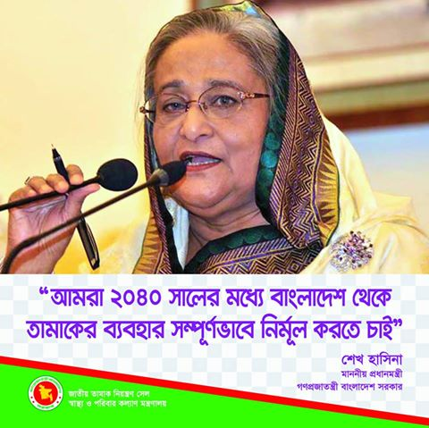
Political Commitment
Prime Minister Sheikh Hasina pledged the commitment of her government to work towards full compliance with the WHO FCTC and stated that overhauling tobacco tax was high on the agenda as the most powerful measure for reducing tobacco use. Bangladesh aims to be tobacco-free by 2040.

Slide 26
Thank you

