Slide 1
“Tobacco Epidemic and
Control Strategies”
Aminul Islam Sujon
Bureau of Economic Research, University of Dhaka
13 November, 2018

Slide 2
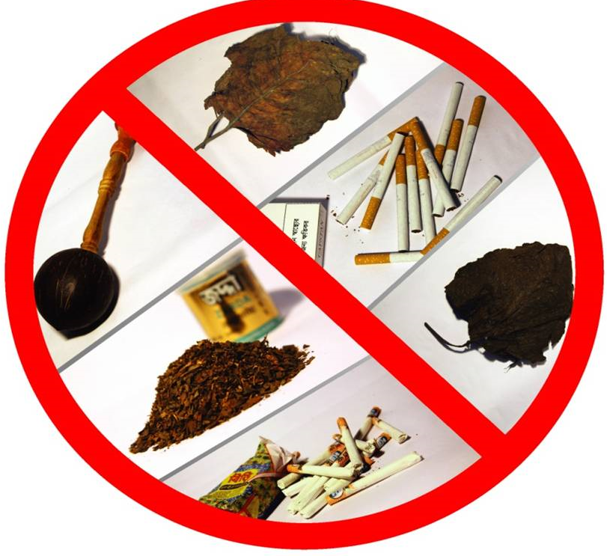
Definition of Tobacco
“Tobacco” means Nicotima Tobaccum or any plants of Nicotima Bustica or any other plants thereof or it’s leaf, roots, branches or any other parts of the plant or produce
“Tobacco Products” means anything made from tobacco, tobacco leaf or part of tobacco plants, which is used through chewing or smoking like Bidi, Cigarette, Cheroot, Cigar, Gul, Jorda, Khoinee, White leaf (Sada Pata), Hukka or mixture used in pipe.
Smoking and Using of Tobacco Products (Control) Act 2005
(Amended in 2013)

Slide 3
Tobacco – Major Killer
Tobacco is only legal consumer product proven to kill more than half of its regular users
It harms in every process, cultivation and leaf curing, production and use

Slide 4
Tobacco in the World
Christopher Columbus brought samples back to Europe
16th century a few Europeans started to use it – (for whom nicotine is named) popularize the use.Jean Nicot
Introduced to France in 1556, Portugal in 1558, and Spain in 1559, and England in 1565.
First commercial crop in Virginia, USA in 1612
Cigars became popular in the early 1800s
Note: Chewing betel quid (betel leaf mixed with areca nut, slaked lime and khoyer) known as ‘pan’ used in Bangladesh (the then India) even 2000 years back, long before introduction of tobacco by the Europeans.

Slide 5
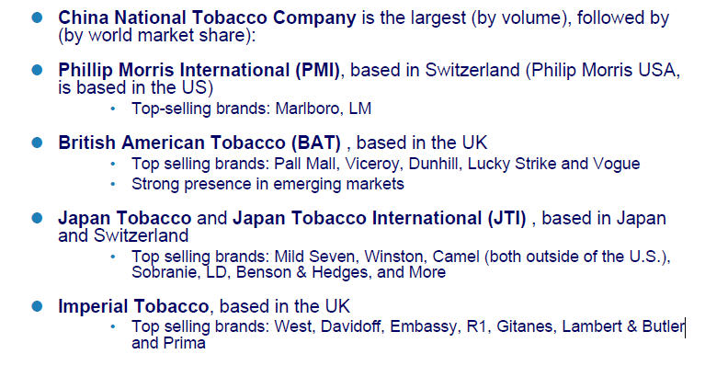
Large vector (tobacco industry) of social inequalities
WHO, 23 March 2011

Slide 6
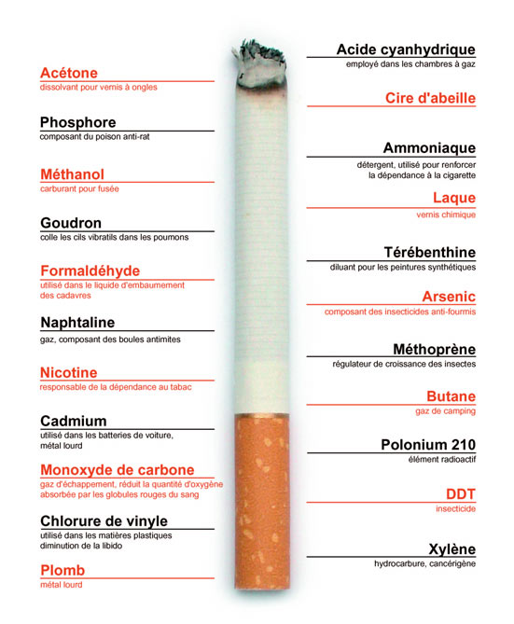
Tobacco substances
Smoking tobacco causes exposure to a lethal mixture of more than 7000 chemicals,
  70 known carcinogens
  (Source: US Surgeon General Report 2010)

Slide 7
Some dangerous substances and effects 5
Nicotine - highly addictive, extremely fast-acting drug.
  It reaches the brain within 15 seconds of being inhaled.
  Nicotine exposure can lead to vomiting, depression,
  central nervous system.
Carbon Monoxide - poisonous gas. It has no smell or taste.
  Inhaling certain amount can cause to go coma and die.
  It decreases muscle and heart function, it causes weakness, and dizziness. It is especially poisonous for babies still in the womb, infants and individuals with heart or lung disease.
Tar - 70% of tar remains in the smokers lungs, causes several types of cancer.

Slide 8
Tobacco related death in World
Tobacco use is the leading cause of preventable disease, disability, and death.
7.1 million death per year
  5.1 million in men,
  2.0 million in women
  About .9 million people die due to exposure to tobacco smoke
Source: The Tobacco Atlas 2018

Slide 9
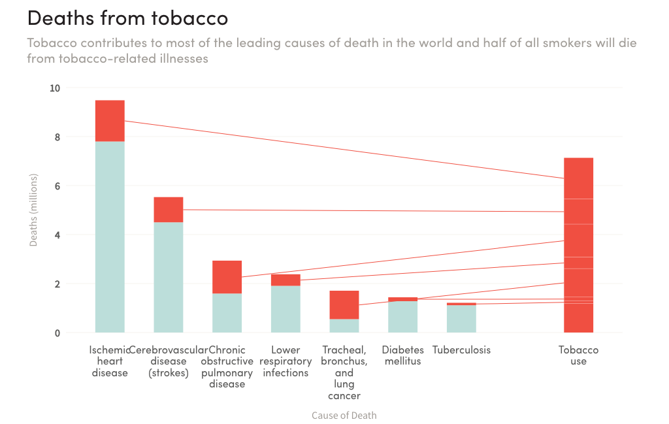

Slide 10
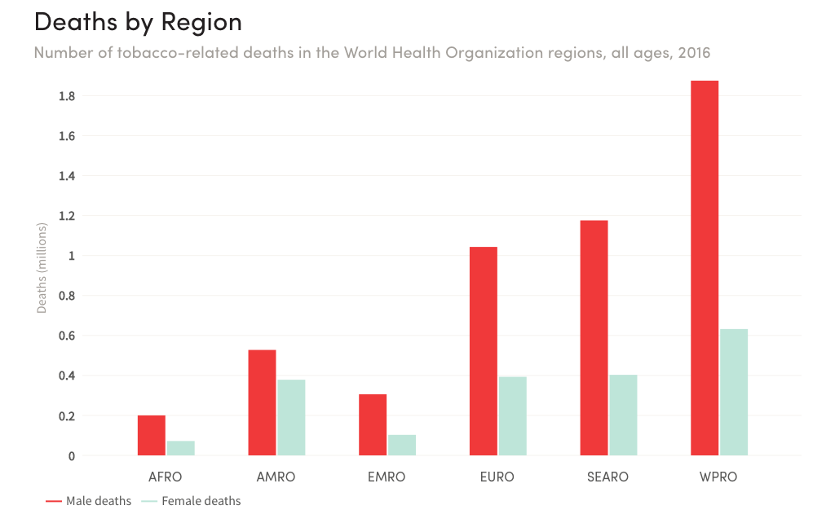

Slide 11
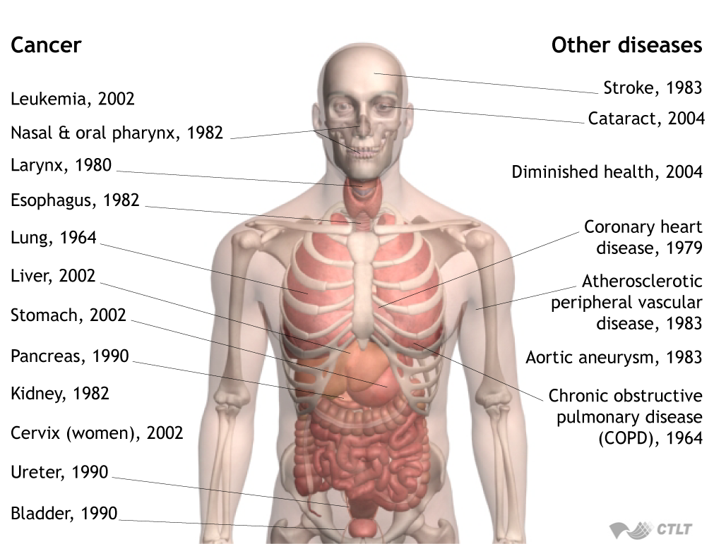
Scientific Evidence on Active Smoking
Source: adapted by CTLT from U.S. Surgeon General’s Report. (2004).

Slide 12

Exposure to tobacco smoke
There is no risk-free level of exposure to secondhand smoke.

Slide 13
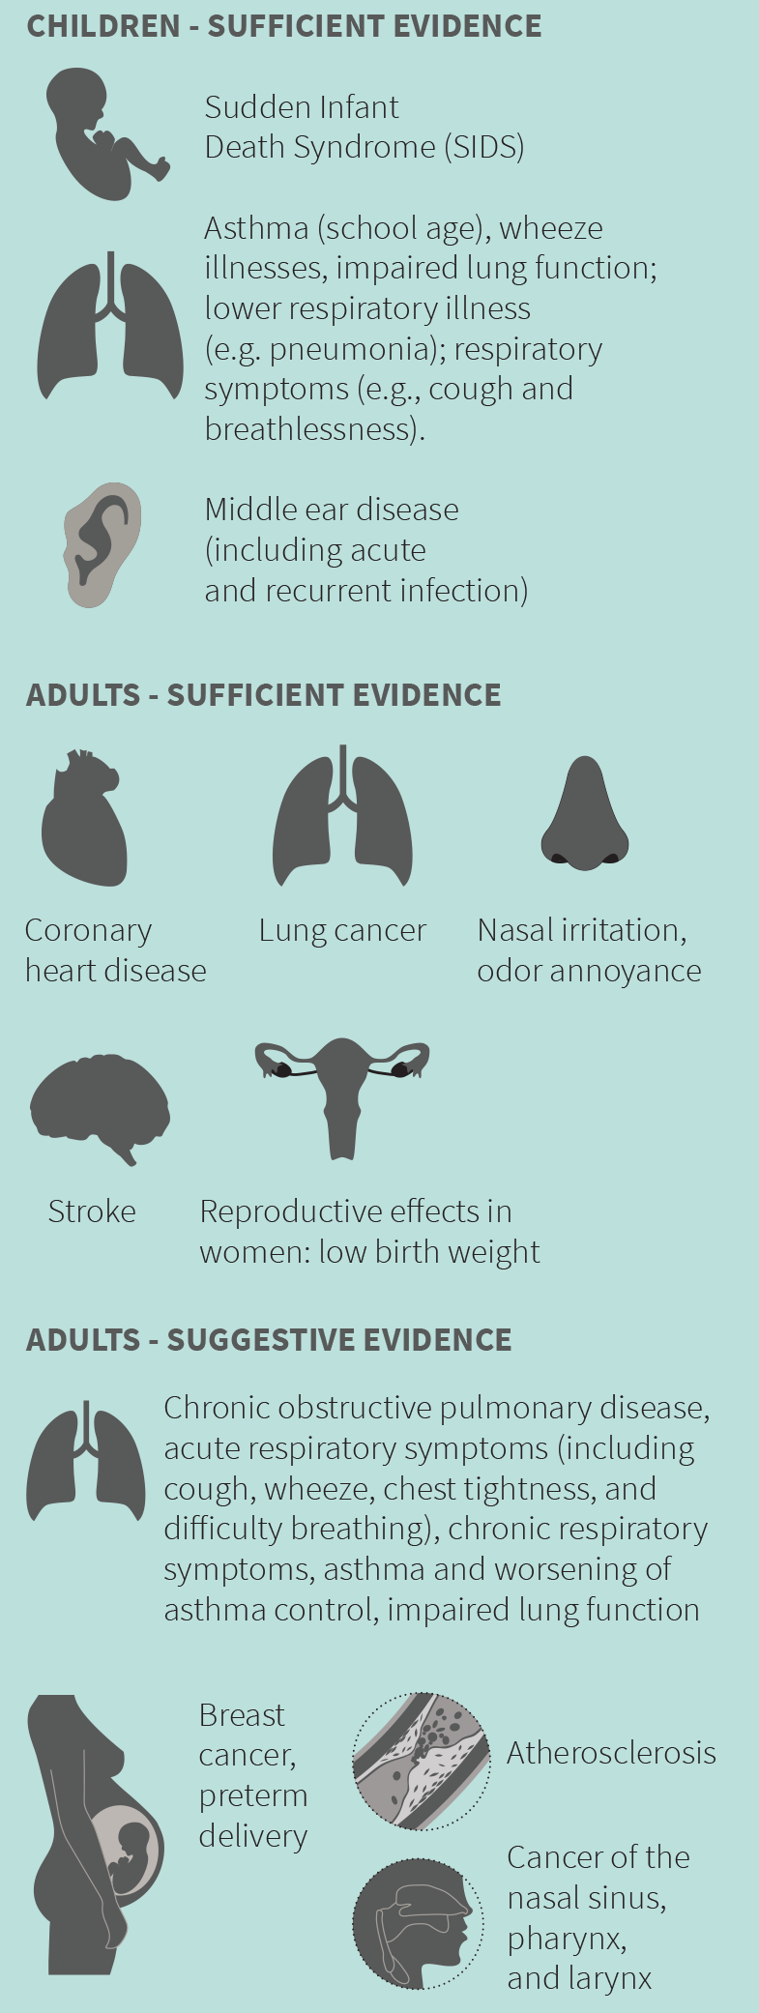
Exposure to tobacco smoke

Slide 14
Tobacco Cultivation
Tobacco growing, production, and consumption are devastating our environment.
Tobacco leaf curing deforestation and pollute air.
Working in tobacco cultivation is major causes for Green Tobacco Sickness and skin diseases.
Over-utilizes harmful chemicals and fertilizers gradually reduces fertility of agro-land, pollute water and soil.
The waste from production— much of it toxic— and disposal of packaging and cigarette butts pollute our fragile ecosystems.

Slide 15
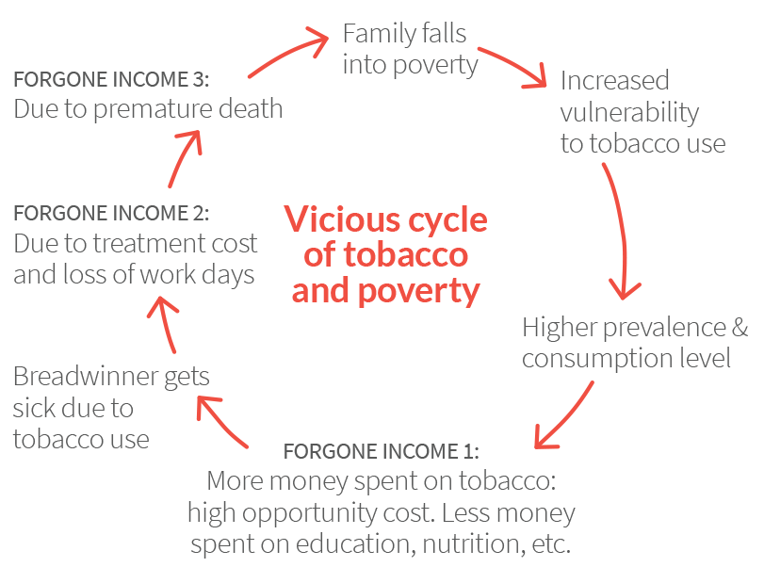

Slide 16
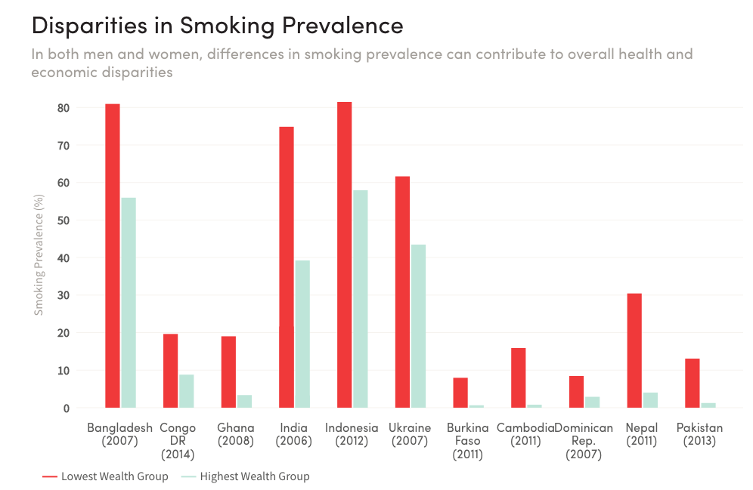

Slide 17
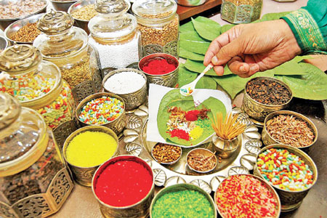
Smokeless Tobacco: Health Burden
More than 300 million people around the world, most of whom live in South Asia
In 2016, there were approximately 315,000 deaths caused by smokeless tobacco products, most of which were in South Asia.
Source: Global Burden of Disease Collaborators, 2016.

Slide 18
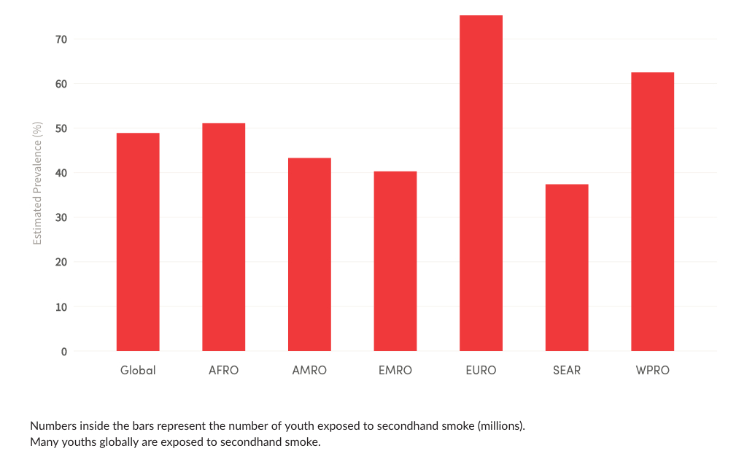
Youth and Tobacco
Tobacco is gateway of other addiction
Among 13–15 years old boys and girls
  25 million smokes
  13 million use SLT
  Exposed to tobacco smoke among youth, by WHO region

Slide 19
Smoking can cause cancer:
Globally, smoking causes almost 80% of male and nearly 50% of female lung cancer deaths (Tobacco Atlas, 4th Edition)
90% of lung cancer developed because of smoking.
Cancer caused by smokeless tobacco:
Mouth and throat
Esophagus
Pancreas
https://www.cdc.gov/tobacco/basic_information/health_effects/cancer

Slide 20
Smoking Related CVD
Smoking is a major cause of CVD and causes one of every three deaths from CVD.
Smoking Related COPD
Smoking accounts for as many as 8 out of 10 COPD-related deaths.

Slide 21
Worldwide tobacco use
About 5.7 trillion cigarettes were smoked worldwide in 2016.
Globally, more than 1.1 billion ages 15 or older are current smokers
  942 million men and
  175 million women

Slide 22
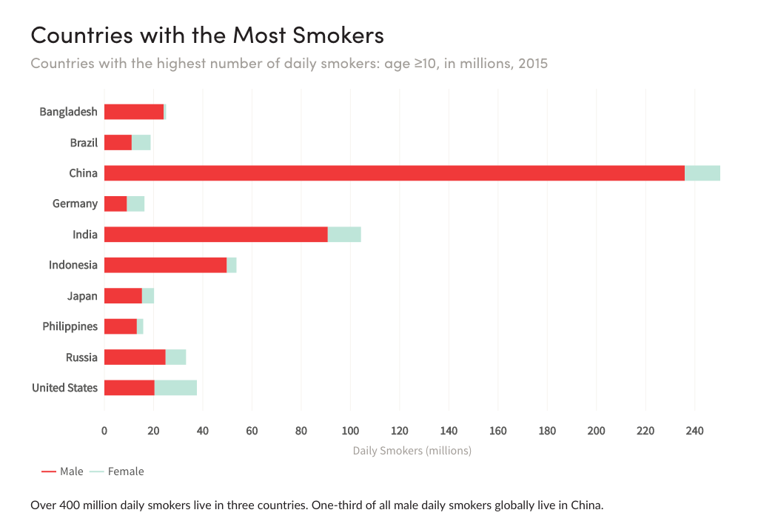
  Top 10 countries with smokers

Slide 23
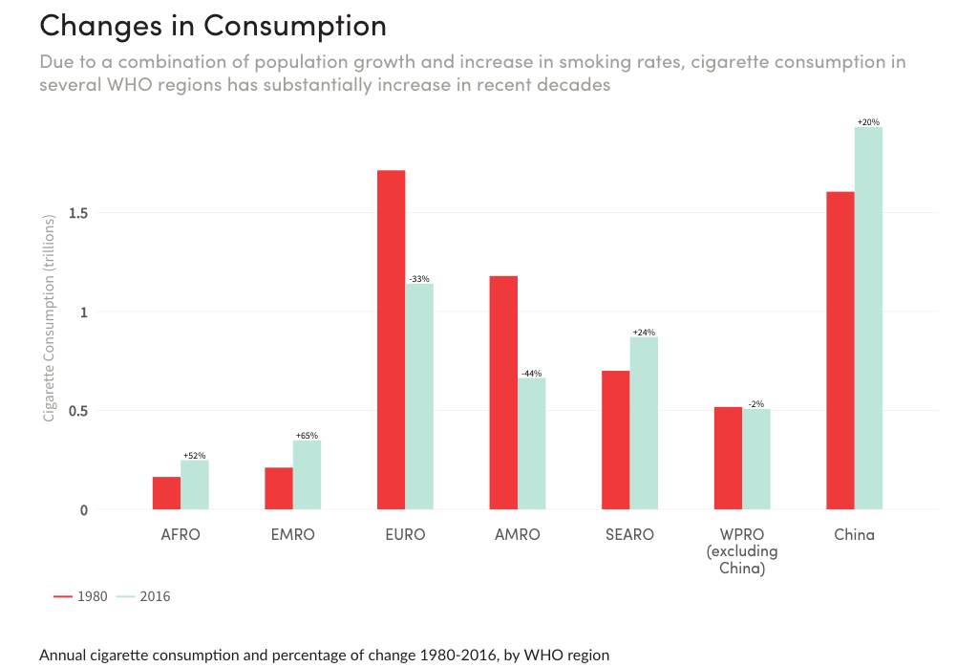

Slide 24
Tobacco Control Strategies in World
1944, American Cancer Society began to warn on possible ill effects of smoking.
1952, Readers Digest published Cancer by Carton, detailing the dangers of smoking.
1964 US Surgeon General report concluded that cigarette smoking is causally related to lung cancer in men
1980s: increasing evidence, and still growing, of harmful effects of exposure to second- hand tobacco smoke (SHS).
World Conference on Smoking and Health in 1967 (USA), 1971 (UK), 1975 (USA), 1979 (Sweden), 1983 (Canada), 1987 (Japan), 1990 (Australia), 1992 (Argentina), 1994 (France), 1997 (China), 2000 (USA), 2003 (Finland), 2006 (USA), 2009 (India), 2012 (Singapore), 2015 (UAE) and 2018 (South Africa)
  Regional conference such as APACT

Slide 25
Tobacco Control Strategies in World
World No Tobacco Day celebration from 1987
1995, 48th World Health Assembly formally initiated to develop a global treaty for tobacco control
1996, 49th WHA requested Director General of WHO to take initiative
1999, WHO formed Tobacco Free Initiatives and officially started to developed the WHO Framework Convention on Tobacco Control
1999-2000: Working group developed first draft of treaty
2000-2003, Inter-Government Meeting was reviewed draft text
2003, 56th WHA approved the WHO FCTC

Slide 26
WHO FCTC
WHO Framework Convention on Tobacco Control (WHO FCTC) is is the first global public health treaty.
Developed by countries in response to the tobacco epidemic.
It is a comprehensive document on global tobacco control and it is legally binding treaty.
FCTC entered into force on 27 February 2005 – 90 days after it had been ratified, by 40 States. There are currently 181 Parties to the Convention.
WHO formed FCTC secretariat to facilitate all initiatives regarding implementation of this treaty worldwide.
Conference of the Parties (COP) is the governing body of the WHO FCTC and is comprised of all Parties to the Convention.

Slide 27
Main issues of FCTC
Objective (A.3), guiding principles (A.4) & general obligations (A.5)
  Article 5.3 to protect interference of TI’s
Core demand reduction provisions in articles 6-14
  (A.6) Price and tax measures to reduce the demand for tobacco
  (A.7) Non-price measures to reduce the demand for tobacco, namely:
    (A.8) Protection from exposure to tobacco smoke;
    (A.9) Regulation of the contents of tobacco products;
    (A.10) Regulation of tobacco product disclosures;
    (A.11) Packaging and labelling of tobacco products;
    (A.12) Education, communication, training and public awareness;
    (A. 13) Tobacco advertising, promotion and sponsorship; and,
    (A. 14) Demand reduction measures (tobacco dependence and cessation).

Slide 28
Main issues of FCTC
Core supply reduction provisions in articles 15-17:
  (A.15) Illicit trade in tobacco products;
  (A. 16) Sales to and by minors; and,
  (A.17) Provision of support for economically viable alternative activities.
(A.18) Protection of the environment and the health of persons
(A.19) TI’s Liability
Scientific & technical cooperation & exchange information 20-22.
  (A.20) Research, surveillance and exchange of information
  (A.21) Reporting and exchange of information
  (A.22) Cooperation in the scientific, technical and legal fields and provision of related expertise

Slide 29
Conference of the Parties (COP) of the FCTC
COP is organized in every two years
COP measure progress of FCTC implementation, develop and approve Guideline on various articles and Protocols under Article 33 of the FCTC
  Protocol to Eliminate Illicit Trade in Tobacco Products
  A set of policy options & recommendations on Articles 17 (economically viable alternative activities) and 18 (Protection of the environment )
  Eight guidelines have been adopted :
    Articles 5.3 (TI’s interference), 6 (Price and tax), 8 (SHS), 9 (Contents) and 10 (Disclosure) 11 (Packaging and Labelling /GHW), 12 (E.C.T.&P.A.) 13 (TAPS) and 14 (Cessation).

Slide 30
WHO MPOWER policy package in 2008
M - Monitor tobacco use and prevention policies
P- Protect people from tobacco smoke
O – Offer help to quit tobacco use:
W – Warn danger about tobacco
E – Enforce ban on Tobacco Advertisement, Promotion and Sponsorships R - Raise taxes on tobacco:

Slide 31
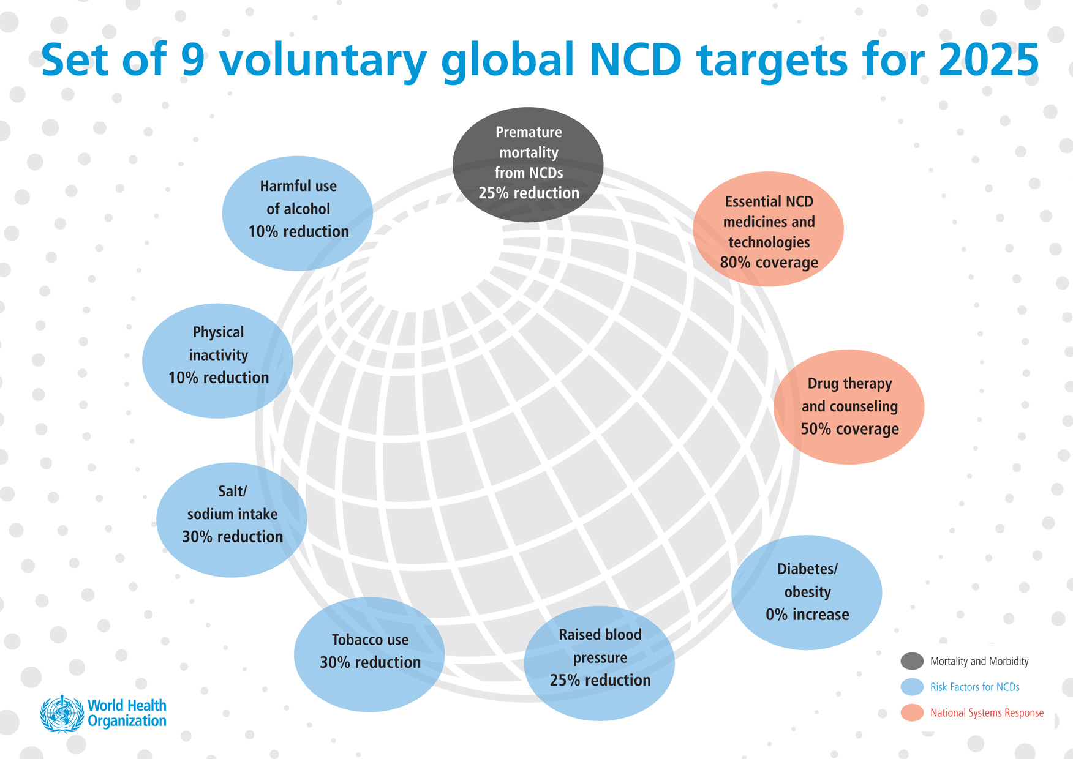

Slide 32
Tobacco Control at the United Nations
United Nations Ad Hoc Interagency Task Force on Tobacco Control was formed by Secretary-General in 1999 to coordinate tobacco control work being carried out by different UN agencies.
  chaired by WHO and comprises 22 Agencies of the UN system as well as outside the UN system. http://www.who.int/tobacco/global_interaction/un_taskforce/en/
UN NCD Summit 2011 political declaration (2014 and 2018)
  Accelerate implementation by States parties of the FCTC recognizing the full range of measures, (to reduce consumption and availability, …, recognizing that substantially reducing tobacco consumption is an important contribution to reducing NCDs and can have considerable health benefits for individuals and countries and that price and tax measures are an effective & important means of reducing tobacco consumption;
http://www.who.int/nmh/events/un_ncd_summit2011/political_declaration_en.pdf

Slide 33
FCTC and Tobacco Control in the UN SDG
Sustainable Development Goals (SDGs) goal 3 (Health and Wellbeing for all).
  targets 3.a “Strengthen the implementation of the WHO FCTC in all countries, as appropriate” and
  3.4 “By 2030, reduce by one third premature mortality from NCDs through prevention & treatment and promote mental health and well-being”
Reducing tobacco use plays a major role to achieve the SDG target by 2030.
Other 16 Goals and many targets under those goals have a direct or indirect relation to tobacco control.

Slide 34
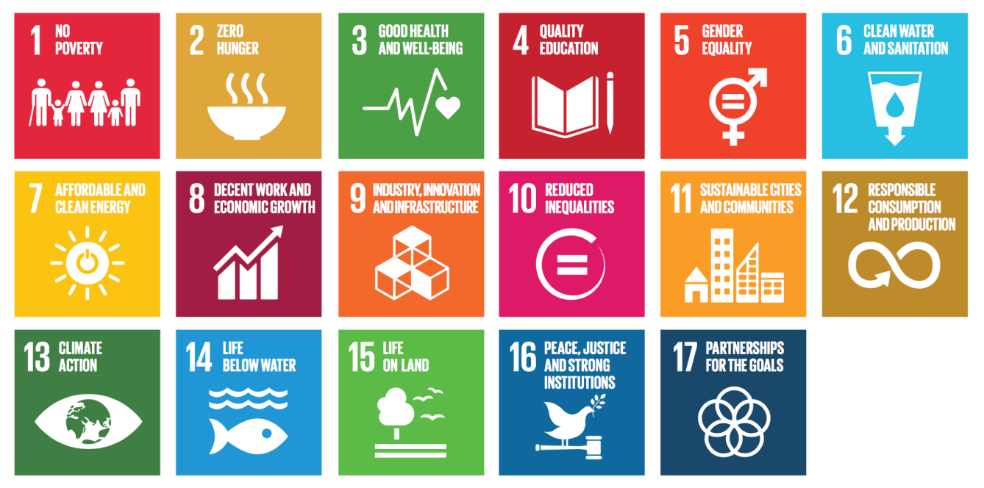
FCTC and Tobacco Control in the UN SDG

Slide 35
Some References:
GBD 2016 Risk Factors Collaborators. Global, regional, and national comparative risk assessment of 84 behavioural, environmental and occupational, and metabolic risks or clusters of risks, 1990-2016: a systematic analysis for the Global Burden of Disease Study 2016. Lancet. 2017 Sep 16;390(10100):1345-1422.
The Economics of Tobacco and Tobacco Control. National Cancer Institute Tobacco Control Monograph 21. NIH Publication No. 16-CA-8029A. Bethesda, MD: U.S. Department of Health and Human Services, National Institutes of Health, National Cancer Institute; and Geneva, CH: World Health Organization; 2016. This monograph and its supplemental materials may be found electronically at http://cancercontrol.cancer.gov/brp/tcrb/monographs/21/index.html
U.S. Department of Health and Human Services. Let’s Make the Next Generation Tobacco-Free: Your Guide to the 50th Anniversary Surgeon General’s Report on Smoking and Health. Atlanta: U.S. Department of Health and Human Services, Centers for Disease Control and Prevention, National Center for Chronic Disease Prevention and Health Promotion, Office on Smoking and Health, 2014 [accessed 2017 Oct]. https://www.cdc.gov/tobacco/data_statistics/sgr/50th-anniversary/#booklet
U.S. Department of Health and Human Services. The Health Consequences of Smoking—50 Years of Progress: A Report of the Surgeon General. Atlanta: U.S. Department of Health and Human Services, Centers for Disease Control and Prevention, National Center for Chronic Disease Prevention and Health Promotion, Office on Smoking and Health, 2014 [accessed 2018 Oct]. https://www.cdc.gov/tobacco/data_statistics/sgr/50th-anniversary/index.htm
Web Appendix 1 and 2. Sreeramareddy CT, Harper S, Ernstsen L. Educational and wealth inequalities in tobacco use among men and women in 54 low-income and middle-income countries. Tobacco Control. Published Online First: 24 November 2016. doi:10.1136/tobaccocontrol-2016-053266.
U.S. Department of Health and Human Services. A Report of the Surgeon General. How Tobacco Smoke Causes Disease: What It Means to You.Atlanta: U.S. Department of Health and Human Services, Centers for Disease Control and Prevention, National Center for Chronic Disease Prevention and Health Promotion, Office on Smoking and Health, 2010 [accessed 2018 Oct. https://www.cdc.gov/tobacco/data_statistics/sgr/2010/consumer_booklet/index.htm
The Tobacco Atlas, https://tobaccoatlas.org
WHO FCTC, http://www.who.int/fctc/en/

Slide 36
“Tobacco Epidemic and
Control Strategies in Bangladesh”

Slide 37
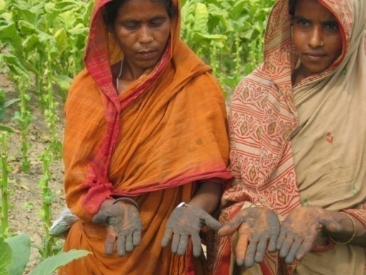
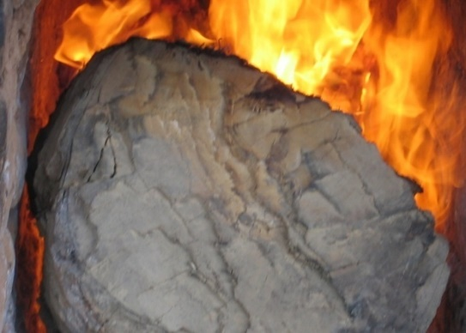
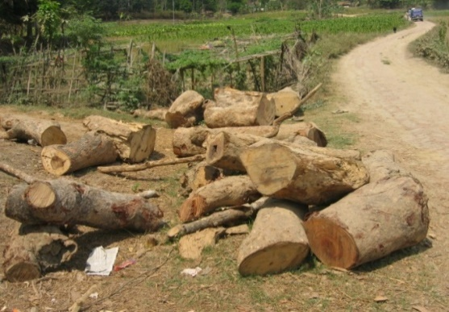
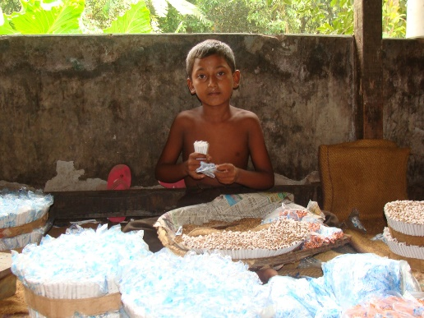
Tobacco burden in Bangladesh
Bangladesh has duel burden due to
  Tobacco cultivation
  Tobacco consumption

Slide 38
Tobacco burden in Bangladesh
More than 1,61,000 people death (Tobacco Atlas 2018).
1.2 million people affected in 8 serious NCDs.
  Nearly 400,000 people became disable due to tobacco related illness (WHO 2004)
Treatment cost of tobacco diseases is a burden for affected individual and their family, as well as severe burden for national economy.
30% of the total deforestation attributed to tobacco
Tobacco cultivation imposing possible threat to food security
Nearly 7% of 13-15 year olds use tobacco products
35.5% people age 15+ consume any form of tobacco

Slide 39
Policy progress on TC in Bangladesh
Year | Subject | Main features
1988 | Government Order on: - ban tobacco ads in BTV/Betar - implement written health warning | Ban tobacco ads in BTV & Bangladesh Radio First written warnings is included in tobacco packs
2003-04 | Bangladesh signed Framework Convention on Tobacco Control (FCTC) as first country in 2003 and ratified in 2004 | FCTC is first global public health treaty that aimed comprehensive tobacco control FCTC focused on controlling tobacco uses (Article 6-14), tobacco cultivation (Article 17-18), tobacco manufacture/ processing, child labor in tobacco, tobacco industries interference (Article 5.3)

Slide 40
Policy progress on TC in Bangladesh
2005 | Parliament passed tobacco control law | Banned smoking in selected public places and public transports Partially banned ‘TAPS’ Introduced written health warning on 30% display area of packs
2006 | Rules passed to support law
2007 | Formed National Tobacco Control Cell | To coordinate all tobacco control activities in Bangladesh.
 | Formed Taskforce at National, District and Sub-district for tobacco control law implementation | To coordinate TC activities and provide necessary guidance to district/sub-district taskforces To coordinate TC activities at districts and provide guidance to sub-district taskforces To coordinate TC activities at sub-districts & provide necessary guidance to Unions

Slide 41
2010 | Bangladesh Bank | Banned to provide loan for tobacco
2011 | BCIC order | Banned on subsidy fertilizer to BATB
2013 | The tobacco control law amended in Parliament | • SLT is included in definition • List of smoke-free public places extended; several places i.e. hospitals, educational institutes become 100% smoke free •Owners/managers made liable to keep smoke-free the area under their jurisdiction; • TAPS ban made comprehensive. Point of sale ad banned; Use of deceptive words as brand element is banned • Sale of tobacco to and by minors banned; • GHW on packs covering at least 50% of the main display area introduced; • Penalty for violation of law increased; • NTCC legally formed

Slide 42
2014-15 | 1% ‘Health Development Surcharge’ is imposed retail prices of all tobacco products either manufactured or imported by Finance law 2014 | To create financial opportunity for tobacco control To ensure TC efforts to be sustainable To reduce external dependency to work on tobacco control
2016 | For the First time, Government of Bangladesh included tobacco control in the 7th Five Year Plan | - to make progress towards achieving UN Sustainable Development Goals as SDG goal 3.a dedicated on effective implementation of the WHO FCTC and 3.4 dedicated to reduce NCDs
2017 | Policy passed use ‘Health Development Surcharge’ | - This policy provided guidelines to utilize HSD for tobacco control with 14 specific issues related to tobacco control - Formed a HDS Management Committee headed by Health Minister

Slide 43
2018 | Government has also approved Multi-Sectoral Action Plan on NCD prevention. | In this plan, tobacco control issues are effectively included
2018 | NTCC prepared a one year program and government allocated revenue budget 94 million BDT (about US$ 11,33,000) and fro October 2018, this program will be implemented | Capacity building for district and sub district taskforce members Mass media campaigns for awareness on health hazards and law

Slide 44
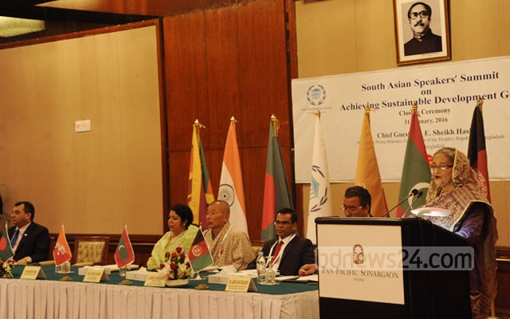
A vision towards tobacco free Bangladesh
PM commitment: ‘Tobacco-free Bangladesh by 2040’
To achieve the target, PM directed to:
Run a National Tobacco Control Program using HDS
Simplify the current complex tobacco tax structure and formulate a tobacco tax policy
Take measures for effective implementation of TC laws

Slide 45
Current tobacco user in Bangladesh
GATS 2017 (age 15 and above)
No. | Tobacco Users/Smokers | Men (%) | Women (%) | Overall (%)
 | Current smokers | 36.2 | 0.8 | 18.0
I.a | Cigarette | 28.7 | 0.2 | 14.0
1.b | bidi | 9.7 | 0.6 | 5.0
 | Current SLT Users | 16.2 | 24.6 | 20.6
2.a | betel quid with tobacco | 14.3 | 23.0 | 18.7
2.b | Gul user | 3.1 | 4.1 | 3.6
 | Total tobacco users | 46.0 | 25.2 | 35.5

Slide 46
Bangladesh progress on tobacco control
WHO MPOWER | Progress on tobacco control in Bangladesh
M - monitoring | Tobacco use prevalence significantly decreased among adults from 43.3% in 2009 to 35.3% in 2017. 18.5% relative decline (20.8% for males; 12.2% for females).
Bangladesh conducts several nationwide surveys
Global Youth Tobacco Survey 2007 and 2013
Global Adult Tobacco Survey 2009 and 2017
Global School Health Professional Survey 2009
WHO STEP wise survey on NCDs 2010 and 2014

Slide 47
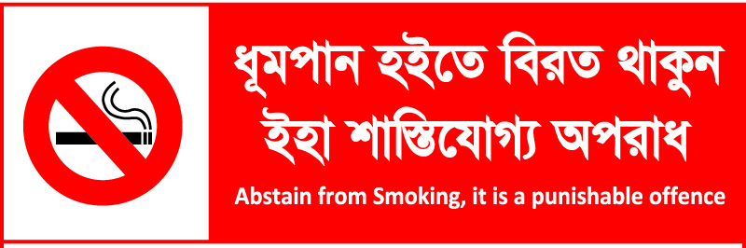
P- Protect people from tobacco smoke
 | Exposure to secondhand smoke in homes & public places significantly declined. In homes, 54.9% in 2009 to 39.0% in 2017.

Slide 48
O – Offer to quit
 | The proportion of current smokers who were advised to quit by health care providers increased significantly from 52.9% in 2009 to 65.8% in 2017.

Slide 49



W – Warn danger about tobacco
 | The percentage of current smokers /smokeless users who thought of quitting smoking/smokeless tobacco use because of health warnings on cigarette/bidi/SLT packages increased significantly in 2017.
Health Warnings 1999-2016
1999-2005
2006-2016
From 2016

Slide 50

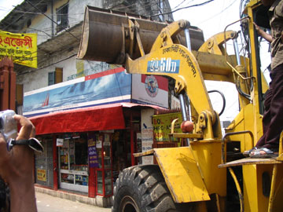
E – Enforce ban on Tobacco Advertisement, Promotion and Sponsorships
 | Exposure to any cigarette advertisement, promotion, or sponsorship in the past 30 days decreased significantly from 48.7% in 2009 to 39.6% in 2017.
Before 2005
After 2005

Slide 51
Questions and feedback
Aminul Islam Sujon
Program Officer, National Tobacco Control Cell
Former: Executive Editor, Swamaswar, Bangladesh Anti Tobacco Alliance (BATA)
Member, Poribesh Bachao Andolon (POBA)
Member, National Girl Child Advocacy Forum
Email : aisujon@yahoo.com
Audio blog : www.yourlisten.com/aisujon
YouTube channel : www.youtube.com/aminulsujonbd

