Slide 1
Tobacco industry Interference to undermine tobacco Taxation in Bangladesh
PROGGA

Slide 2
Does Tobacco Tax Actually Work?

Slide 3
Industry agrees as well!
“Jeffrey Harris of MIT calculated that … the [US] 1982-83 round of price increases caused two million adults to quit smoking and prevented 600,000 teenagers from starting to smoke … We don’t need to have that happen again” (Philip Morris 1987).
“Of all the concerns, there is one – taxation – that alarms us the most. While marketing restrictions on public [sic] and passive smoking do depress volume, in our experience taxation depresses it much more severely. Our concern for taxation is, therefore, central to our thinking about smoking and health (Philip Morris 1985).

Slide 4
What is TI Interference?
“Interference” means
  The set of actions that the tobacco industry takes in order to obstruct the design and implementation of a health policy or promote policies or positions that uphold its commercial interests.
  (Handbook: Health is not negotiable, 2012)

Slide 5
Doing the killing business and making profit
Why TI Undermining Tobacco Control?

Slide 6
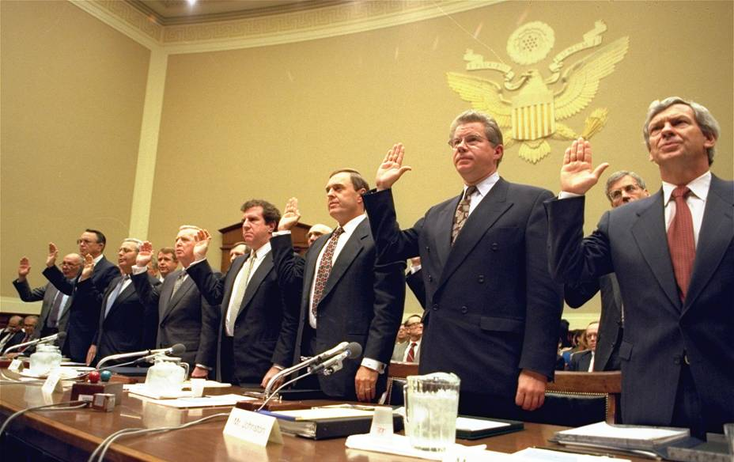
Who Know the Best?
“… nicotine is addictive. We are, then, in the business of selling nicotine…” (1) 1963
“I believe that nicotine is not addictive” (2) 1994
[1] Yeaman, Addison - General Counsel of Brown and Williamson Tobacco Corporation. "Implications Of Battelle Hippo I & II And The Grifffith Filter". 17 Jul 1963. http://legacy.library.ucsf.edu/tid/xrc72d00
[2] HEARING OF THE HOUSE ENERGY & COMMERCE COMMITTEE SUBCOMMITTEE ON HEALTH AND THE ENVIRONMENT, 14 April 1994. http://legacy.library.ucsf.edu/tid/qhy81c00

Slide 7
Conflicting Motives
Public health community
  Reducing death and disease caused by tobacco use
Tobacco industry
  Selling product with goal of profiting from sales to consumers

Slide 8
Tobacco Industry Tactics
TI
Promotion of Tobacco Products
Undermining Tobacco Control
Sustaining and Expanding Tobacco Business

Slide 9
TI’s Interference Focus
Undermining Tobacco Control
Tobacco Control Laws
Tobacco Taxation Policy
Restrict tobacco taxation
Tax evasion
Formulation of Law, Rules and Policy instruments
Implementation of TC law

Slide 10
Undermining Tobacco Control
OVERT
COVERT
CSR
Lobbying
Litigation
Bribing politicians
Undermining Tobacco Control
Submit policies
Mobilizing front-groups
Research/
propaganda
Influence media

Slide 11
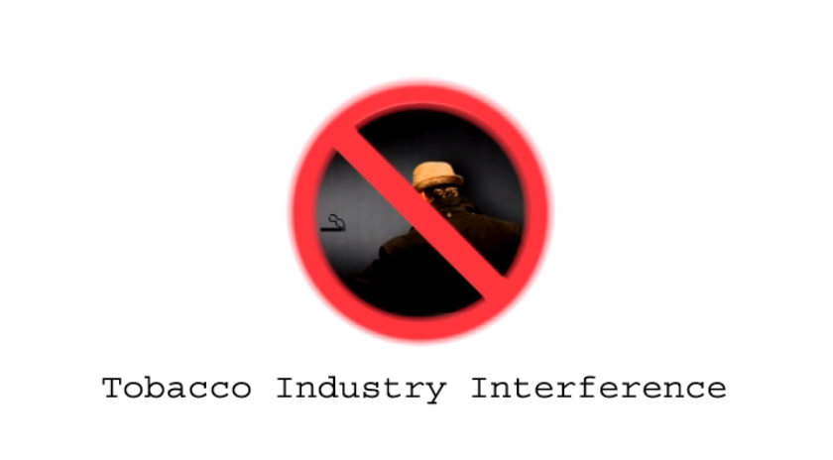
Documentary

Slide 12
Forms of TI Interference

Slide 13
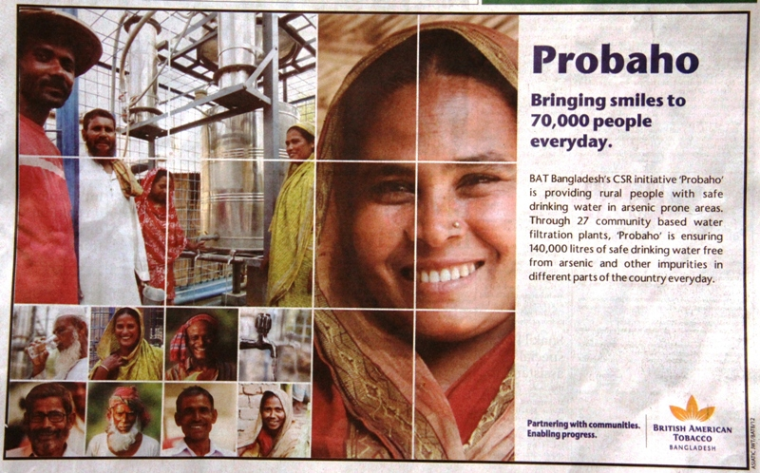
Corporate Social Responsibility
What’s the purpose of CSR?
  Promotion of tobacco products?
  Or influencing policy makers?

Slide 14
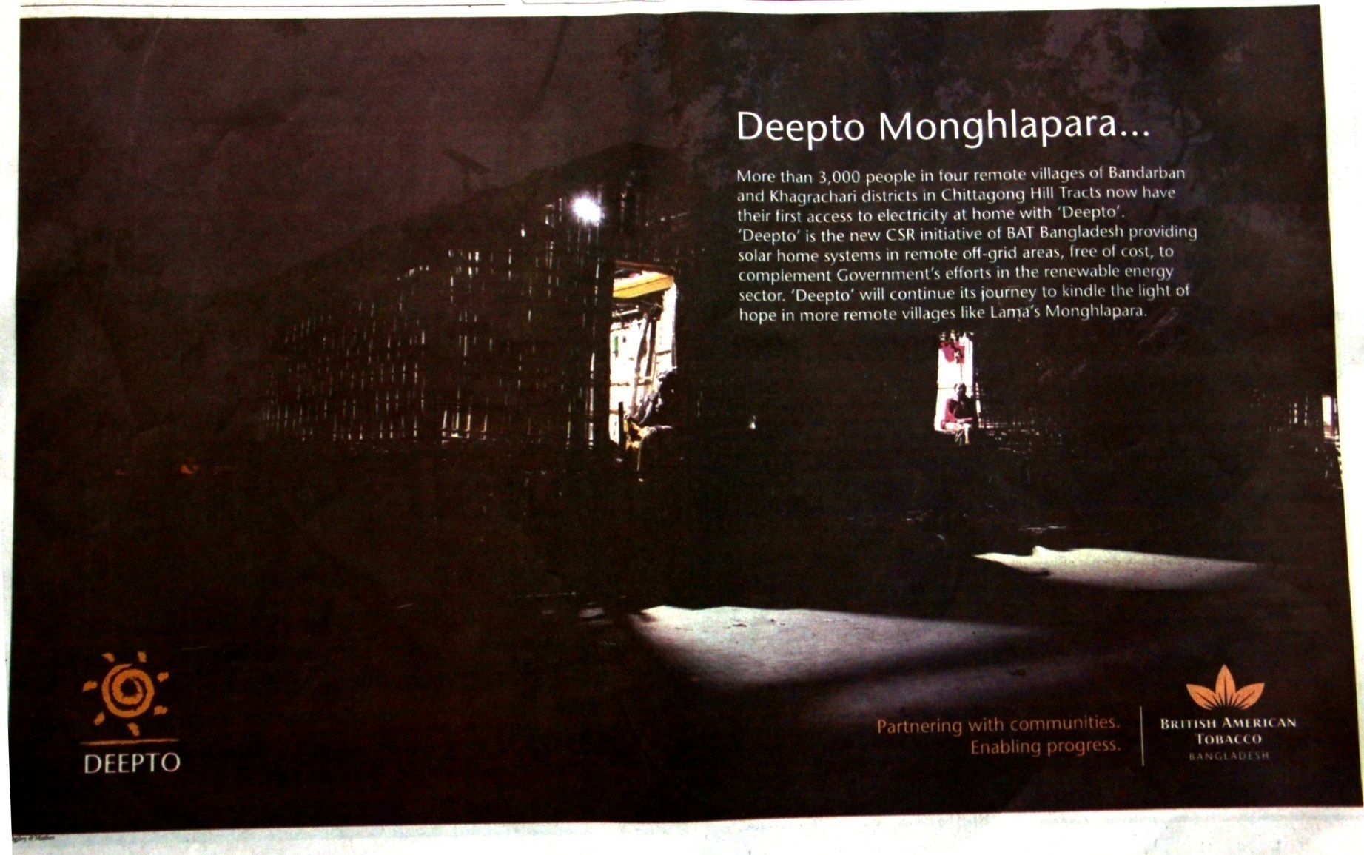
Corporate Social Responsibility (cont)

Slide 15
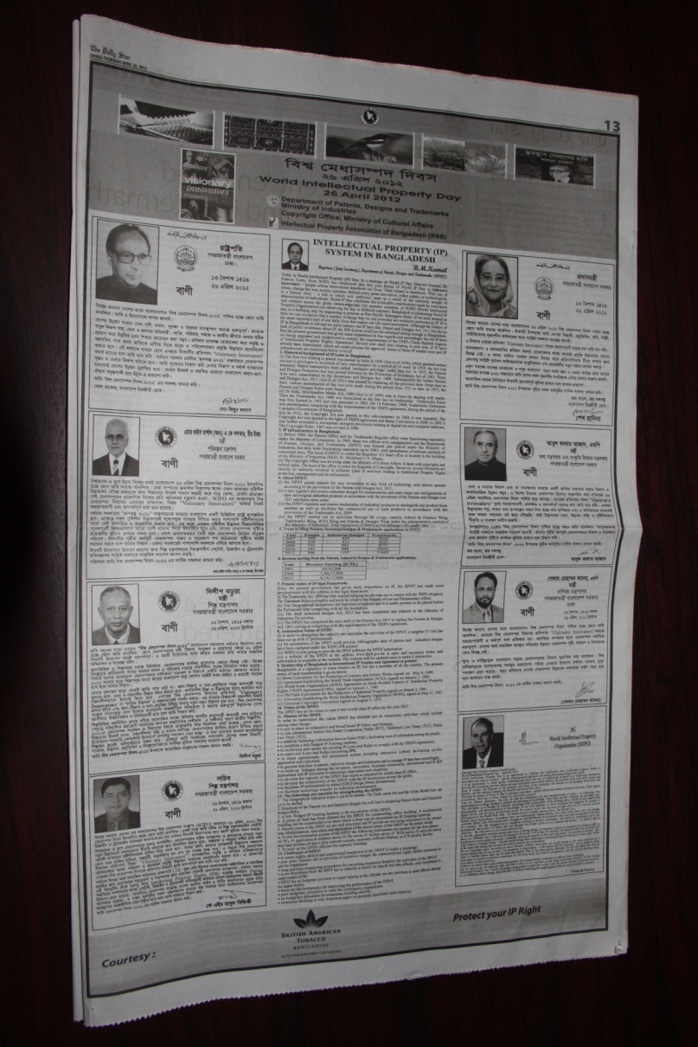
Corporate Social Responsibility
Can we see an increasing trend of CSR initiatives and their advertisement by tobacco industry in the year 2012?
  WHY?

Slide 16
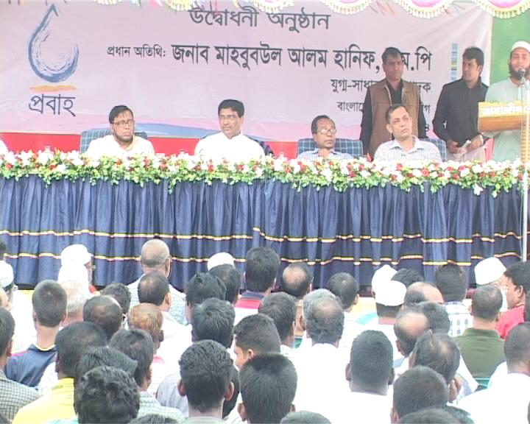

Bribing Politicians
Bribing in different forms
  Indirect bribing
    CSR projects in the localities of key policy makers

Slide 17

Research/Propaganda (cont)
Commissioning studies/research to undermine tobacco control research/evidence
  Propaganda of myths on livelihood impact of Tobacco Cultivation (2012)

Slide 18
Some other Forms …
A Case of BATB

Slide 19
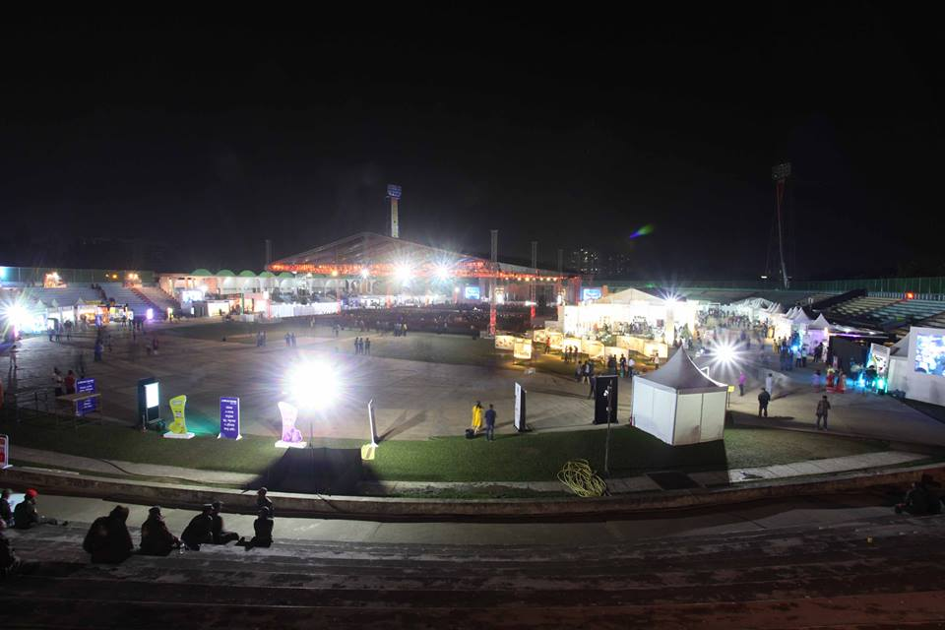
Bengal Classical Music Festival (BCMF)

Slide 20
BCMF connection with BAT
BCMF started from the funding of ITC-SRA in 2012
ITC Sangeet Research Academy (ITC-SRA) is funded by ITC Limited (Former India Tobacco Company)
BAT enjoy 30% share of ITC Limited

Slide 21
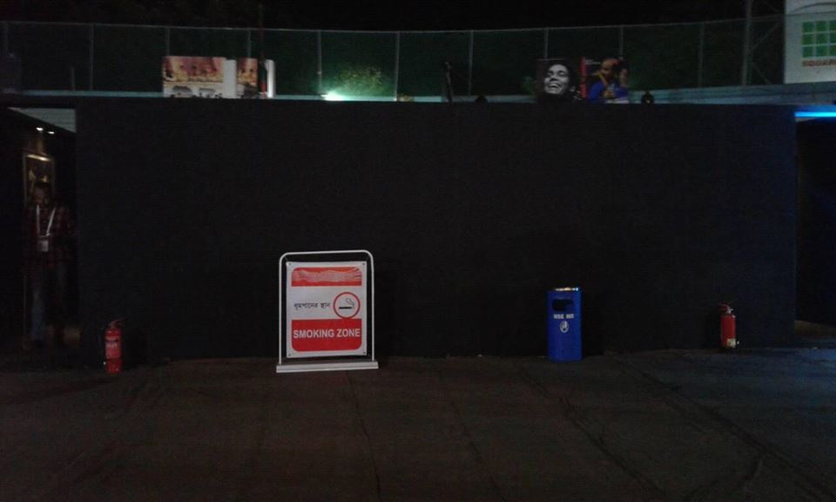
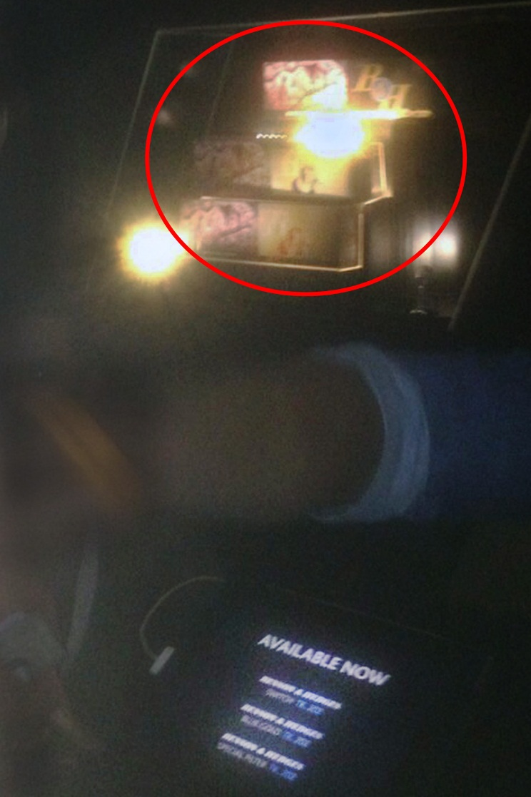
BATB ads at Bengal Classical Music Fest!

Slide 22

“Dhaka Attack” Movie

Slide 23

“Dhaka Attack” Movie

Slide 24
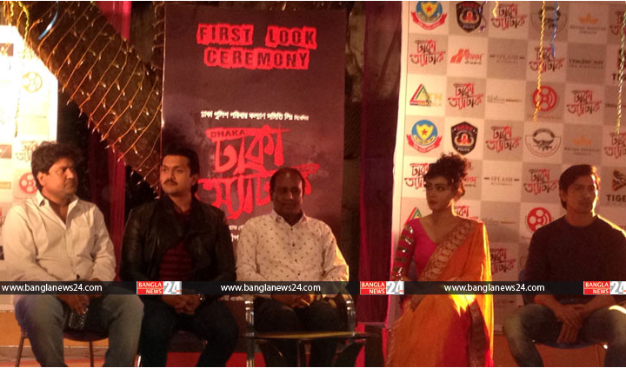
“Dhaka Attack” Movie

Slide 25

“Dhaka Attack” Movie

Slide 26
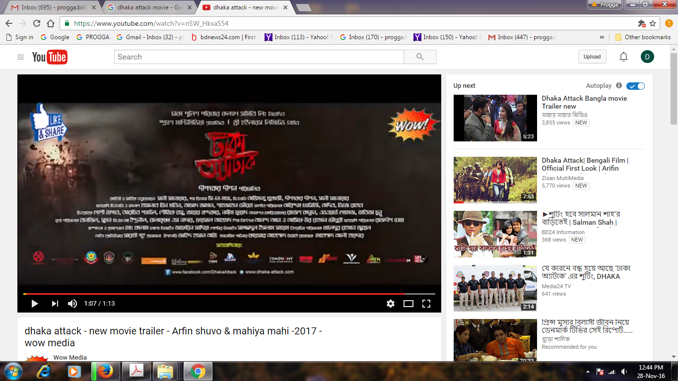
“Dhaka Attack” Movie

Slide 27
TI Interference in Tobacco Taxation

Slide 28
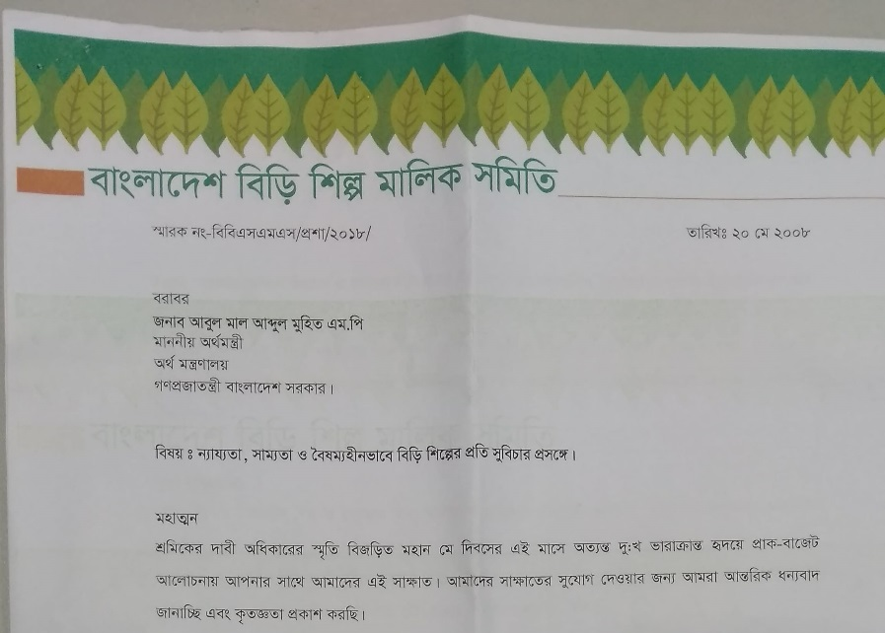
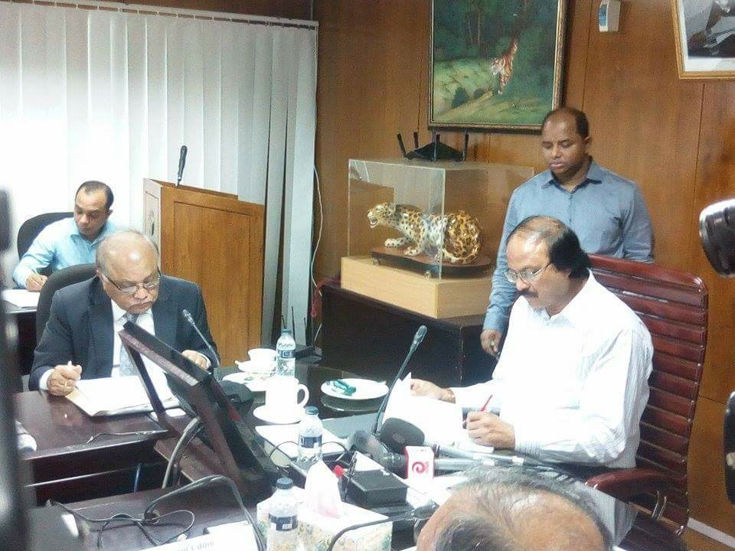
Submission of Policies
Submission of tax proposal to the NBR and Finance Ministry by cigarettes companies every year
Submission of tax proposal to the NBR and Finance Ministry through different trade body representatives
  FBCCI, MCCI, FICCI etc.

Slide 29
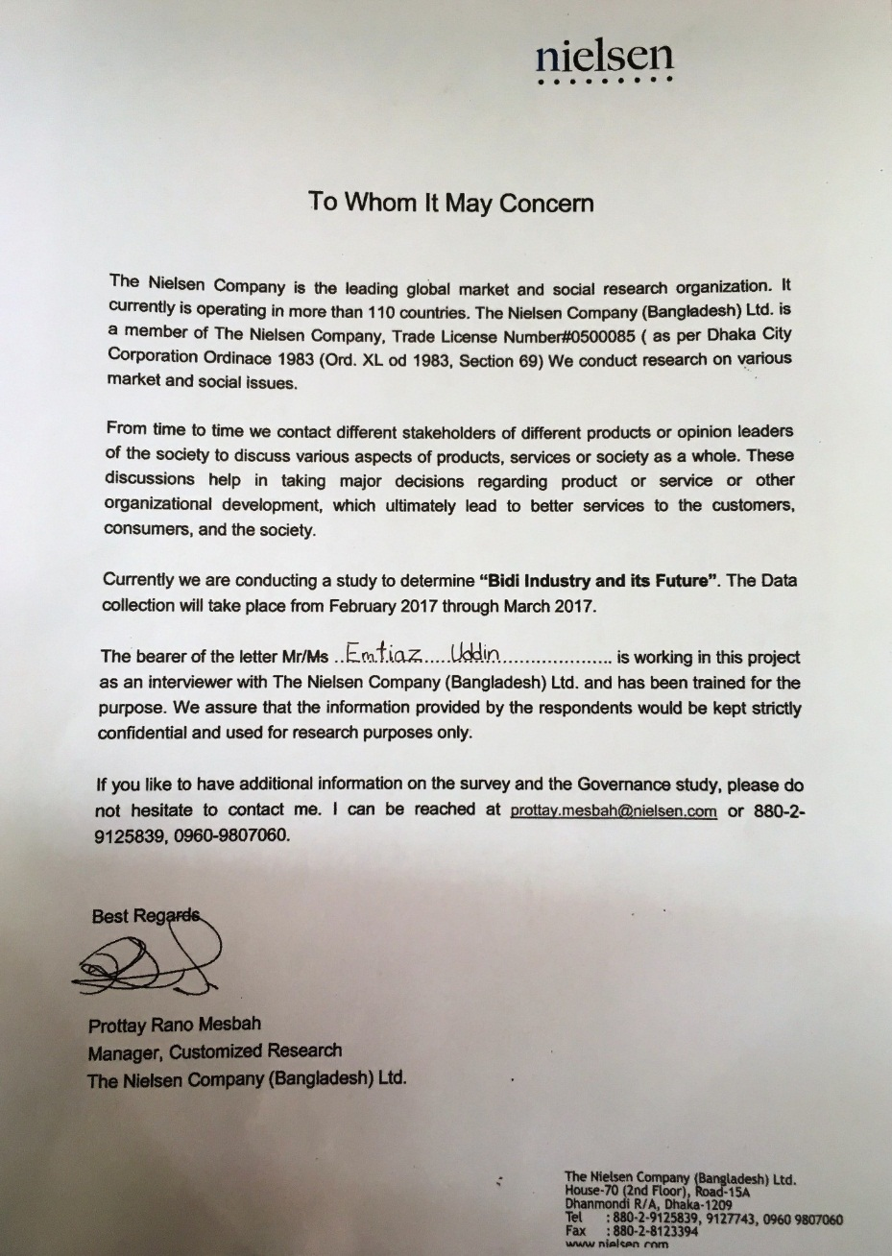
Research/Propaganda
Commissioning studies/research to undermine tobacco control research/evidence (cont.)
  Bidi Industry and Its Future (2017)

Slide 30
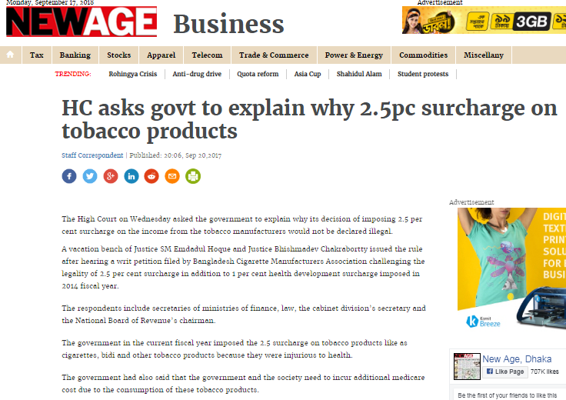
Litigation
Attempts to halt collection of 2.5% surcharge from TI’s income imposed in the budget FY 2017-18
  Suing the government of Bangladesh (Nov, 2017) by BCMA

Slide 31
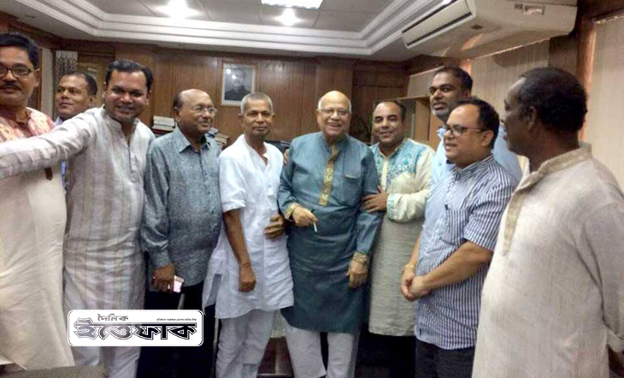
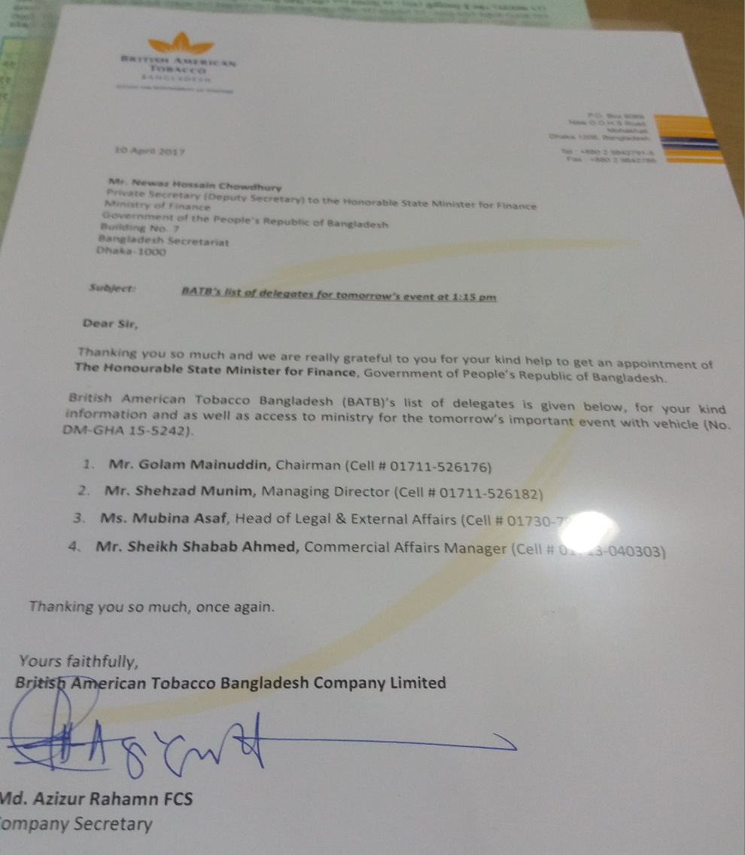
Lobbying
Intense lobbying with key policy makers to prevent higher taxes
  Meeting with Finance Minister, Commerce Minister (2018)
  Meeting with State Minister of Finance and Planning (2017)

Slide 32
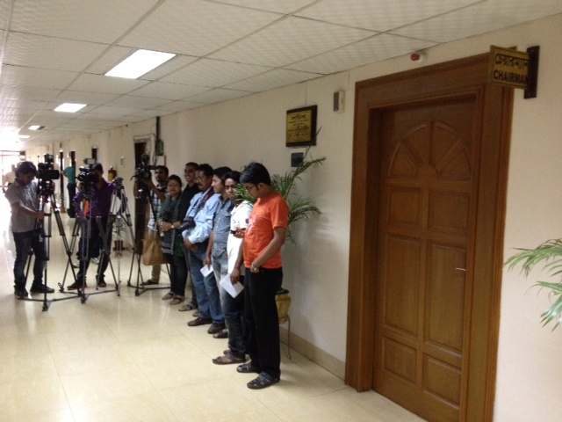
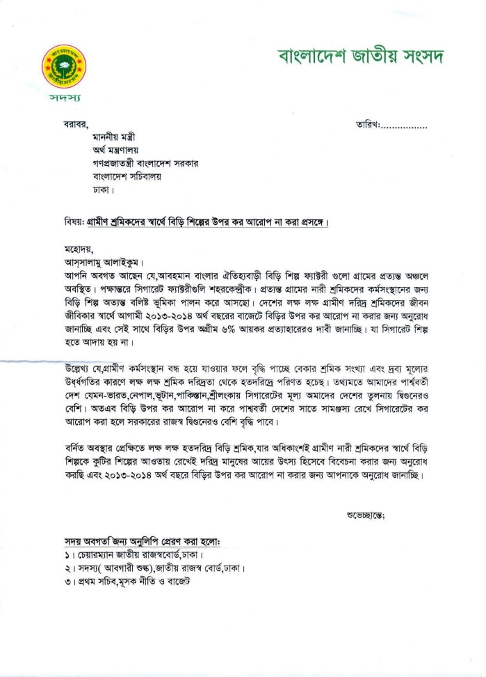
Lobbying (Cont.)
Lobbying with NBR, Finance Ministry (2017)
Sent DO letter to NBR/Finance Ministry through MPs

Slide 33
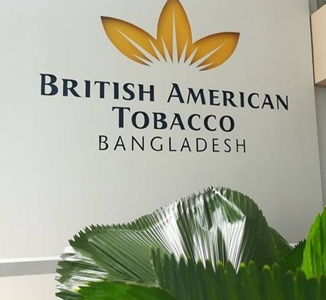
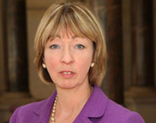
Lobbying (Cont.)
BATB deployed the UK High Commissioner in Bangladesh to negotiate the BDT 19.24 billion tax evasion case Out-of-Court with the Finance Minister (Letter sent on 06 August 2017)
  First revealed by ATMA journalists in the Daily Kaler Kantha, 19 August 2017

Slide 34
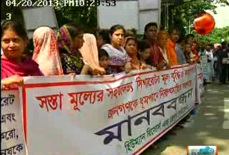
Mobilizing Front Groups
Organizing and supporting different front groups
  Farmers
  Workers (bidi)
  Vendors/retailers
  Civil society
  Even MPs!

Slide 35
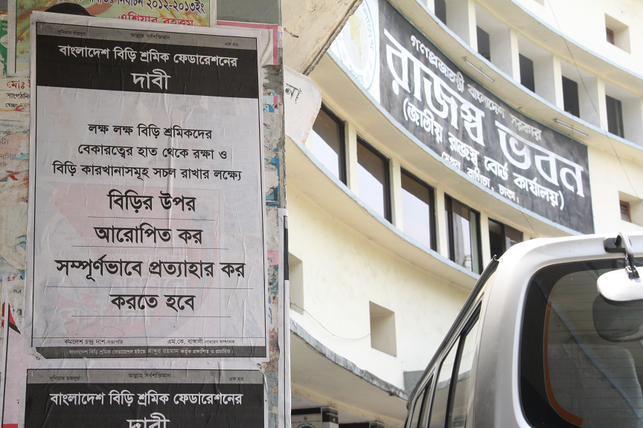
Mobilizing Front Groups (cont)

Slide 36
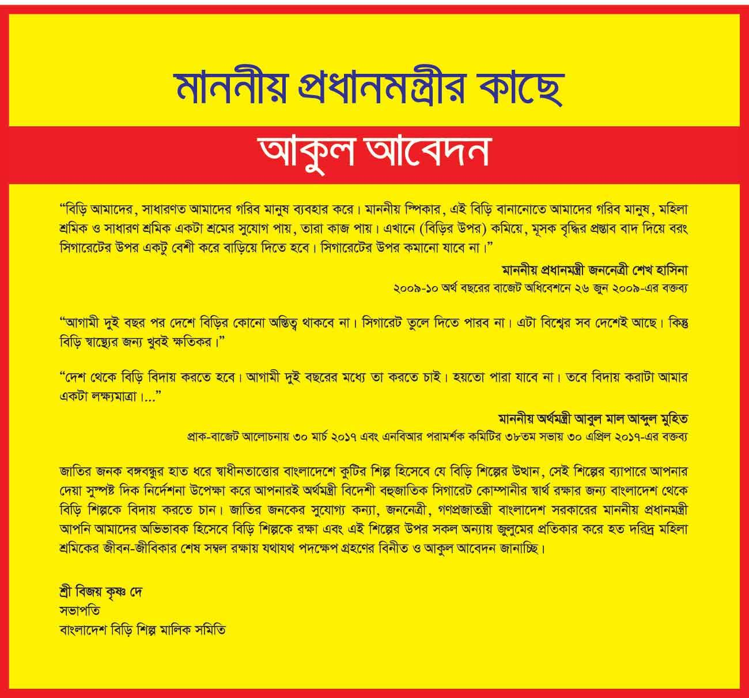
Mobilizing Front Groups (cont)

Slide 37
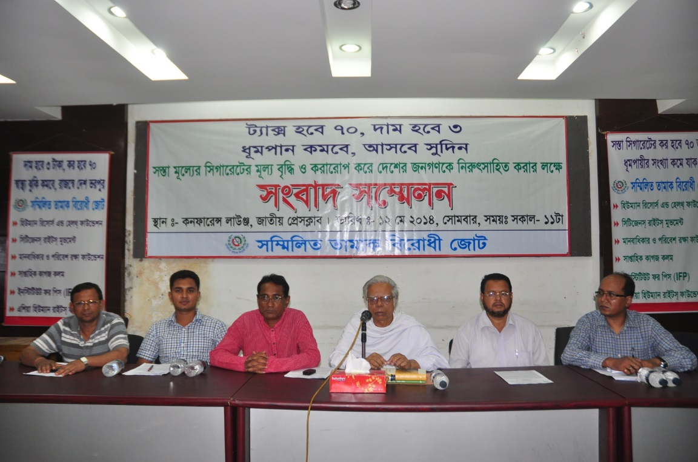
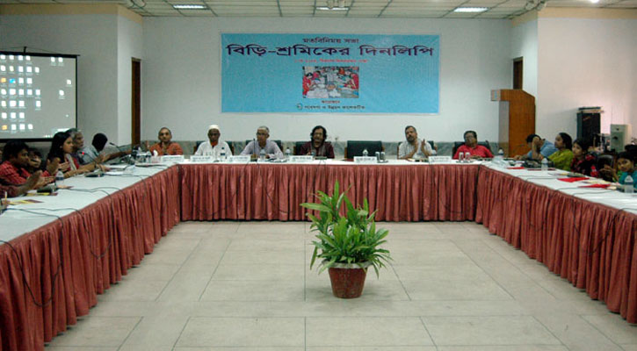
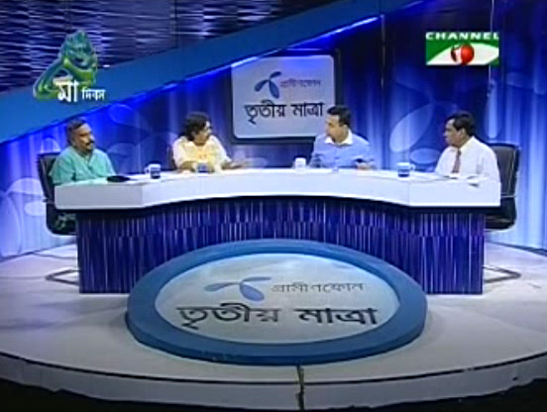
Mobilizing Front Groups (cont)

Slide 38
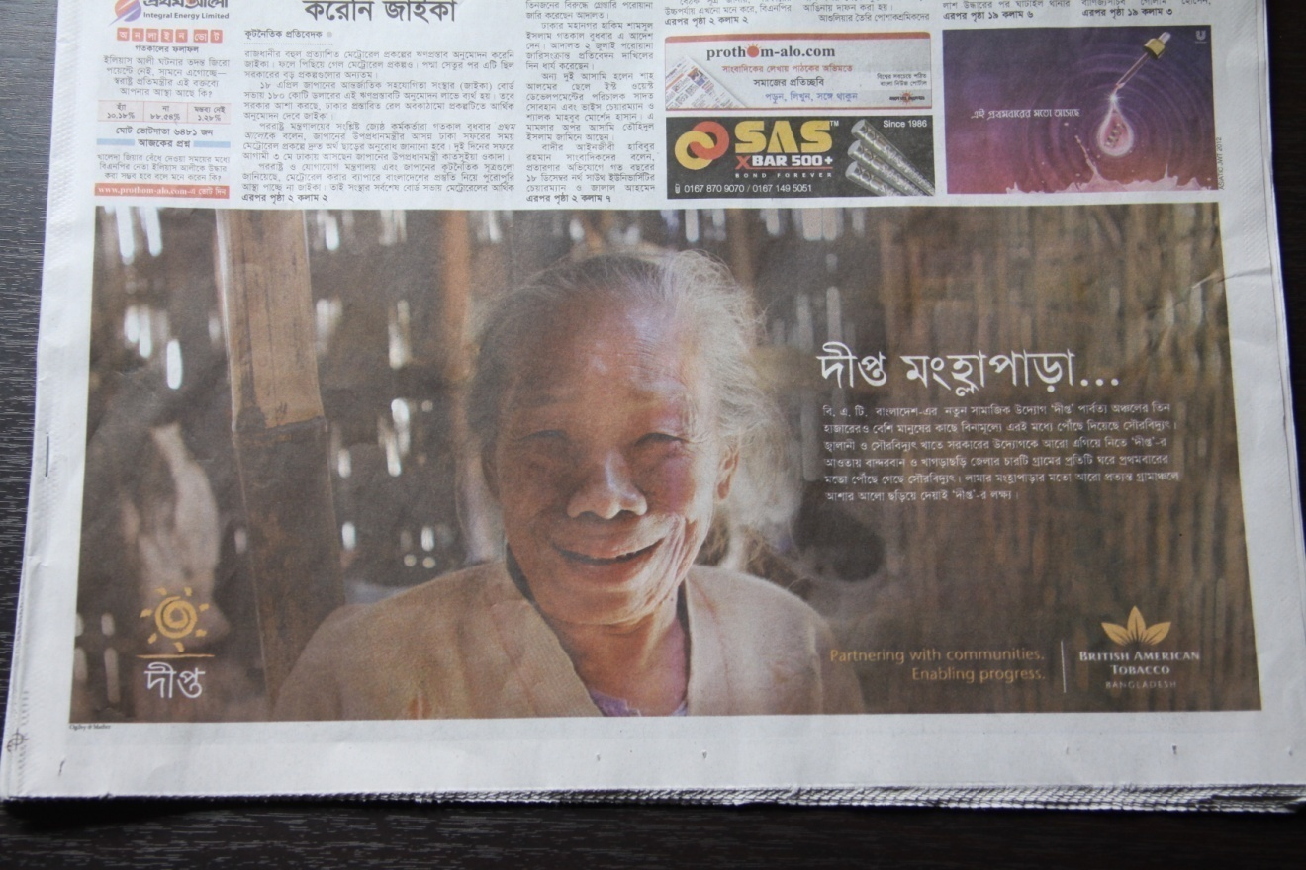
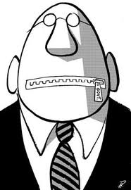


Influencing Media
Trough different ways (i.e. advertisement, leisure trips for gatekeepers)
  WHY?

Slide 39
Industry Propaganda
Tobacco Industry Myths to Undermine Tobacco Tax

Slide 40


Tobacco Industry Myths (1)
Tobacco is good for the economy
Tobacco control will result in permanent job losses for an economy

Slide 41

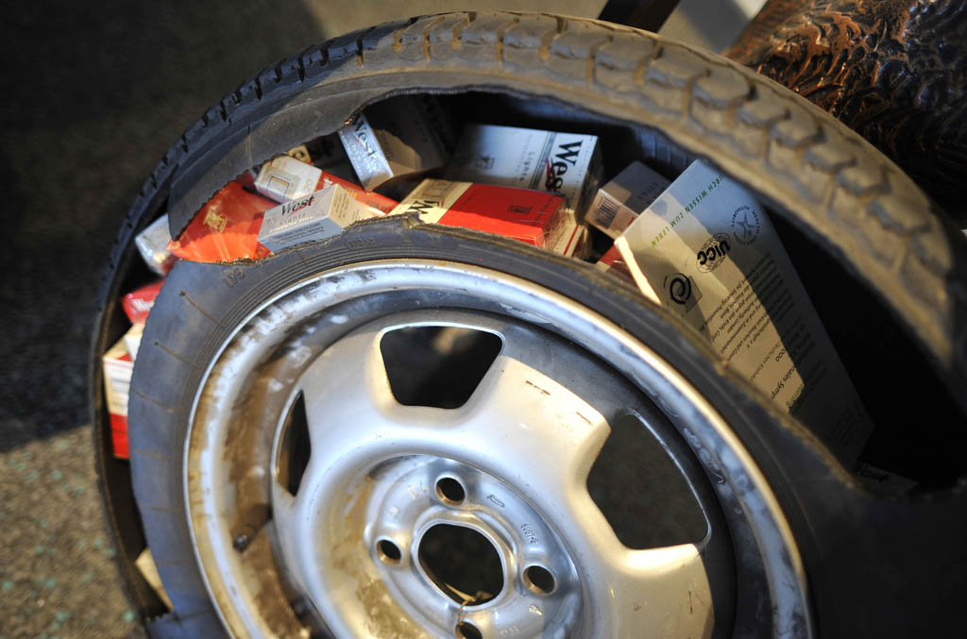
Tobacco Industry Myths (2)
Governments will lose revenues if they increase cigarette taxes, because people will buy fewer cigarettes
Smuggling and illicit production will undermine the effects of raised tobacco taxes

Slide 42


Tobacco Industry Myths (3)
Tobacco addiction is so strong that simply raising taxes will not reduce demand; therefore, raising taxes is not justified
Tax rates for cigarettes are already too high

Slide 43
Countering TI Interference

Slide 44
WHO FCTC
“the need to be alert to any efforts by the tobacco industry to undermine or subvert tobacco control efforts and the need to be informed of activities of the tobacco industry that have a negative impact on tobacco control efforts”
Article 5.3: “in setting and implementing their public health policies with respect to tobacco control, Parties shall act to protect these policies from commercial and other vested interests of the tobacco industry in accordance with national law”.

Slide 45
FCTC Article 5.3 Recommendations
No partnerships, non-binding or non-enforceable agreements between tobacco industry and governments;
No contributions by tobacco industry to governments;
No tobacco industry-drafted legislation or policy, or voluntary codes as substitutes for legally enforceable measures;
No investments by governments or public officials in tobacco industry;
No tobacco industry representation on government tobacco control bodies or FCTC delegations.

Slide 46
Countering TI Interference
Reminding government about its obligation to FCTC Article 5.3 which adopted in 2008
  Formulation of article 5.3 code-of-conduct
Exposing the covert activities of the TI to prevent tobacco control policies
Countering the overt propaganda of TI through evidence based campaign

Slide 47
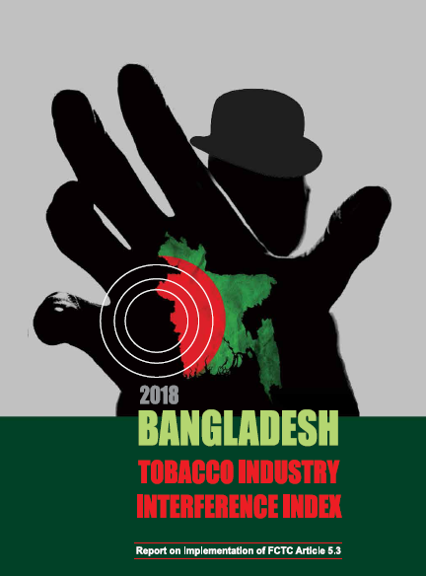
Bangladesh
Tobacco Industry Interference Index 2018
Report on the Implementation of FCTC Article 5.3

Slide 48
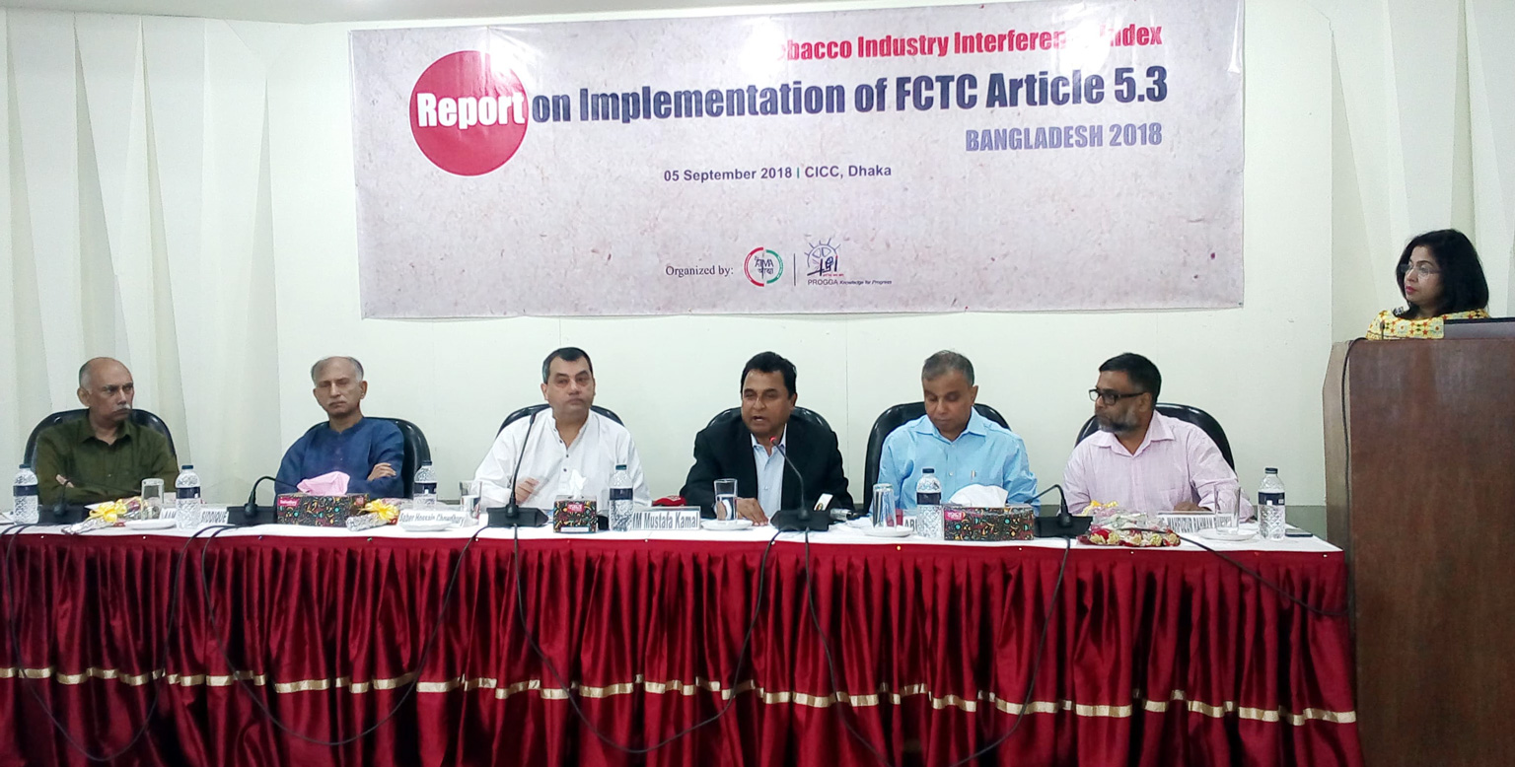

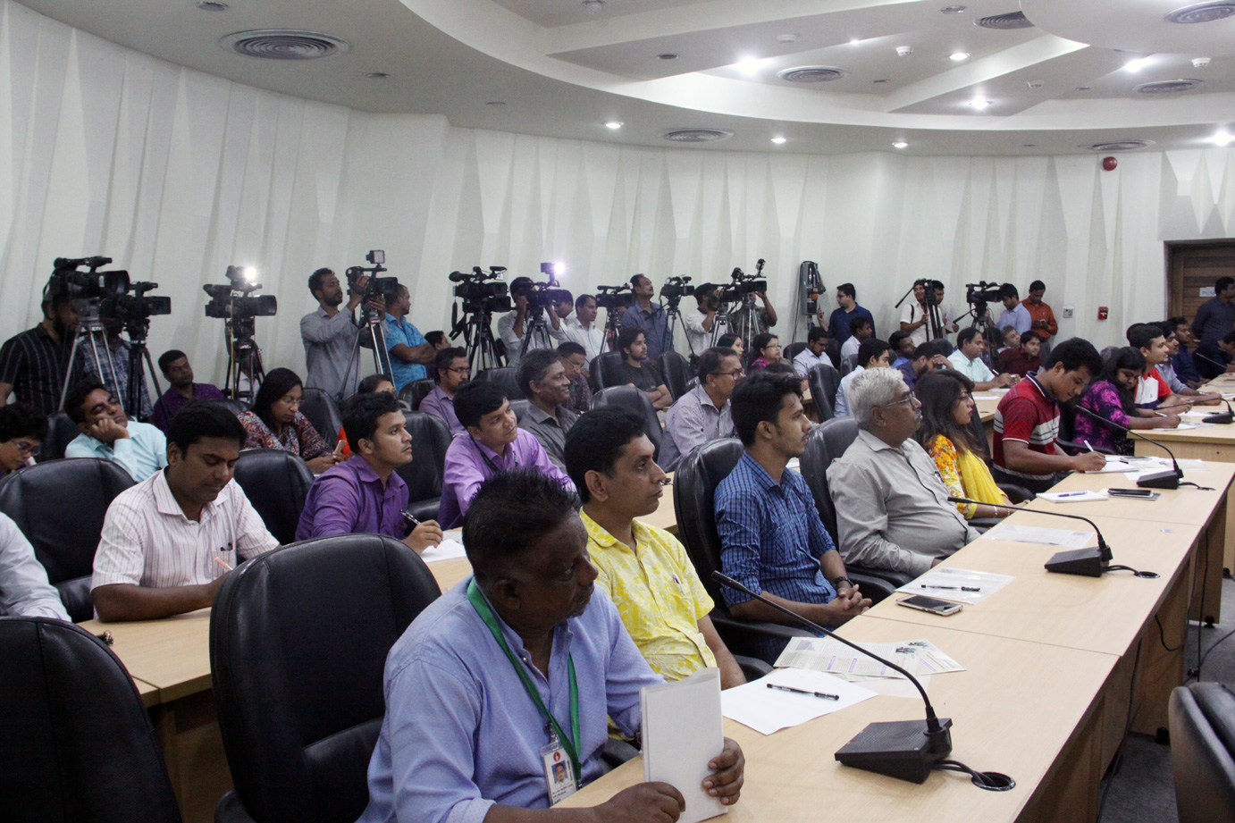
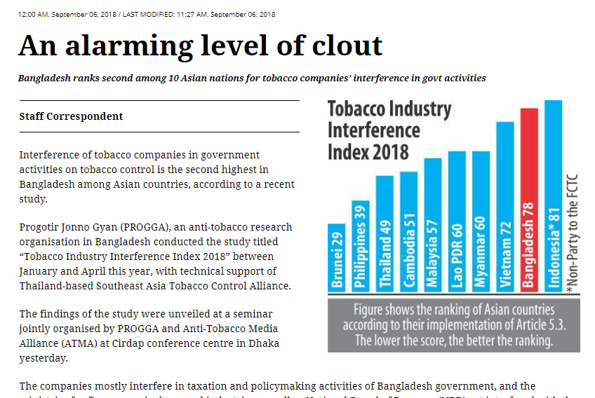
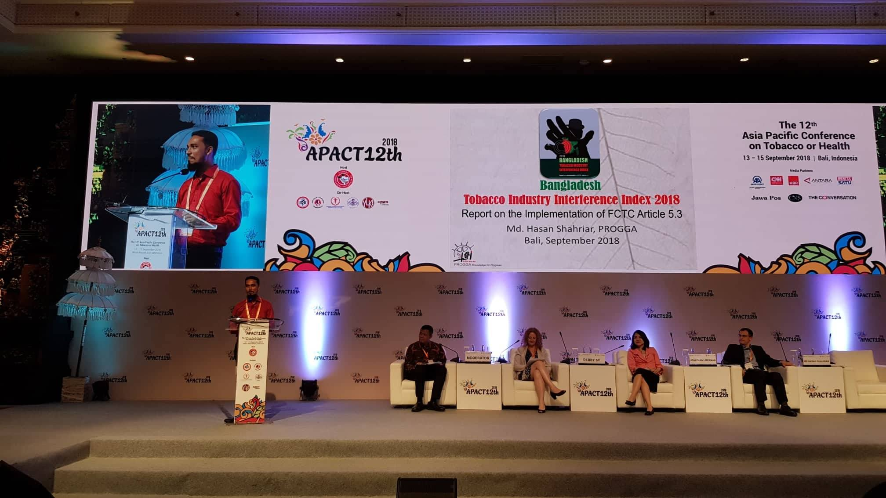
Launched in September 2018

Slide 49
Tobacco Industry Interference in Asia
* Indonesia is a non-Party to the WHO FTCC
** The lower the score, the better the ranking

Slide 50
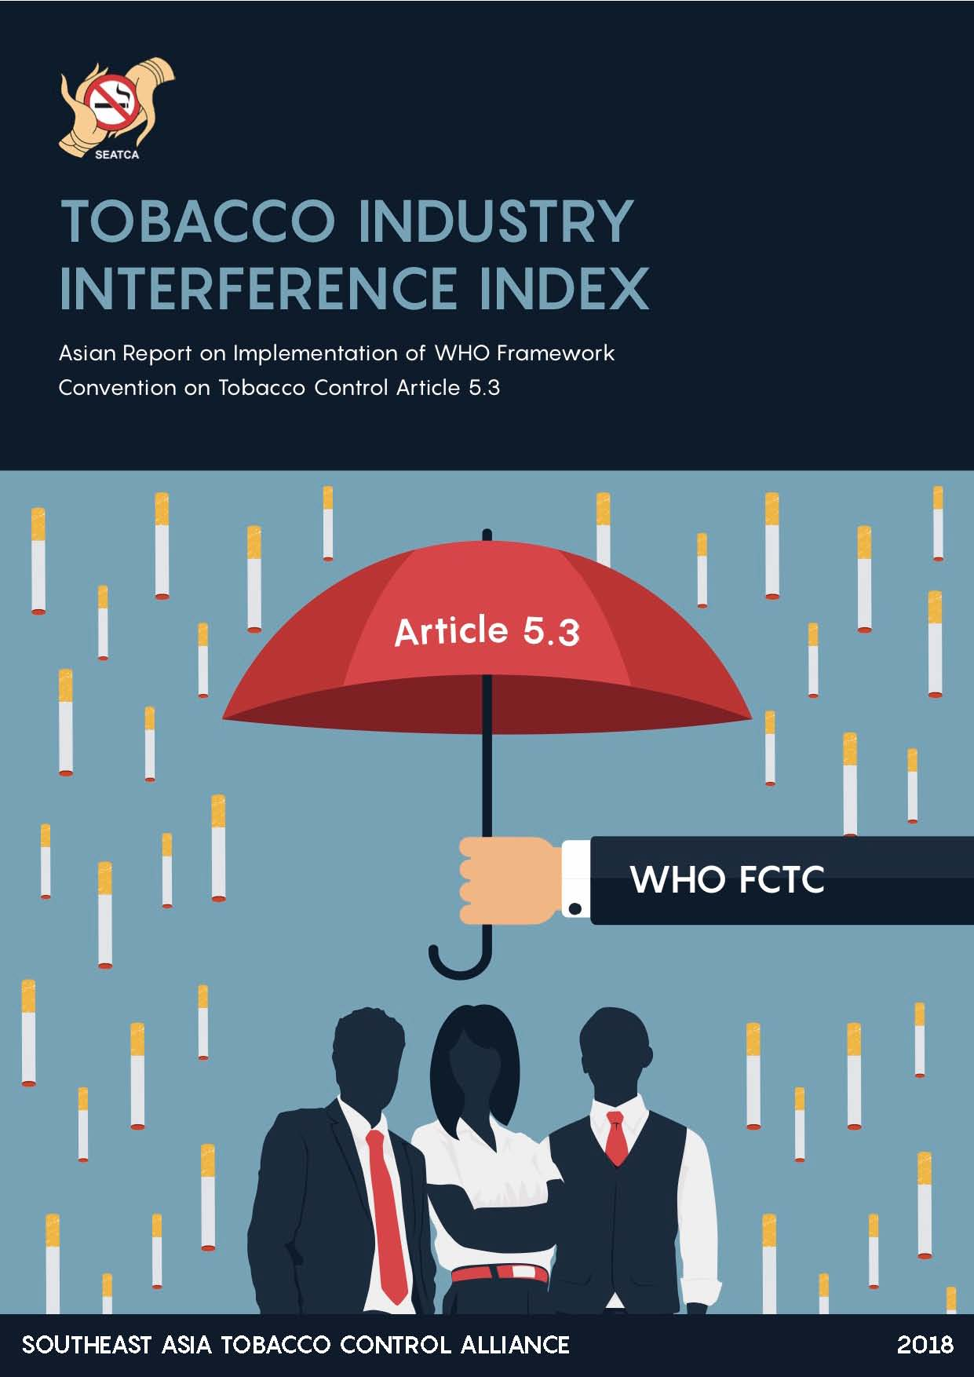


Slide 51
BAT and JTI Presence in Asia Pacific Region
Stronger tobacco industry presence with higher tobacco prevalence

Slide 52
BAT Presence in the region
Bangladesh (35.3%)
British American Tobacco Bangladesh (BATB)
BAT Share: 72.91%
India (28.6%)
ITC Ltd.
BAT Share: 30%
Nepal (30.8%)
Surya Tobacco Co.
ITC Share: 59%
Pakistan (19.1%)
Pakistan Tobacco Company (PTC)
BAT Share: 94.34%
Srilanka (15%)
Ceylon Tobacco Co.
BAT Share: 84.13%
+
Indonesia (76.2% M)
Malaysia (43% M)
Vietnam (47.7% M)
Japan (…)

Slide 53
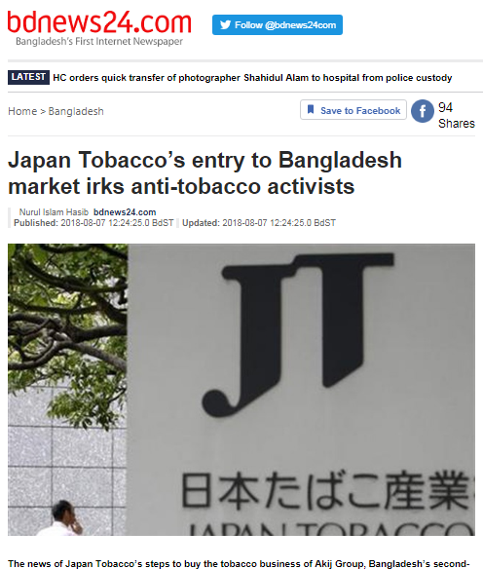


JTI acquires local companies….
Aug, 2018
2017
Prevalence 43% M
Mighty Corporation
Prevalence 76.2% M
2017
Karyadibya Mahardhika (KDM)

Slide 54
Thoughts…
Could we think about a regional network to combat Tobacco Industry?

Slide 55
Available Information Sources to Expose TI Interferences
Social Media

Slide 56
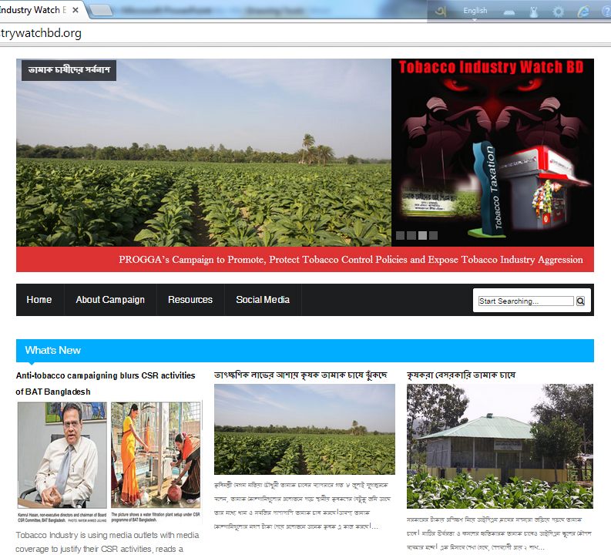
Tobacco Industry Watch BD
Website

Slide 57
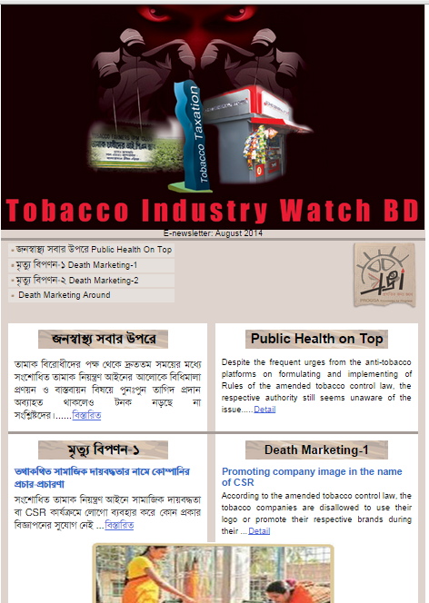
Tobacco Industry Watch BD (cont)
E-newsletter

Slide 58
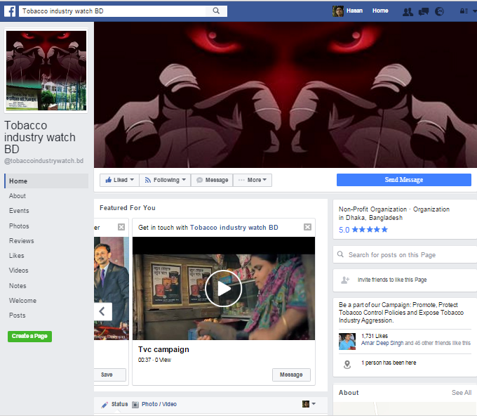
Tobacco Industry Watch BD (cont)

Slide 59
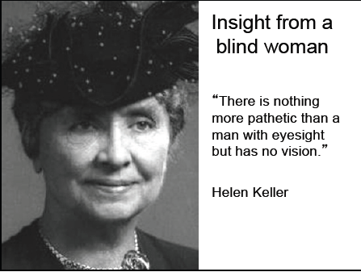

Slide 60
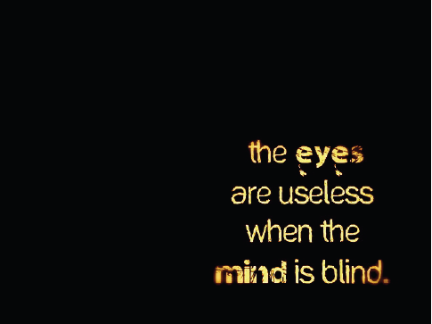

Slide 61

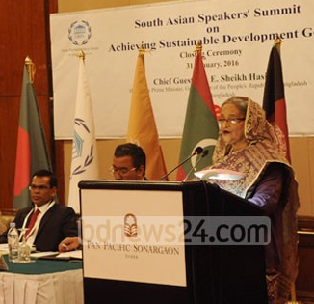
TOBACCO FREE BANGLADESH BY 2040:
Prime Minister
A MILES TO GO BEFORE WE SLEEP…..

Slide 62

progga.bd@gmail.com

Slide 63
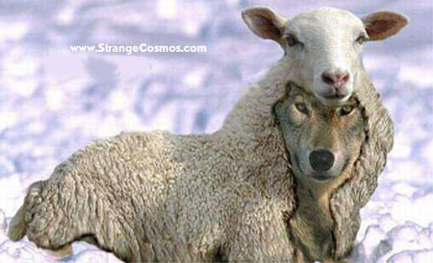
Beware of the wolf in sheep’s clothing!

