Slide 1
Economics of Tobacco (Day 1 Session 1.2)
Training Program on
Economics of Tobacco and Tobacco Taxation:
Public Health Perspectives
13-15 November 2018
Rumana Huque, PhD
Department of Economics
University of Dhaka
November 13, 2018

Slide 2
Basic concepts (Supply)
Different combinations of the price and the quantity that producers are willing to produce in a particular period, other factors besides price held constant.
Law of Supply:
All else being equal, quantity produced increases as price increases.
As the price increases producers typically want to produce more
Desire for extra profit
Need to pay the additional resources more

Slide 3
A hypothetical example
Price per pack of cigarettes (BDT) | Quantity supplied
0 | 0
25 | 0
50 | 0
75 | 0
100 | 300
125 | 600
150 | 900
175 | 1200
200 | 1500

Slide 4
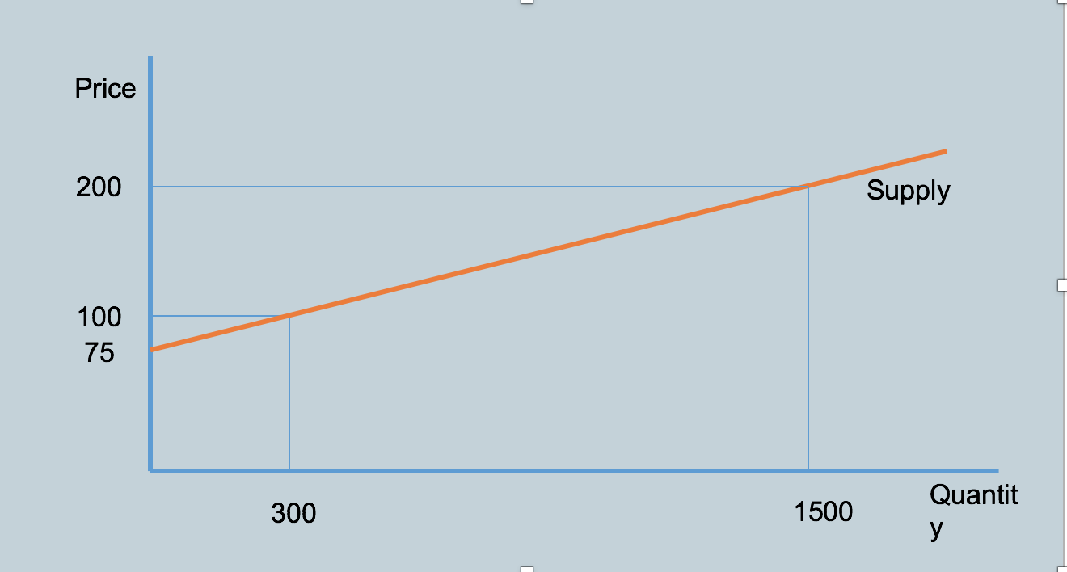
Presenting this graphically

Slide 5
Market Supply
Non-price determinants of supply
Costs and technology
Prices of other goods or services offered by the seller
Future expectations
Number of sellers
Weather conditions

Slide 6
Movements of the supply curve
Why would the supply curve shift?
Changes in costs of production
Imposition of a tax
Number of suppliers
(others)
Distinguish between a shift of the supply curve and a shift along the supply curve

Slide 7
Combining the two concepts
Demand is determined by the consumers
Supply is determined/controlled by the producers
The interaction of these two forces yields market equilibrium
At equilibrium we derive the price and equilibrium quantity

Slide 8
Price | Quantity demanded | Quantity supplied | Shortage or surplus
0 | 1100 | 0 | 1100 (shortage)
25 | 1000 | 0 | 1000 (shortage)
50 | 900 | 0 | 900 (shortage)
75 | 800 | 0 | 800 (shortage)
100 | 700 | 300 | 400 (shortage)
125 | 600 | 600 | 0 (equilibrium)
150 | 500 | 900 | 400 (surplus)
175 | 400 | 1200 | 800 (surplus)
200 | 300 | 1500 | 1200 (surplus)

Slide 9
Price
200
Supply
Surplus
125
100
75
Shortage
Demand
Quantity
1500

Slide 10
Market Equilibrium
Equilibrium price: The price that equates the quantity demanded with the quantity supplied.
Equilibrium quantity: The amount that people are willing to buy and sellers are willing to offer at the equilibrium price level.

Slide 11
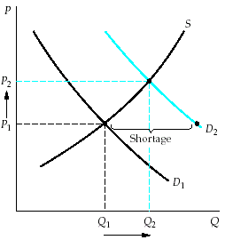
An increase in demand causes equilibrium price and quantity to rise.

Slide 12
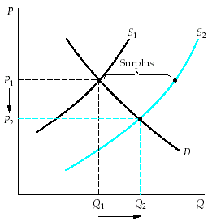
An increase in supply causes equilibrium price to fall and equilibrium quantity to rise.

Slide 13
The aim of tobacco control policy
Shift the demand curve or the supply curve such that the equilibrium quantity decreases
Some examples:
Ban tobacco advertising
Impose smoke-free policies
Impose/increase excise taxes
How do we represent this graphically?

Slide 14
Price elasticity of supply
Producers’ responsiveness to a change in price
Percentage change in quantity supplied divided by percentage change in price
S
If the price increases from p to p’, the quantity supplied increases from q to q’.
Price and quantity supplied move in the same direction, so the price elasticity of supply is a positive number.
p’
Price per unit
p
0
q
q’
Quantity per period

Slide 15
Price elasticity of supply
Elastic
Inelastic
Perfectly elastic
Perfectly inelastic
Unit elastic

Slide 16
Elasticity
S_{w}
S_{m}
S_{y}
$1.25
1.00
Price per unit
0
100
110
140
200
Quantity per day
S_{w} is less elastic than S_{m}, which is less elastic than S_{y}

Slide 17
Price Elasticity and Tax Incidence
The more price elastic the D:
The more tax producers pay
The less tax consumers pay
The more elastic the S:
The less tax producers pay
The more tax consumers pay

Slide 18
Effects of Price Elasticity of Supply on Tax Incidence
(a) More elastic supply
(b) Less elastic supply
$0.20 Tax
S_{t}”
S_{t}’
S”
$1.15
S’
$1.05
$0.20 Tax
1.00
1.00
0.95
0.85
D’’
D’’
Price per ounce
Price per ounce
0
8
10
Millions of ounces per day
9
10
The more elastic the S curve, the more tax is paid by consumers as a higher price.

Slide 19
Training Program on
Economics of Tobacco and Tobacco Taxation:
Public Health Perspectives
13-15 November 2018
Thank You

