Slide 1
Economics of Tobacco (Day 1 Session 1.2)
Training Program on
Economics of Tobacco and Tobacco Taxation:
Public Health Perspectives
13-15 November 2018
Prof. Dr. Nazma Begum
Director, Bureau of Economic Research
University of Dhaka
November 13, 2018

Slide 2
Basic concepts (Demand)
Different combinations of the price and the quantity that people are willing and able to buy, during a specific period of time, given their incomes and tastes and preferences and all other things.
If all other things are constant, then when price increases, quantity demanded decreases and vice versa. There is an inverse or negative relationship between price & quantity demanded when all other things remain constant. This is called the law of demand.

Slide 3
A hypothetical example
Price per pack of cigarettes (BDT) | Quantity demanded
0 | 1100
25 | 1000
50 | 900
75 | 800
100 | 700
125 | 600
150 | 500
175 | 400
200 | 300

Slide 4
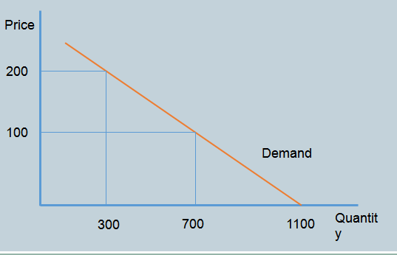
Presenting this graphically

Slide 5
Some comments
Demand curve graphically presents the relationship between demand and price
This is a negative relationship
Can the demand curve shift?
Distinguish between a shift of the demand curve and a movement along the demand curve

Slide 6
Shifting the demand curve
The demand curve shifts if any of the following changes:
Tastes and preferences
Income
Advertising
Price of substitute goods
(and other things)

Slide 7
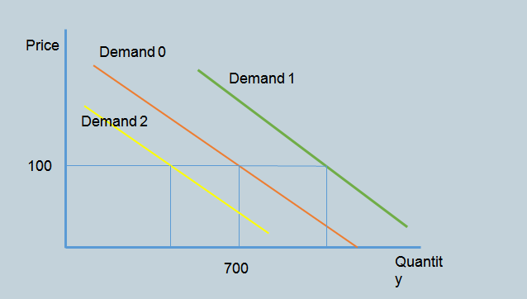
Shifting demand curve graphically

Slide 8
Some examples
Consider the demand for cigarettes. What will happen to the demand curve if the following things happen?
Tobacco advertising is banned
Indoor smoking is banned
The government increases the excise tax on cigarettes

Slide 9
Nominal vs. real price
Nominal price:
The price that you see in the shop/retail outlet
It changes (increases) from year to year
Real price
An “artificial” price that removes the impact of inflation (i.e. the fact that prices in general are increasing)
It is typically used to determine whether product X is becoming relatively cheaper or more expensive over time
Can the nominal price increase and the real price decrease at the same time?

Slide 10
Elasticity
Responsiveness
By how much does something change in response to a 1% change in something else

Slide 11
Price elasticity of demand
Definition:
By how much does consumption of good X change in response to a 1% increase (or decrease) in the price of the good
Formula:
Percentage change in Q_{d}/percentage change in P
Relatively elastic vs. relatively inelastic demand:
E_{p} between 0 and -1: relatively inelastic
E_{p} greater than -1 (in absolute terms): relatively elastic

Slide 12
Interpreting the measure
What would happen to consumption of a product if the price increases by 1% and the price elasticity of demand was:
-0.5?
-1.2?
0?
If the price increases from 100 Taka to 110 Taka and the price elasticity of demand is -0.6, by what percentage would consumption decrease?

Slide 13
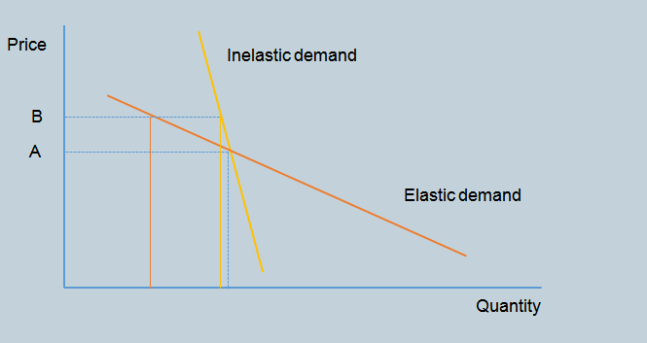
Presenting elasticity graphically

Slide 14
How does price elasticity work in practice? An example
At the outset:
1000 smokers, each smoking 100 cigarettes; total consumption is 100 000 cigarettes
Price = 200 taka
Price elasticity of demand = -0.6
Assume that price increases by 10%
As a result consumption drops by 10 x 0.6 = 6%
New consumption = 94 000
Two questions:
What happens to the number of smokers?
Are remaining smokers going to reduce their smoking?

Slide 15
Elasticity
Cross price elasticity of demand
Measures the extent that the quantity demanded of one good changes when the price of another good changes
Elastic demand
Elasticity less than –1.0
The quantity demanded decreases proportionately more than the price increases
Inelastic demand
Elasticity greater than –1.0
The quantity demanded decreases by less than the percentage increase in price
Evidence shows that demand for smoking is inelastic

Slide 16
Understanding the decrease in consumption better
International evidence:
About 50% of decrease in consumption is due to people quitting and the other 50% due to remaining smokers smoking less on average
Thus in this example
Number of smokers decrease by 3% from 1000 to 970
Average cigarette consumption by remaining smokers decreases by 3% from 100 to 97 cigarettes
Some smokers are completely unaffected by the price; others are
A possible (one of an infinite number) outcome is the following:
679 smokers continue smoking at 100 cigarettes
291 smokers reduce their smoking to 90 cigarettes

Slide 17
What is the magnitude of the price elasticity of demand for tobacco?
Many studies have estimated the price elasticity of demand for tobacco
Initially only in high-income countries, especially the US
Since the early 1990s increasingly in LMICs
Different data sets and techniques
The results are consistent
Price elasticity lies in inelastic range (between 0 and -1)
Most estimates lie between -0.4 and -0.8
Demand for tobacco is often more price inelastic in HICs than in LMICs
Lower income groups and young people are more price sensitive (elastic) than the general population

Slide 18
Bangladesh
Overall price elasticity of cigarette demand is −0.49, which is less than 1
Which means that a given percentage increase in cigarette price leads to a less than proportionate decrease in cigarette consumption
This will result in higher tobacco expenditure along with higher tax revenue for the government.
In Bangladesh the impact of increasing price through taxation would have a considerably greater impact on reducing health harms of tobacco use than in other countries – N. Nargis et al. (2013)

Slide 19
Increased taxes and price
Effectiveness of excise tax as a tool to reduce tobacco use depends on how the tax increase impacts the retail price of the product.
People change their purchasing behavior in response to retail price changes
An excise tax increase typically increases the price of cigarettes.
The magnitude of the price increase depends on the degree to which the tax increase is passed through to consumers
Referred to as “tax pass-through”

Slide 20
Tax pass-through
Tax pass-through: The degree to which the tax increase is passed onto consumers in the form of higher retail prices
If the tax increases by R2, and the (net-of-VAT) price increases by
Less than R2→ under shifting
More than R2→ over shifting
Exactly R2→ full pass-through

Slide 21
Increased taxes and price
Increasing the excise tax on cigarettes is a win-win situation:
Reduces consumption
Increases government revenues
The evidence that the price elasticity of demand for cigarettes is in the inelastic range is so strong, that one can safely apply this knowledge to countries that do not have the data to allow one to estimate the price elasticity

Slide 22
Thank you

