Slide 1
Taxing Tobacco: Collecting Revenue and Reducing Health Cost
Md. Tariq Hassan
Second Secretary (VAT Policy)
National Board of Revenue
Email: tariq.hassan@nbr.gov.bd

Slide 2
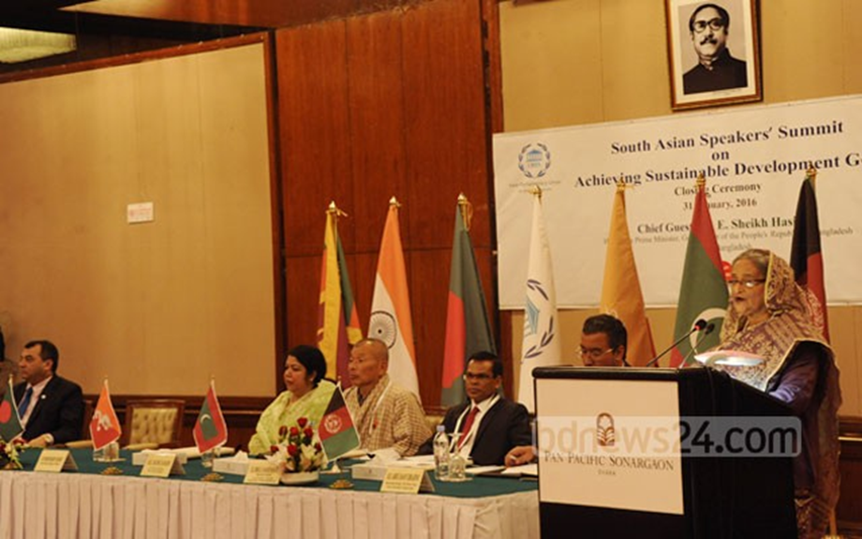
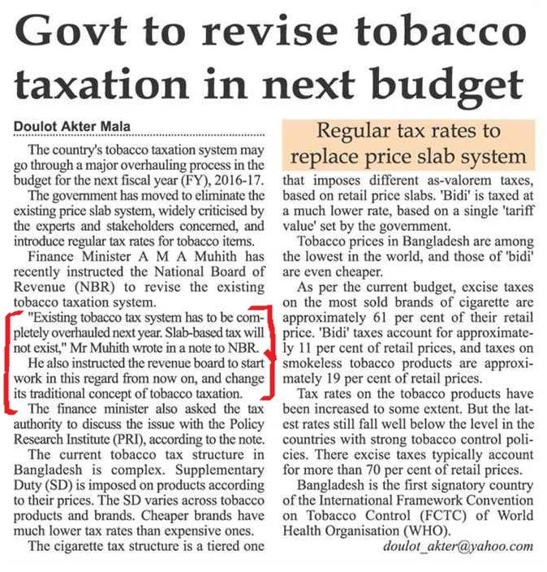
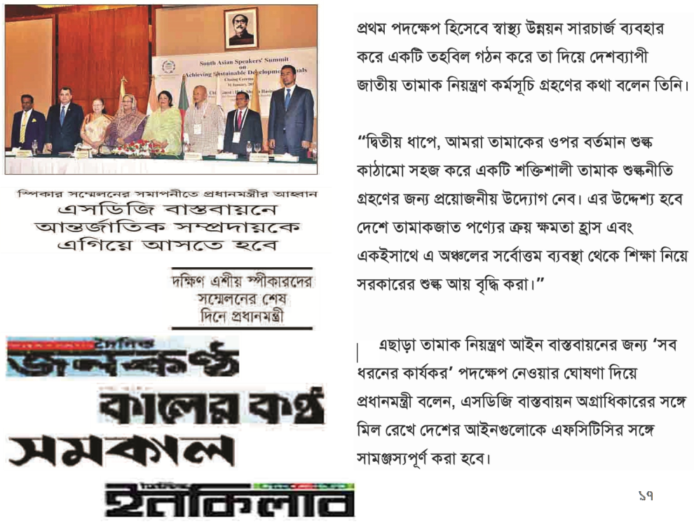

Slide 3
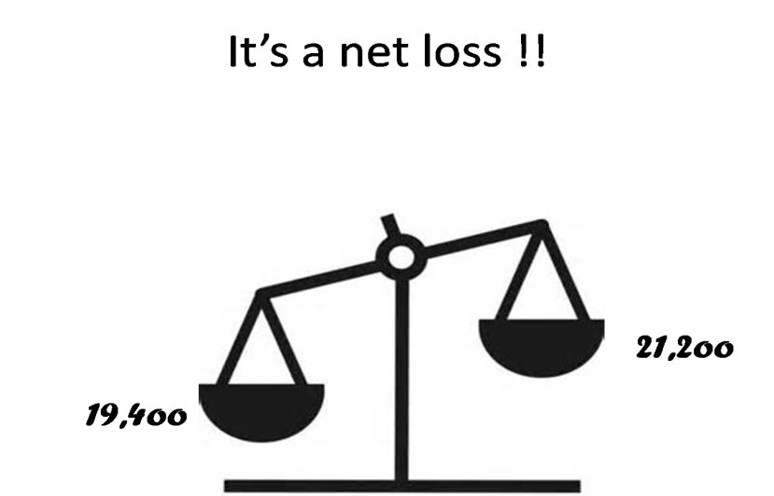
Some Facts and Figures
Bangladesh recorded remarkable reduction in adult smoking prevalence from 23% in 2009 to 18% in 2017 (Global Adult Tobacco Surveys, Bangladesh, 2009, 2017).
With 37.8 million adult tobacco users, Bangladesh is one of the largest tobacco consuming countries in the world:
35.3% of all adults (age 15+) use any tobacco products
46.0% of men, 25.2% of women
18.0% (19.2 million) adults use smoked tobacco
36.2% of men, 0.8% of women
20.6% (22.0 million) adults use smokeless tobacco
16.2% of men, 24.8% of women

Slide 4
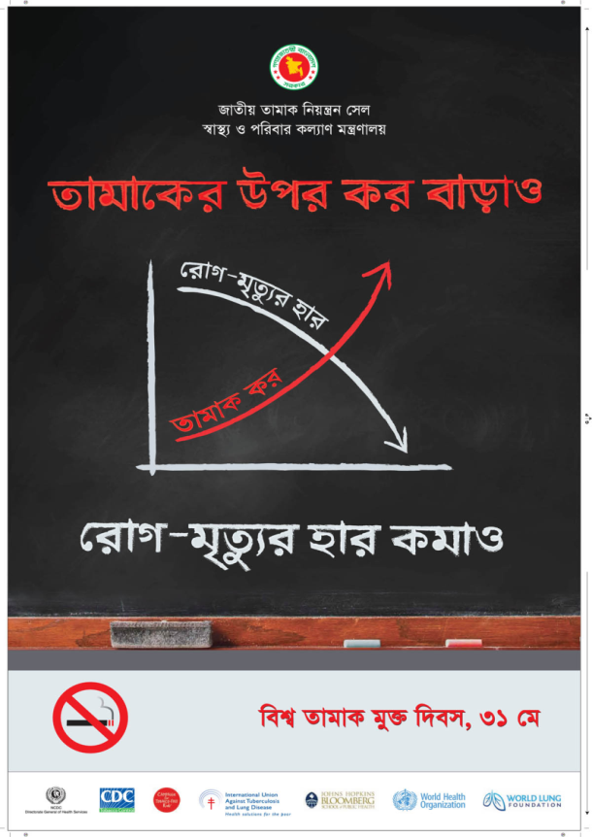
Tobacco Taxes: A Win-Win Measure for Revenue Collection and Reducing Health Cost
↑
taxes
↑
prices
↓ affordability
↓ consumption

Slide 5
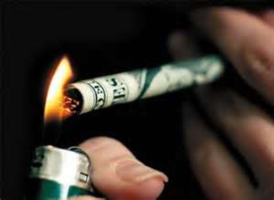
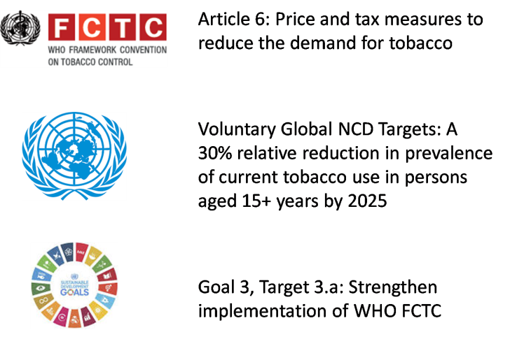
Rationale for pragmatic tobacco tax policy and higher taxes on tobacco products
international commitments
Economic Rationale (Money matters)
Moral Arguments (Life matters)

Slide 6
Various types of excise tax imposed on tobacco by 187 countries
 |  | Number of countries
Ad-valorem excise only |  | 52
1. | Uniform rate |  | 31
2. | Different rate (tier) |  | 6
 | Data not available |  | 15
Specific excise only |  | 59
1. | Uniform rate |  | 34
2. | Different rate (tier) |  | 20
 | Data not available |  | 5
Mixed system (Specific + Ad-valorem) |  | 57
1. | Uniform rate |  | 50
2. | Different rate (tier) |  | 7
No excise tax |  | 19
Source: WHO Report on the Global Tobacco Epidemic, 2013

Slide 7
Background
Tobacco contributes to around 10% of total revenue earned by NBR.
On the other hand tobacco has emerged as a major killer being a common risk factor to number of non-communicable diseases including cancer, stroke and heart disease.
Amidst this serious dilemma, NBR do not have a written policy on taxing tobacco. Rather, every year NBR proposes change in tax rates on an ad-hoc basis during preparation of national budget.

Slide 8
Current Tobacco Tax Structure
Value Added Tax (VAT)
Before 1991 only excise tax was there in Bangladesh and for tobacco products excise was collected according to the Excise and Salt Act 1944.
After the introduction of Value Added Tax (VAT) in 1991, on domestically produced tobacco products, basically two types of tax are realized by VAT wing of NBR. One is VAT and other is Supplementary Duty (SD).
At present, 15 % VAT is applicable on all kind of tobacco products.

Slide 9
Current Tobacco Tax Structure
Rate of supplementary duty on tobacco products as per the 3rd schedule
HS Code | Product | Supplementary duty (%)
2402.10.00 | Cigars, Cheroots and Cigarillos | 100
2402.20.00 | Cigarette | 350
2402.90.00 | Hand rolled biri | 100
2403.91.00 | Smokeless tobacco product | 100

Slide 10
Current Tobacco Tax Structure
Non Tax Revenue (Health Development Surcharge):
The Government imposed 1% ‘Health Development Surcharge’ on all tobacco products in 2014 – 2015 national budget. This is a non-tax revenue and the process of calculation is just like VAT on cigarette, bidi and SLT.

Slide 11
Tax Structure: Cigarette
In Bangladesh taxes on cigarette are somewhat different from other countries.
The cigarettes are divided into four segments based on Maximum Retail Price (MRP) and SD rates are imposed segment wise.
As for example, if the MRP of a definite brand of cigarette is “X”, and the rate of supplementary duty is “Y%” and VAT rate is 15% then the Amount of SD is X*Y% and Amount of VAT is X*15%.

Slide 12
Tax Structure: Cigarette
Present rates of VAT and SD on manufactured cigarette
Tax base MRP: BDT/ 10 sticks | SD (% of MRP) | VAT (% of MRP) | HDS (% of MRP) | Total tax burden
37.00 + | 55% | 15% | 1% | 71%
63.00 + | 65% |  |  | 81%
93.00 + | 65% |  |  | 81%
123.00 + | 65% |  |  | 81%

Slide 13
Tax structure : Biri
For Hand Rolled Biri (HS Code 2402.90.00):
Previously tax base for biri was tariff value. The tariff value is fixed by the NBR considering market price and inflation.
Since 2017-18 Fiscal Year NBR declared MRP as the tax base.

Slide 14
Tax structure : Biri
Present rates of VAT and SD on biri
Tax base MRP | Stick per pack | MRP per pack (BDT) | SD (% of MRP) | VAT (% of MRP) | HDS (% of MRP) | Total tax burden
Biri without filter | 8 | 4.48 | 35% | 15% | 1% | 51%
 | 12 | 6.72
 | 25 | 14.00
Biri with filter | 10 | 8.50 | 40% |  |  | 56%
 | 20 | 17.00

Slide 15
Tax Structure: SLT
For Smokeless Tobacco (HS Code 2403.91.00):
For the smokeless tobacco products (SLT), previously the tax base was ex-factory price of the tobacco products. If the ex-factory price is “X” and the rate of SD is “Y%” and VAT rate is 15%, then the amount of SD is X*Y% and Amount of VAT is (X+SD)*15%.
From Fiscal Year 2018-2019 NBR decided to set tariff values for smokeless tobacco products, namely zarda and gul.

Slide 16
Tax Structure: SLT
current tariff value, rate of VAT and SD on SLTs
Tax base MRP: BDT/ 10 gram | SD | VAT (% | HDS (% of Tariff value) | Total tax burden
Zarda: MRP 30 Tk /10 gram | 50% | 15% | 1% | 66%
Tax base MRP: BDT/ 10 gram

Slide 17
Cigarette price increase in Bangladesh
Courtesy: Dr Nigar Nargis, American Cancer Society

Slide 18
Revenue Collection Figure (Cigarette)
Year | Total Revenue in Crore Tk(VAT+SD) | Growth rate
2006-07 | 3653
2007-08 | 4310 | 18%
2008-09 | 5170 | 20%
2009-10 | 6424 | 24%
2010-11 | 7404 | 15%
2011-12 | 10320 | 39%
2012-13 | 9899 | -4%
2013-14 | 12424 | 26%
2014-15 | 14503 | 17%
2015-16 | 16361 | 13%
2016-17 | 19225 | 18%
2017-18 | 23000 | 20%

Slide 19
Revenue Collection Figure (Biri)
Year | Revenue ( Crore Tk) | Growth
2009-10 | 251.62
2010-11 | 237.66 | -6%
2011-12 | 213.33 | -10%
2012-13 | 230.64 | 8%
2013-14 | 277.97 | 21%
2014-15 | 329.32 | 18%
2015-16 | 340.54 | 3%
2016-17 | 364.61 | 7%
2017-18 | 809.96 | 122%

Slide 20
Segment Wise Total Contribution Percentage (Cigarette)
Year | Segment Wise Supply quantity (In Volume Percentage)
 | Premium | High | Medium | Low | Total
2006-07 | 5.22% | 16.80% | 52.51% | 25.46% | 100%
2007-08 | 5.78% | 16.77% | 36.20% | 41.25% | 100%
2008-09 | 5.52% | 11.93% | 38.47% | 44.07% | 100%
2009-10 | 6.17% | 13.86% | 29.08% | 50.89% | 100%
2010-11 | 6.03% | 9.67% | 27.32% | 56.99% | 100%
2011-12 | 6.26% | 9.80% | 24.04% | 59.91% | 100%
2012-13 | 6.24% | 12.11% | 21.85% | 59.80% | 100%
2013-14 | 4.80% | 11.03% | 21.03% | 63.14% | 100%
2014-15 | 4.92% | 9.71% | 15.02% | 70.36% | 100%
2015-16 | 4.73% | 5.46% | 11.11% | 78.70% | 100%
2016-17 | 5.24% | 5.26% | 10.30% | 79.19% | 100%
2017-18 ( Till March) | 7.24% | 5.67% | 16.32% | 70.77% | 100%

Slide 21
Company Wise Total Contribution Percentage (cigarette)
Year | Supply quantity (In sticks) |  |  | Total
 | BATB | Dhaka | Abul Khair
2006-07 | 49.08% | 46.72% | 4.20% | 100%
2007-08 | 43.91% | 48.45% | 7.63% | 100%
2008-09 | 39.76% | 47.29% | 12.95% | 100%
2009-10 | 40.96% | 40.88% | 18.15% | 100%
2010-11 | 34.88% | 44.38% | 20.74% | 100%
2011-12 | 35.97% | 39.07% | 24.96% | 100%
2012-13 | 46.55% | 36.53% | 16.92% | 100%
2013-14 | 47.05% | 35.44% | 17.52% | 100%
2014-15 | 49.79% | 31.98% | 18.24% | 100%
2015-16 | 54.96% | 26.23% | 18.80% | 100%
2016-17 | 62.94% | 20.67% | 16.39% | 100%
2017-18 (Till March) | 69.27% | 19.63% | 11.10% | 100%

Slide 22
Company Wise Contribution Percentage in Low Segment
Year | Supply quantity (In volume percentage) |  |  | Total
 | BATB | Dhaka Tobacco | Abul Khair
2006-07 | 0.00% | 83.51% | 16.49% | 100%
2007-08 | 3.18% | 78.32% | 18.50% | 100%
2008-09 | 0.61% | 70.35% | 29.04% | 100%
2009-10 | 7.43% | 57.13% | 35.44% | 100%
2010-11 | 9.37% | 55.41% | 35.22% | 100%
2011-12 | 15.47% | 44.90% | 39.63% | 100%
2012-13 | 26.45% | 45.69% | 27.86% | 100%
2013-14 | 30.30% | 42.10% | 27.61% | 100%
2014-15 | 37.77% | 36.33% | 25.90% | 100%
2015-16 | 48.15% | 27.97% | 23.89% | 100%
2016-17 | 58.04% | 21.26% | 20.69% | 100%
2017-18 (Till March) | 63.73% | 20.58% | 15.69% | 100%

Slide 23
Untapped potential of generating more revenue from low segment

Slide 24
Tobacco Taxation Thumb Rules..
Revenue Growth
Reduce overall consumption (Health Cost perspective)
Minimize indexing gap and consistency in indexing gap for uptrading and value creation
To reduce price gap between cigarette segments
Maintain balance in the market dynamics ( MNC and Local Companies)
Uniform tax base for all tobacco products ( Fix MRP for Cigarette, Biri, Zarda, Gul)
Increase tax rate and prices of biris and smokeless tobacco proportionately to avoid substitution and reduce consumption of those products.

Slide 25
Main Policy Challenges
Tobacco is an important sector for revenue earning by the Government.
At the same time tobacco is a serious threat to public health.
The challenge is to adopt a policy which will address both priority areas of the Government, and to bring a balance between the two.

Slide 26
Main Policy Challenges…..
There exists conflict of interest among policymakers and stakeholders which seriously impedes sound tobacco tax policy.
There are concerns about unemployment and the opportunities of alternative livelihoods for tobacco cultivators and workers representing the regions where tobacco cultivation and production is concentrated in Bangladesh.

Slide 27
Problems of tobacco taxation
The price of tobacco in Bangladesh is one of the lowest in the world. As tax system is fundamentally ad-valorem, a low tax base yields low revenue. Moreover low price makes tobacco easily affordable to consumers.
Every year the tax base of cigarette (Maximum Retail Price - MRP) is increased. As the tax system is pure ad-valorem, the Government gets only a portion of increased price (for lowest tier 70% only as supplementary duty and VAT) – rest is enjoyed by the industry. This encourages industry to expand their business further thereby increasing risk to public health. On the other hand the Government deprives itself from potential revenue.
Cigarette is taxed based on four tiers of MRP with wide gap between tiers. This has created opportunity for smokers to substitute with low priced brand. As a result smokers do not quit but substitute. Government also loses revenue as low priced brands yield lower revenue.

Slide 28
Problems of tobacco taxation
Biri is extremely cheap, making it very much affordable in current per capita income context in Bangladesh. Very low price of biri encourages substitution as well. Data indicates tax evasion by biri industry, particularly taking the advantage of low tech bandroll.
Data indicates existence of informal manufacturing facilities for zarda and gul. Thereby tax is evaded by zarda and gul industry at a large scale.
Tax base for cigarette, biri and smokeless tobacco (zarda and gul) are different thereby makes the system complicated and unjust.
Capacity of NBR to administer tax on tobacco is low due to shortage of trained manpower and modern equipment.

Slide 29
Thank You !

