Slide 1
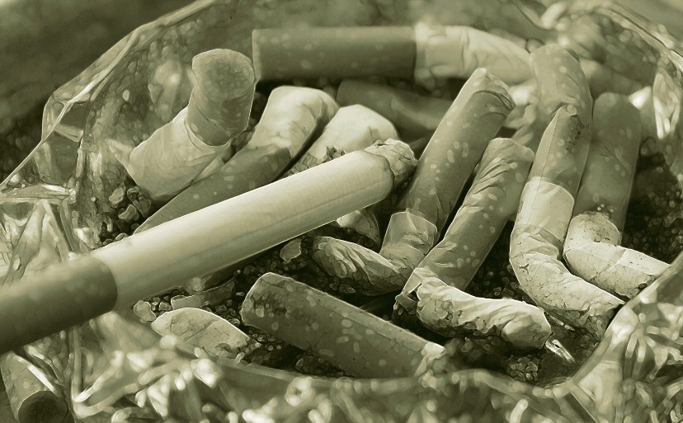
ECONOMICS OF TOBACCO TAXATION IN BANGLADESH
07 APRIL 2019 | TOBACCO TAXATION PROGRAMME
FUNDED BY THE UNIVERSITY OF ILLINOIS AT CHICAGO’S (UIC) INSTITUTE FOR HEALTH RESEARCH AND POLICY TO CONDUCT ECONOMIC RESEARCH ON TOBACCO TAXATION IN BANGLADESH

Slide 2
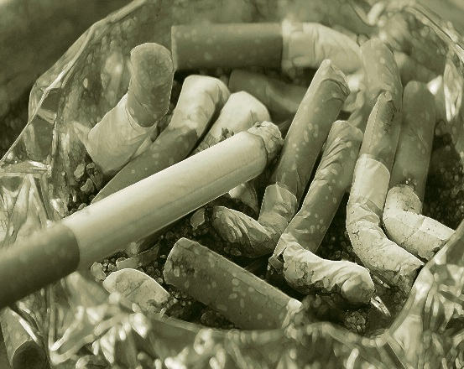
Objectives of the study
Methods of study
Supply chain of tobacco products in Bangladesh
Tobacco taxes
Issues in tobacco taxation
Price elasticities of demand
Simulation
Challenges of tobacco taxation
Recommendations
Specific recommendations for FY 2019-2020
CONTENTS

Slide 3
OBJECTIVES OF STUDY
To examine the tax structure of tobacco products in Bangladesh;
To estimate the own-and cross-price elasticities of demand for tobacco products with a view to suggesting appropriate tobacco tax policy;

Slide 4
CONTD…
To assess the impact of cigarette tax increases no government revenue and public health; and
To propose specific recommendations on tobacco tax policy and administrative reforms.

Slide 5
METHODS OF THE STUDY
Primary data
Survey of 5036 stakeholders of whom 1000 farmers (7 districts), 192 manufacturers (26 districts), 997 retailers (14 districts) and 2847 consumers (16 districts).
Conducted 23 FGDs (230 persons) with tobacco farmers and tobacco users (11 districts) and 25 KIIs with tobacco manufacturers and retailers (9 districts).

Slide 6
CONTD…
Secondary data
HIES 2016 of BBS: 45,702 households, of whom 31,827 (69.64%) are rural and 13,875 (30.36%) are urban.
HIES 2010 of BBS: 12,240 households, of whom 7840 (64.05%) are rural and 4400 (35.95%) are urban.
Elasticity estimation
Using Deaton Model (1997) estimated own-and cross -price elasticities of demand from HIES 2010 and HIES 2016.

Slide 7
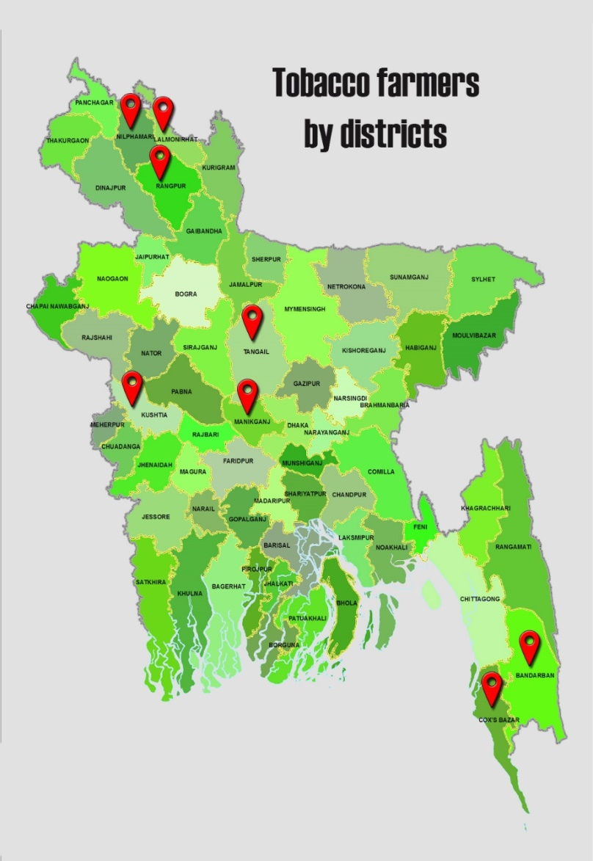
Supply chain of tobacco products
IN BANGLADESH
Tobacco Farmers by Districts
> NILPHAMARI
> LALMONIRHAT
> RANGPUR
> TANGAIL
> MANIKGANJ
> KUSHTIA
> BANDARBAN
> COX’S BAZAR

Slide 8
KAUS MIA, THE ZARDA MUGHAL
Kaus Mia (87) has been on the list of the highest taxpayers nine times and has received a long time taxpayer award from the NBR. He has now different business enterprises, including the manufacturing of Hakimpuri Zarda
Kaus Mia started the tobacco business in 1955. He set up the factory on a 3.5 katha (7 decimals) plot of land at Agha Nawab Dewri, Chawk Bazar, Dhaka with 4 floors. At present 20-21 workers are employed on a regular payroll.

Slide 9
CONTD…
Along with tobacco business, Kaus Mia is now the sole agent of 18 companies. According to the NBR data, he paid total taxes (income tax and VAT & SD) to the NBR amounting to Taka 49.47 crore (US$ 5.90 million) in FY 2017-18.

Slide 10
Market shares of different retail channels in Bangladesh
Sources: TTRD survey, 2018

Slide 11
Buyers of tobacco products at retail outlet
Cigarette Buyer |  | Biri Buyer |  | SLT Buyer
Type | Percentage | Type | Percentage | Type | Percentage
Adult male | 37.79% | Adult male | 67.56% | Adult male | 44.47%
Adult female | 11.48% | Adult female | 8.78% | Adult female | 32.83%
Adolescent male | 31.01% | Adolescent male | 17.56% | Adolescent male | 13.45%
Adolescent female | 6.63% | Adolescent female | 1.15% | Adolescent female | 4.41%
Children (boy) | 11.02% | Children (boy) | 4.58% | Children (boy) | 3.11%
Children (girl) | 2.08% | Children (girl) | 0.38% | Children (girl) | 1.74%
Sources: TTRD survey, 2018

Slide 12
Prevalence of tobacco use (%)
(GATS, 2009 and 2017)
Percentage

Slide 13
TOBACCO TAXES
Revenue Collected and Health Cost of Tobacco Products, 2018 (in crore Taka)
NBR revenue | 206407
Revenue collected from tobacco products | 22866.91
Economic cost of tobacco use | 30570
Tobacco revenue as % of NBR revenue | 11.08%
Tobacco revenue as % of GDP | 1.02%
Economic cost of tobacco use as % of GDP | 1.4%
Sources: Faruque, G.M. et al., 2019. and National Board of Revenue (NBR) data

Slide 14
Tobacco Tax Structure in Bangladesh
FY 2018-2019
Tobacco Products | Category | Tax base | Price (Taka) | VAT (%) | SD (%) | HDS (%) | TTI (%)
Cigarette (10 sticks) | Low | Retail price | 35+ | 15 | 55 | 1 | 71
 | Medium |  | 48+ | 15 | 65 | 1 | 81
 | High |  | 75+ | 15 | 65 | 1 | 81
 | Premium |  | 105+ | 15 | 65 | 1 | 81
Biri (Sticks) | Without filter (25 sticks) | Retail price | 12.5 | 15 | 30 | 1 | 46
 | With filter (20 sticks) |  | 15 | 15 | 35 | 1 | 51
SLT (per 10 gm) | Zarda | Tariff value | 12 | 15 | 100 | 1 | 116
 | Gul |  | 6 | 15 | 100 | 1 | 116
Source: National Board of Revenue (NBR) data

Slide 15
ISSUES IN TOBACCO TAXATION
TOBACCO PRICES AND TAXES
Tobacco prices and taxes, Bangladesh and selected countries (in international purchasing power parity USD)
Country | Cigarette
 | Price | Taxes, % of retail price
Pakistan | 2.2 | 60
Bangladesh | 3.4 | 77
Indonesia | 5.2 | 57
Nepal | 5.7 | 26
Thailand | 7.1 | 74
India | 9.2 | 43
Sri Lanka | 19.6 | 62
Source: WHO 2015

Slide 16
SUBSTITUTION EFFECT
Market Shares of Medium and Low Tiers
of Cigarettes (%)
Percentage
Source: NBR data

Slide 17
REVENUE SHARES
Revenue Shares of Different tiers of Cigarettes (%)
8.02%
Low
16.85%
Premium
21.37%
Premium
FY 2006-2007
Tier-wise revenue contribution
FY 2017-2018
Tier-wise revenue contribution
30.39%
High
11.53%
High
44.74%
Medium
47.09%
Low
20.01%
Medium
Source: NBR data

Slide 18
Real Growth Rate of Cigarette and Biri Revenue FY 2011-12 to FY 2017-18
REVENUE GROWTH (%)
Percentage
Source: Based on NBR and BBS data

Slide 19
AFFORDABILITY OF TOBACCO PRODUCTS
Source: Nargis et al, 2018

Slide 20
Specific vs. ad valorem taxes
With respect to the impact on tobacco product prices, ad valorem taxes result in greater price differentials between high and low priced products than is the case for a single specific tax. This creates more opportunities for users to switch down to cheaper brands in response to tax increase resulting in reduction in revenue.
In terms of revenue, specific tax is likely to generate more stable and predictable revenue than ad valorem tax.

Slide 21
CONTD…
Specific excise taxes tend to be easier to administer than ad valorem tax.
Empirical evidence from different countries shows that specific taxes are more effective than ad valorem taxes in reducing tobacco use and raising tax revenue (Barkat et al. 2012; Ho et al. 2018; Rodriguez-Iglesias and Blecher, 2018; Shang et al. 2017).

Slide 22
PRICE ELASTICITIES OF DEMAND
The results of the study suggest that the overall consumption of smoking tobacco products does respond significantly to price changes.
The poor households are found to be more responsive to the changes in the prices of cigarettes and biris than the rich households. This is expected as the poor households respond more to the changes in the prices of cigarettes and biris than the rich households.
Therefore, using the tobacco tax structure to increase substantially the prices of tobacco products would lead to a substantial reduction in tobacco use, particularly among the poor while increasing government revenue.

Slide 23
Own-price Elasticities of Demand for Tobacco Products
Product | HIES | Overall | Rural/Urban |  | Expenditure quintiles
 |  |  | Rural | Urban | Low (q1-q3) | High (q4-q5)
Cigarette | 2016 | -0.98*** (0.02) | -1.33*** (0.034) | -0.86*** (0.028) | -1.20*** (0.05) | -0.94*** (0.033)
 | 2010 | -1.13*** (0.039) | -1.02*** (0.067) | -1.27*** (0.04) | -1.16*** (0.06) | -0.76*** (0.079)

Slide 24
Contd…
Product | HIES | Overall | Rural/Urban |  | Expenditure quintiles
 |  |  | Rural | Urban | Low (q1-q3) | High (q4-q5)
Biri | 2016 | -1.05*** (0.02) | -1.03*** (0.024) | -1.34*** (0.06) | -1.10*** (0.056) | -0.98*** (0.07)
 | 2010 | -1.05*** (0.022) | -1.04*** (0.022) | -0.84*** (0.068) | -1.02*** (0.028) | -1.01*** (0.005)

Slide 25
Contd…
Product | HIES | Overall | Rural/Urban |  | Expenditure quintiles
 |  |  | Rural | Urban | Low (q1-q3) | High (q4-q5)
SLT | 2016 | -0.25*** (0.018) | -0.27*** (0.019) | -0.39** (0.03) | -0.15*** (0.022) | -0.15*** (0.04)
 | 2010 | -0.37*** (0.04) | -0.58*** (0.048) | 0.16** (0.08) | -0.11 (0.069) | -0.16 (0.107)

Slide 26
SIMULATION
Assumptions and Proposals
A number of parameter have been used for simulation
Policy interventions proposed are:
Reducing the existing four price tiers of cigarettes to two: (1) lower tier (by merging low and medium tiers) and (2) upper tier (by merging high and premium tiers)

Slide 27
CONT…
The retail price of lower tier is proposed at BDT 50 with SD at 60%
The retail price of upper tier is proposed at BDT 105 with SD at 65%
In both tiers, a specific tax of BDT 5 per 10 sticks is proposed
Two estimates of price elasticities (-0.98 of our study and -0.49 of Nargis et al. 2014) have been used to simulate the various revenue and health outcomes of policy interventions.

Slide 28
Alternative scenarios of simulation
FY 2019-20
 | Price tiers | Estimates of price elasticity | Estimated total revenue (billion Taka) | Revenue growth (%) | Reduction in smokers (million persons) | Deaths averted (million persons)
Scenario A | Low Medium High Premium | -0.98 -0.98 -0.98 -0.98 | 316.47 | 13.86 | 3.03 | 1.00

Slide 29
Contd…
 | Price tiers | Estimates of price elasticity | Estimated total revenue (billion Taka) | Revenue growth (%) | Reduction in smokers (million persons) | Deaths averted (million persons)
Scenario B | Low Medium High Premium | -0.49 -0.49 -0.49 -0.49 | 365.32 | 31.43 | 1.27 | 0.42

Slide 30
CHALLENGES OF TOBACCO
TAXANTION
Existence of a complex multi-tiered ad valorem excise tax structure.
SLT is an area of growing concern for public health. However, there exists the challenges of regulating SLT products because of the informality of SLT products, which are often manufactured in small and unlicensed units.

Slide 31
CONTD…
There is an increasing trend in the affordability of tobacco products because of low prices and taxes in Bangladesh.
Adopting a pragmatic tobacco taxation policy will bring a balance between protecting public health and mobilizing revenue from tobacco products.

Slide 32
CONTD…
There exists a conflict of interest among policymakers and government officials pertaining to tobacco tax. The government has more than 10% share in BTAB and some senior officers of the government sit on the Board of the BATB. Some Members of the Parliament have stake in tobacco business.

Slide 33
CONTD…
Several senior officials are involved in tobacco related CSR activities.
National Board of Revenue (NBR) is not strong enough to enforce law effectively because of lack of adequate trained manpower, modern equipment and tracking system.

Slide 34
RECOMMENDATIONS
Phasing out of the existing multi-tiered ad valorem tax system of cigarettes.
Replacing the existing ad valorem taxes with specific taxes by amending the existing law. As the first step, the government can reduce the number of the current cigarette price tiers and add a specific tax to all the tiers in the existing ad valorem tax structure.

Slide 35
CONTD…
Increasing biri taxes substantially through a uniform specific biri excise tax that significantly raises biri prices and reduces its use.
Formalizing SLT manufacturing units by bringing them under registration process and replacing the existing tariff value with the maximum retail price as the tax base.

Slide 36
CONTD…
Harmonizing tax rates across all tobacco products in order to avoid substitution of one tobacco product by another.
Formulating a comprehensive tobacco tax policy and then Implementing annual adjustments to specific excise tax rates for retaining their real value over time

Slide 37
CONTD…
Strengthening the NBR by reforming its legal framework and enhancing its institutional capacity.
Undertaking strong advocacy programs to convince the government to address the conflict of interest in tobacco taxation.

Slide 38
CONTD…
Earmarking tobacco tax revenue to support the programs for creating health awareness as well as for other comprehensive tobacco control programs.

Slide 39
Addressing Conflict of Interest
The Ministry of Health and Family Welfare (Health Services Division) should take the initiative to raise awareness about Article 5.3 of the WHO FCTC among the Ministry of Finance, Ministry of Agriculture and Ministry of Industries.

Slide 40
Contd…
The government must withdraw all incentives provided to the tobacco industries including the exemption of export duty and VAT. The government should enforce the ban on the use of subsidized fertilizer for tobacco growing.

Slide 41
Contd…
The government must stop giving award for the highest taxpayer or the longest serving taxpayer award or any other recognition to the persons involved in tobacco business.

Slide 42
Contd…
Tobacco related CSR activities should be banned as required under Article 5.3 of the WHO FCTC. Moreover, the government should also take the initiative to offload its shares in the BATB.

Slide 43
SPECIFIC REMMENDATIONS FOR FY 2019 - 2020
Cigarette: Proposed Tax Structure FY 2019-2020
Tier | Retail price of 10-stick pack (Taka) | SD Specific Component (Taka per 10 sticks) | SD* Ad valorem | VAT* | Health Development Surcharge* | Total tax share on retail price (%)
Lower tier | 50.00 | 5.00 | 60% | 15% | 1% | 86.0%
Upper tier | 105.00 + | 5.00 | 65% |  |  | 85.8%

Slide 44
Biri: Proposed Tax Structure FY 2019-2020
Tier | Retail price (Taka) | SD Specific Component (Taka per stick) | SD* Ad valorem | VAT* | Health Develop-ment Surcharge* | Total tax share on retail price (%)
Without filter, 25 stick pack | 35 | 6 | 45% | 15% | 1% | 78.1%
Without filter, 12 stick pack | 16.8 | 2.88 |  |  |  | 78.1%
Without filter, 8 stick pack | 11.2 | 1.92 |  |  |  | 78.1%
With filter, 20 stick pack | 28 | 4.8 |  |  |  | 78.1%
With filter, 10 stick pack | 14 | 2.4 |  |  |  | 78.1%

Slide 45
Smokeless Tobacco: Proposed Tax Structure FY 2019-2020
 | Tax base (Retail Price) TK./10 gm) | SD Specific Component (Taka/10g) | SD* Ad valorem | VAT* | Health Development Surcharge* | Total tax share on retail price (%)
Zarda | 35.00 | 5.00 | 45% | 15% | 1% | 75.3%
Gul | 20.00 | 3.00 |  |  |  | 76%

Slide 46
Thank you

