Slide 1
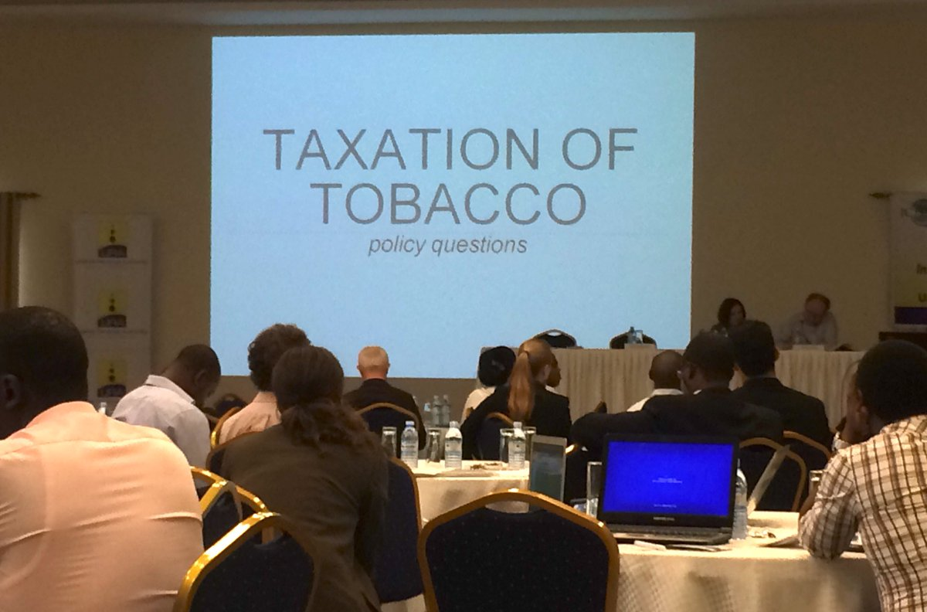
CSO engagement to advocate for increasing tobacco tax: Success and challenges
Farida Akhter
UBINIG (Policy Research for Development Alternative)

Slide 2
What do we mean by CSOs
CSO – Civil Society Organizations
“[CSOs] can be defined to include all non-market and non- state organizations outside of the family in which people organize themselves to pursue shared interests in the public domain.” 2007–2008 Advisory Group on CSOs and Aid Effectiveness and now adopted by the OECD DAC
Civil society is the “third sector” of society, along with government and business. It comprises civil society organizations and non-governmental organizations. The UN recognizes the importance of partnering with civil society, because it advances the organization’s ideals, and helps support its work.
http://www.un.org/en/sections/resources-different-audiences/civil-society/
CSOs include community-based organizations and village associations, environmental groups, women’s rights groups, farmers’ associations, faith-based organizations, labour unions, co-operatives, professional associations, chambers of commerce, independent research institutes and the not-for-profit media”.

Slide 3
NGOs, Civil Society and CSOs
NGO, is non governmental organization, who does what is like a limited function of the government but is funded through non governmental channels. An NGO is a subset of Civil Society. Civil society is collection of NGOs, activists, academician thinkers, think tanks etc.
A member of civil society represents their own views. It is very presumptuous of anyone to claim to represent the view of another as we often see. This does nothing but de-legitimize the work done by CSOs and should be guarded against.
“Civil society organizations (CSOs) play a vital role in enabling people to claim their rights, in promoting rights‐based approaches, in shaping development policies and partnerships, and in overseeing their implementation”.
http://www.cn.undp.org/content/dam/china/docs/Publications/UNDP-CH03%20Annexes.pdf
“Determined, knowledgeable and well-organized NGOs that are willing to form caucuses and alliances can achieve successes in advocacy and lend tremendous weight to international and United Nations-led campaigns.” Kofi Annan (1998)

Slide 4
CSOs in Tobacco Control
Nationally and globally, CSOs are engaged in tobacco control advocacy. They have clear mandate of tobacco control following international conventions and national laws.
They can be self-financed or funded by government or international tobacco control bodies
Engaging in Tobacco control means
ABSOLUTELY NO LINK PERSONALLY OR ORGANISATIONALLY WITH TOBACCO INDUSTRY
So Tobacco industry funded or supported tobacco control groups are NOT part of CSOs.

Slide 5
Perception about CSOs: Friend of Tobacco-control, knowledgeable, focused, strategic and active
Public Perception
Tobacco Industry
Positive: A group of Do-gooders, partners, ally, independent, grass-root voices
Negative: Outsiders, money-seekers, nuisance makers, enemy, anti-government
Nuisance and noise-makers
Game-changer
Innovative advocacy
Need to find new ways & work hard

Slide 6
Global actions in tobacco control by CSOs
The WHO FCTC is a powerful global public good for health, in that it is catalyzing international health cooperation to reduce the burden of disease attributable to tobacco consumption
Global CSOs are active in many countries, including many developing ones: where
Domestic legislation is nonexistent or extremely weak;
The tobacco control movement is in its infancy;
Tobacco control is not perceived by politicians as a public health priority;
Resources for tobacco control are nonexistent

Slide 7
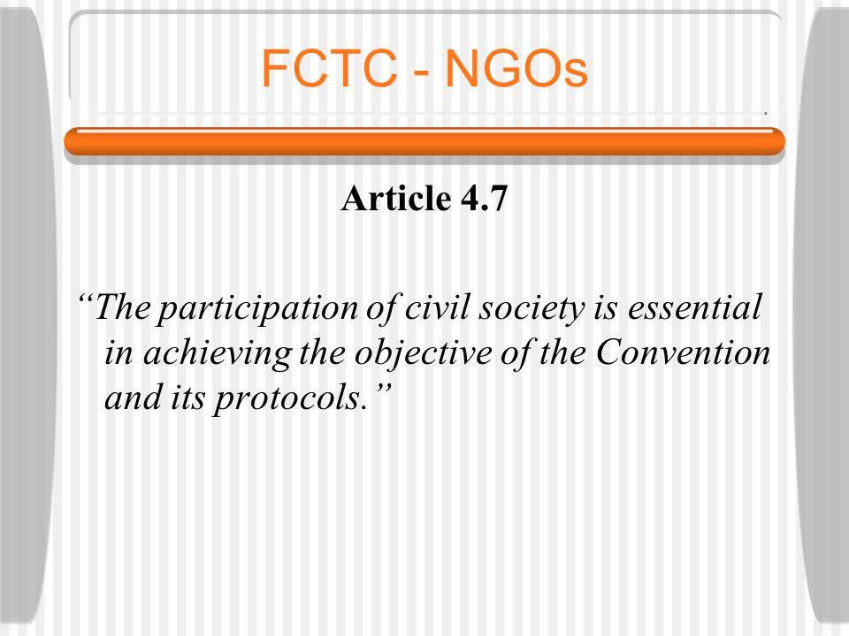
FCTC Process: NGO/Civil Society participation Critical
The treaty and its implementing guidelines adopted by the Parties recognize that the participation of civil society is essential to achieve the objectives of the FCTC and its protocols (FCTC Art. 4.7).
Emphasizes special contribution of NGOs and other members of civil society to tobacco control efforts
ARTICLE 12 provides for education, communication, training, and public awareness measures
The participation of civil society is essential in achieving the objectives of the Convention and its protocols
NGO involvement results in stronger treaties with shorter timelines
[Laurent Huber, FCA
2007 Johns Hopkins Bloomberg School of Public Health]

Slide 8
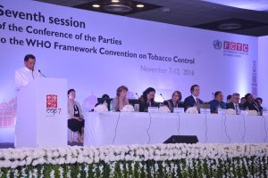
CSOs are powerful in the FCTC Process
Although FCTC is a treaty of the Parties, i.e. the governments/States, CSOs are active and play a significant role in the FCTC process. Because,
NGOs/CSOs have more political independence than governments or WHO
NGOs can better catalyze and coordinate NGO coalitions
The engagement of civil society in a treaty-making process is a key
Aspect of democracy and good governance

Slide 9
The Framework Convention Alliance (FCA)
Comprised of 500+ NGOs from 100+ countries
A true global tobacco control coalition
Brought together health, consumer, human rights, environmental, religious, and other groups to address tobacco
Powerful voice in WHO FCTC negotiation process
FCA -NGO representatives have participated in: All six treaty negotiating sessions, as well as two working group sessions
Dozens of regional treaty meetings
Several annual meetings of the World Health Assembly
Two Open-Ended Intergovernmental Working Group (IGWG) meetings
The First Conference of the Parties (COP) and Expert Working group meetings

Slide 10
WHO FCTC Article 6: Price and Tax Measures to Reduce the Demand for Tobacco
Article 6 of the WHO FCTC stipulates that the Parties shall provide rates of taxation for tobacco products, and trends in tobacco consumption in their periodic reports, in accordance with Article 21.
The Parties recognize that price and tax measures are an effective and important means of reducing tobacco consumption by various segments of the population, in particular young persons.

Slide 11
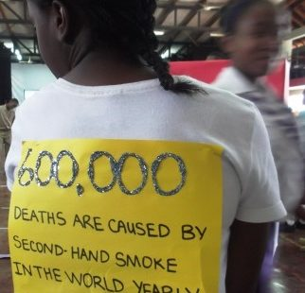
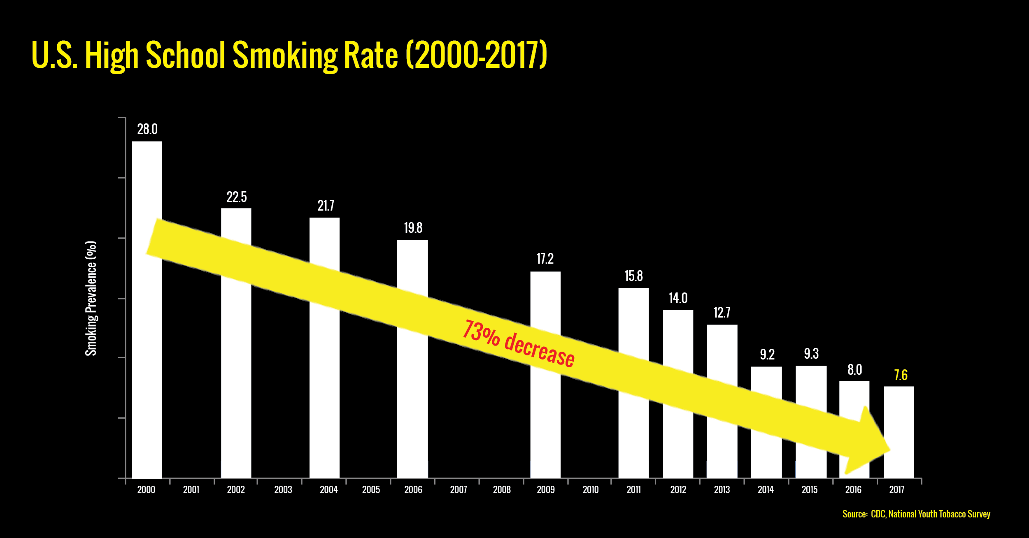
Global & regional CSO actions on Tobacco Taxes
In Jamaica, tobacco tax raised by 17%,
Not enough says FCA member

Slide 12
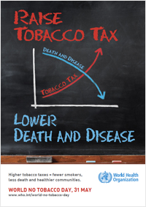
Theme of World No Tobacco Day, 31 May (WNTD), 2014
The theme of World No Tobacco Day 2014 (31 May) is Raise tobacco taxes.
“Precisely because the excise tax on tobacco products in many countries is still low, WHO has made taxation the theme in this year’s World No Tobacco Day,” said Bungon Rithiphakdee, Director of SEATCA, an FCA member.
1,000% increase
The Philippines recently revised its tobacco taxes, so that by 2017 the price of the country’s cheapest brands will have increased more than 1,000 percent.
“Countries should recognise that higher tobacco prices will save lives and reduce the high economic and social burden of tobacco addiction. They should strongly resist tobacco industry pressure,” said Dr Shin Young-soo, WHO Regional Director for the Western Pacific.

Slide 13
Southeast Asia Tobacco Control Alliance (SEATCA) & Tobacco Taxes
SEATCA Tobacco Tax Index 2017
Implementation of WHO Framework Convention on Tobacco Control Article 6 in 10 ASEAN Countries
The Index shows that while some countries have made significant progress in formulating and implementing tobacco tax policies, the region as a whole has advanced slowly.
Important obstacles
1. ineffective tobacco tax structures (e.g. Indonesia’s multi-tiered system or those with purely ad valorem tax systems) and
2. weak tax administration (e.g. inadequate licensing and reporting requirements,
3. tobacco industry interference in tobacco tax policy formulation (e.g. by claiming that implementing tobacco tax measures will lead to increased illicit trade and declines in tobacco tax revenue or create a burden for poor smokers)

Slide 14
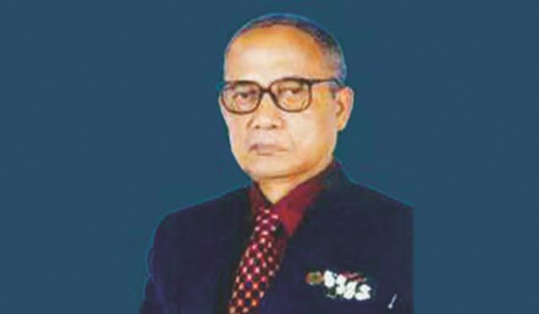
Evolution of Tobacco Control CSO movement in Bangladesh
Support by Bloomberg Philanthropies played an important role
Role of CSOs in formulation of Tobacco Control law (2005), the Rules and the amendment (2013)
Formation of National Tobacco Control Cell (NTCC) under the MOHFW is an important link of CSO activities
Formation of Alliances of CSOs including media–
BATA – Bangladesh Anti-Tobacco Alliance
TABINAJ – Tamak Birodhi Nari Jote
ATMA – Anti-Tobacco Media Alliance
UFAT – United Forum Against Tobacco
Civil society engagement in tobacco control started by physicians, led by National Professor Dr. Nurul Islam in the 1980’s much before FCTC .
“আমরা ধূমপান নিবারণ করি” (আধুনিক) Adhunik was among the first CSO engagement in Tobacco Control.
মানস – by Dentist Dr. Arup Ratan Chowdhury
Dr. (Brigadier) Abdul Malik of National Heart Foundation
Organized CSO engagement in Tobacco control is new in Bangladesh

Slide 15
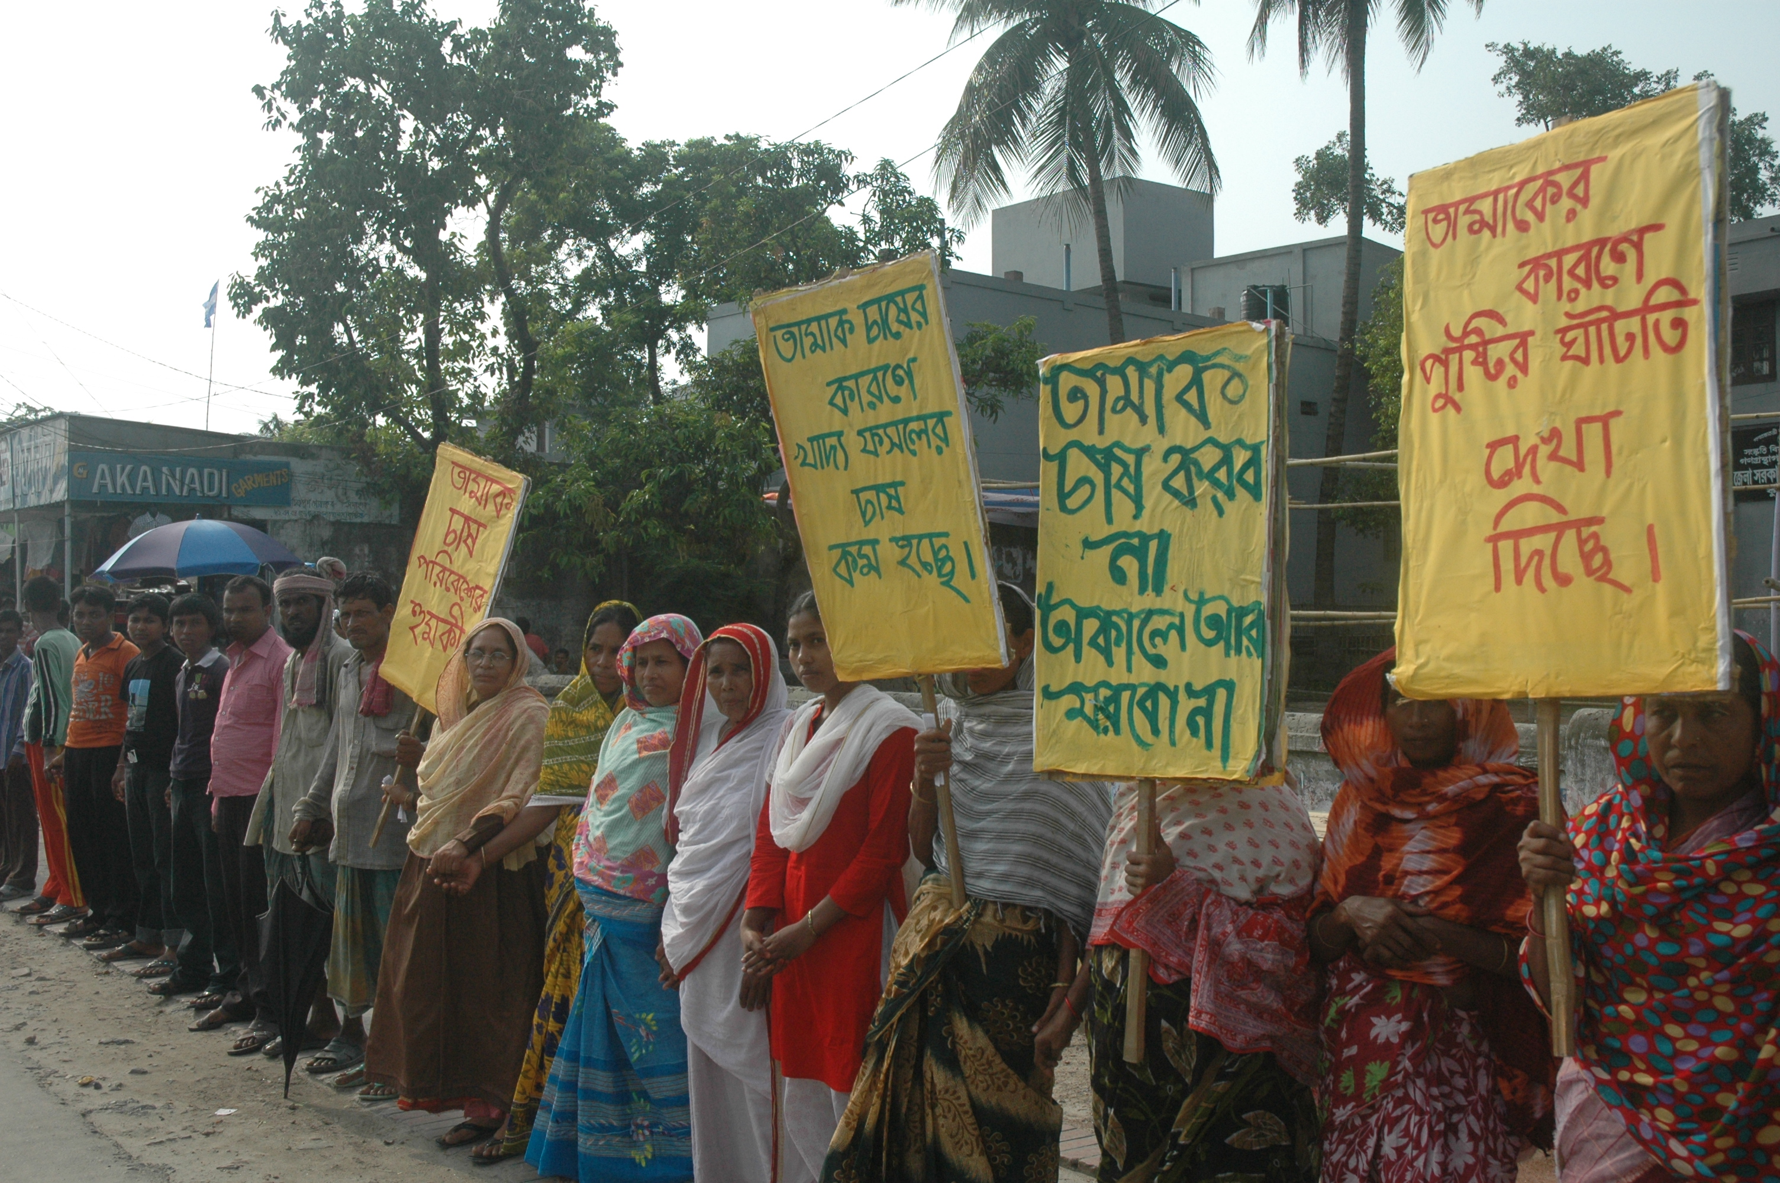
Issues addressed by CSOs in tobacco control
Tobacco cultivation impacts on
-Food security
-environmental degradation
- health of farmers & workers
-use of child labour
Article 17 & 18 of FCTC: Alternative Livelihood and Environmental Protection
Health impacts of smoking
Anti-smoking awareness
Law & its implementation
Tobacco Industry promotional activities – Advertisement, sponsorships
Role of MPs in taxation
Tobacco Taxation
Tobacco industry interference
Prevalence of use of smokeless tobacco
Situation of production of Bidi and Zarda

Slide 16
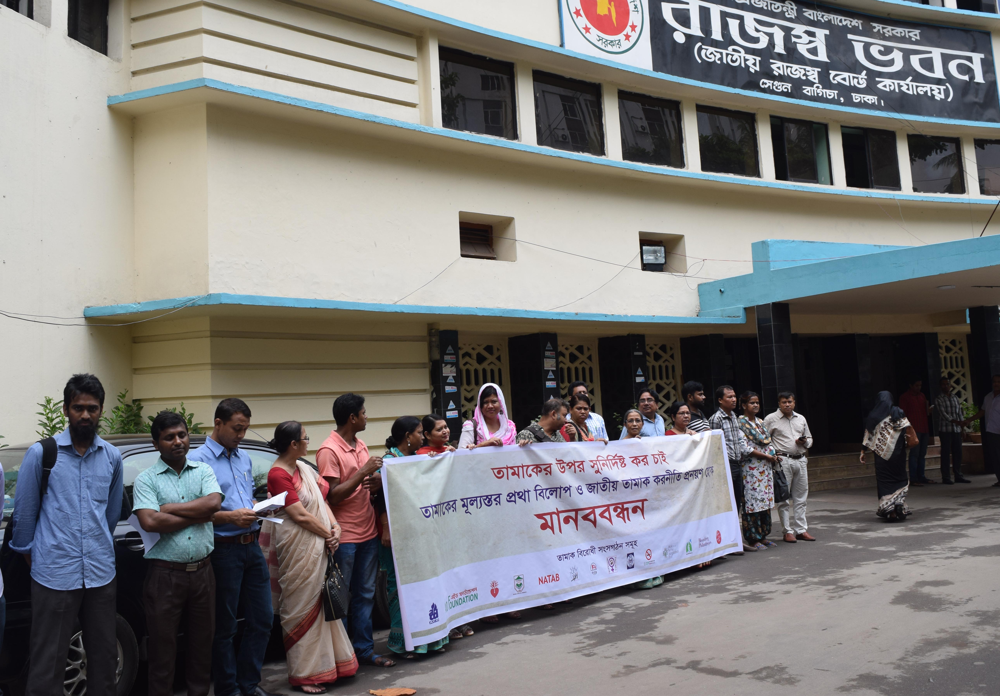
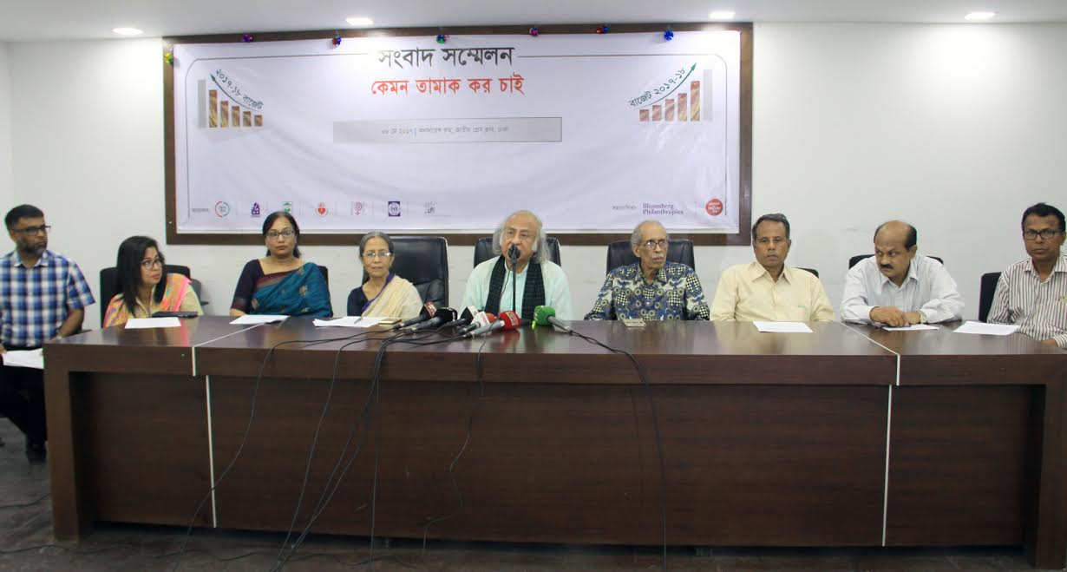
CSOs in tobacco taxation
Higher Taxation as a measure to reduce tobacco consumption, particularly smoking, has been recognized as an important task of CSOs before National Budget every year
Meeting the National Board of Revenue authorities and Ministry of Finance (where tobacco industry pays a regular visit).
Human chains in front of NBR
CSOs needed to understand “Economics” of tobacco consumption, effects of taxation on consumption – they did
Working at National Parliament with DO letters by Members of Parliament
Organizing Human chains, seminars, meetings, Press Conferences

Slide 17
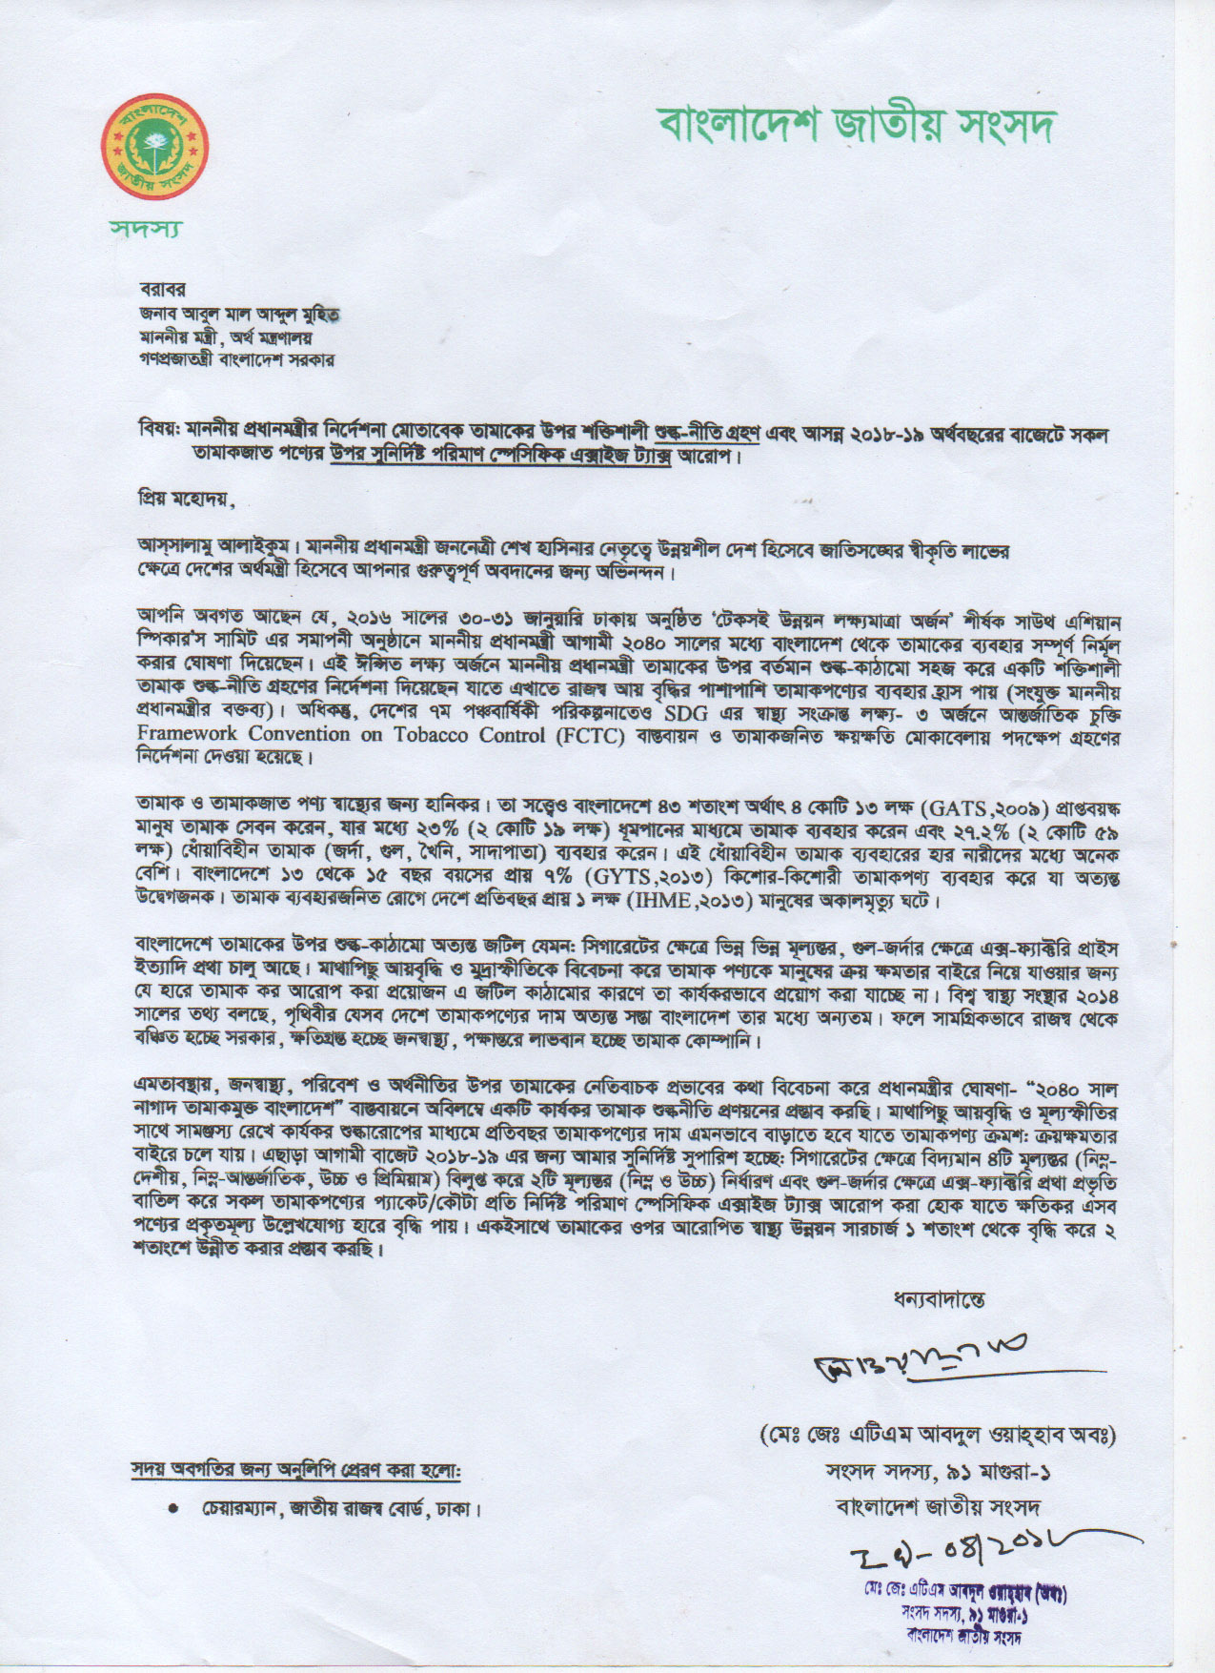
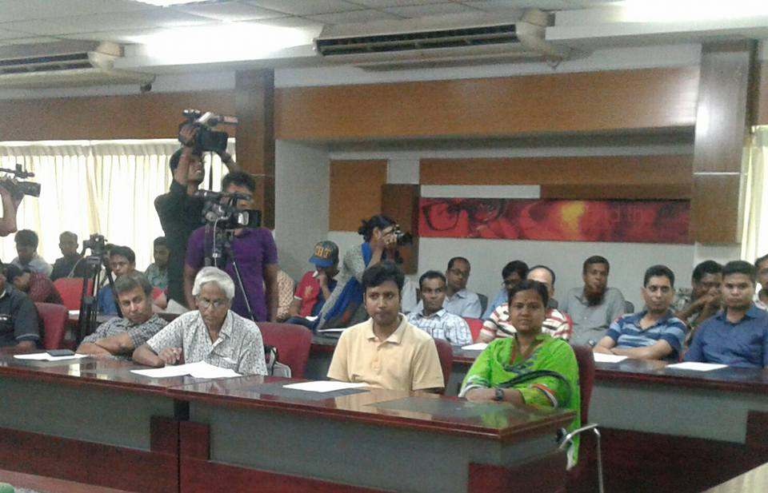
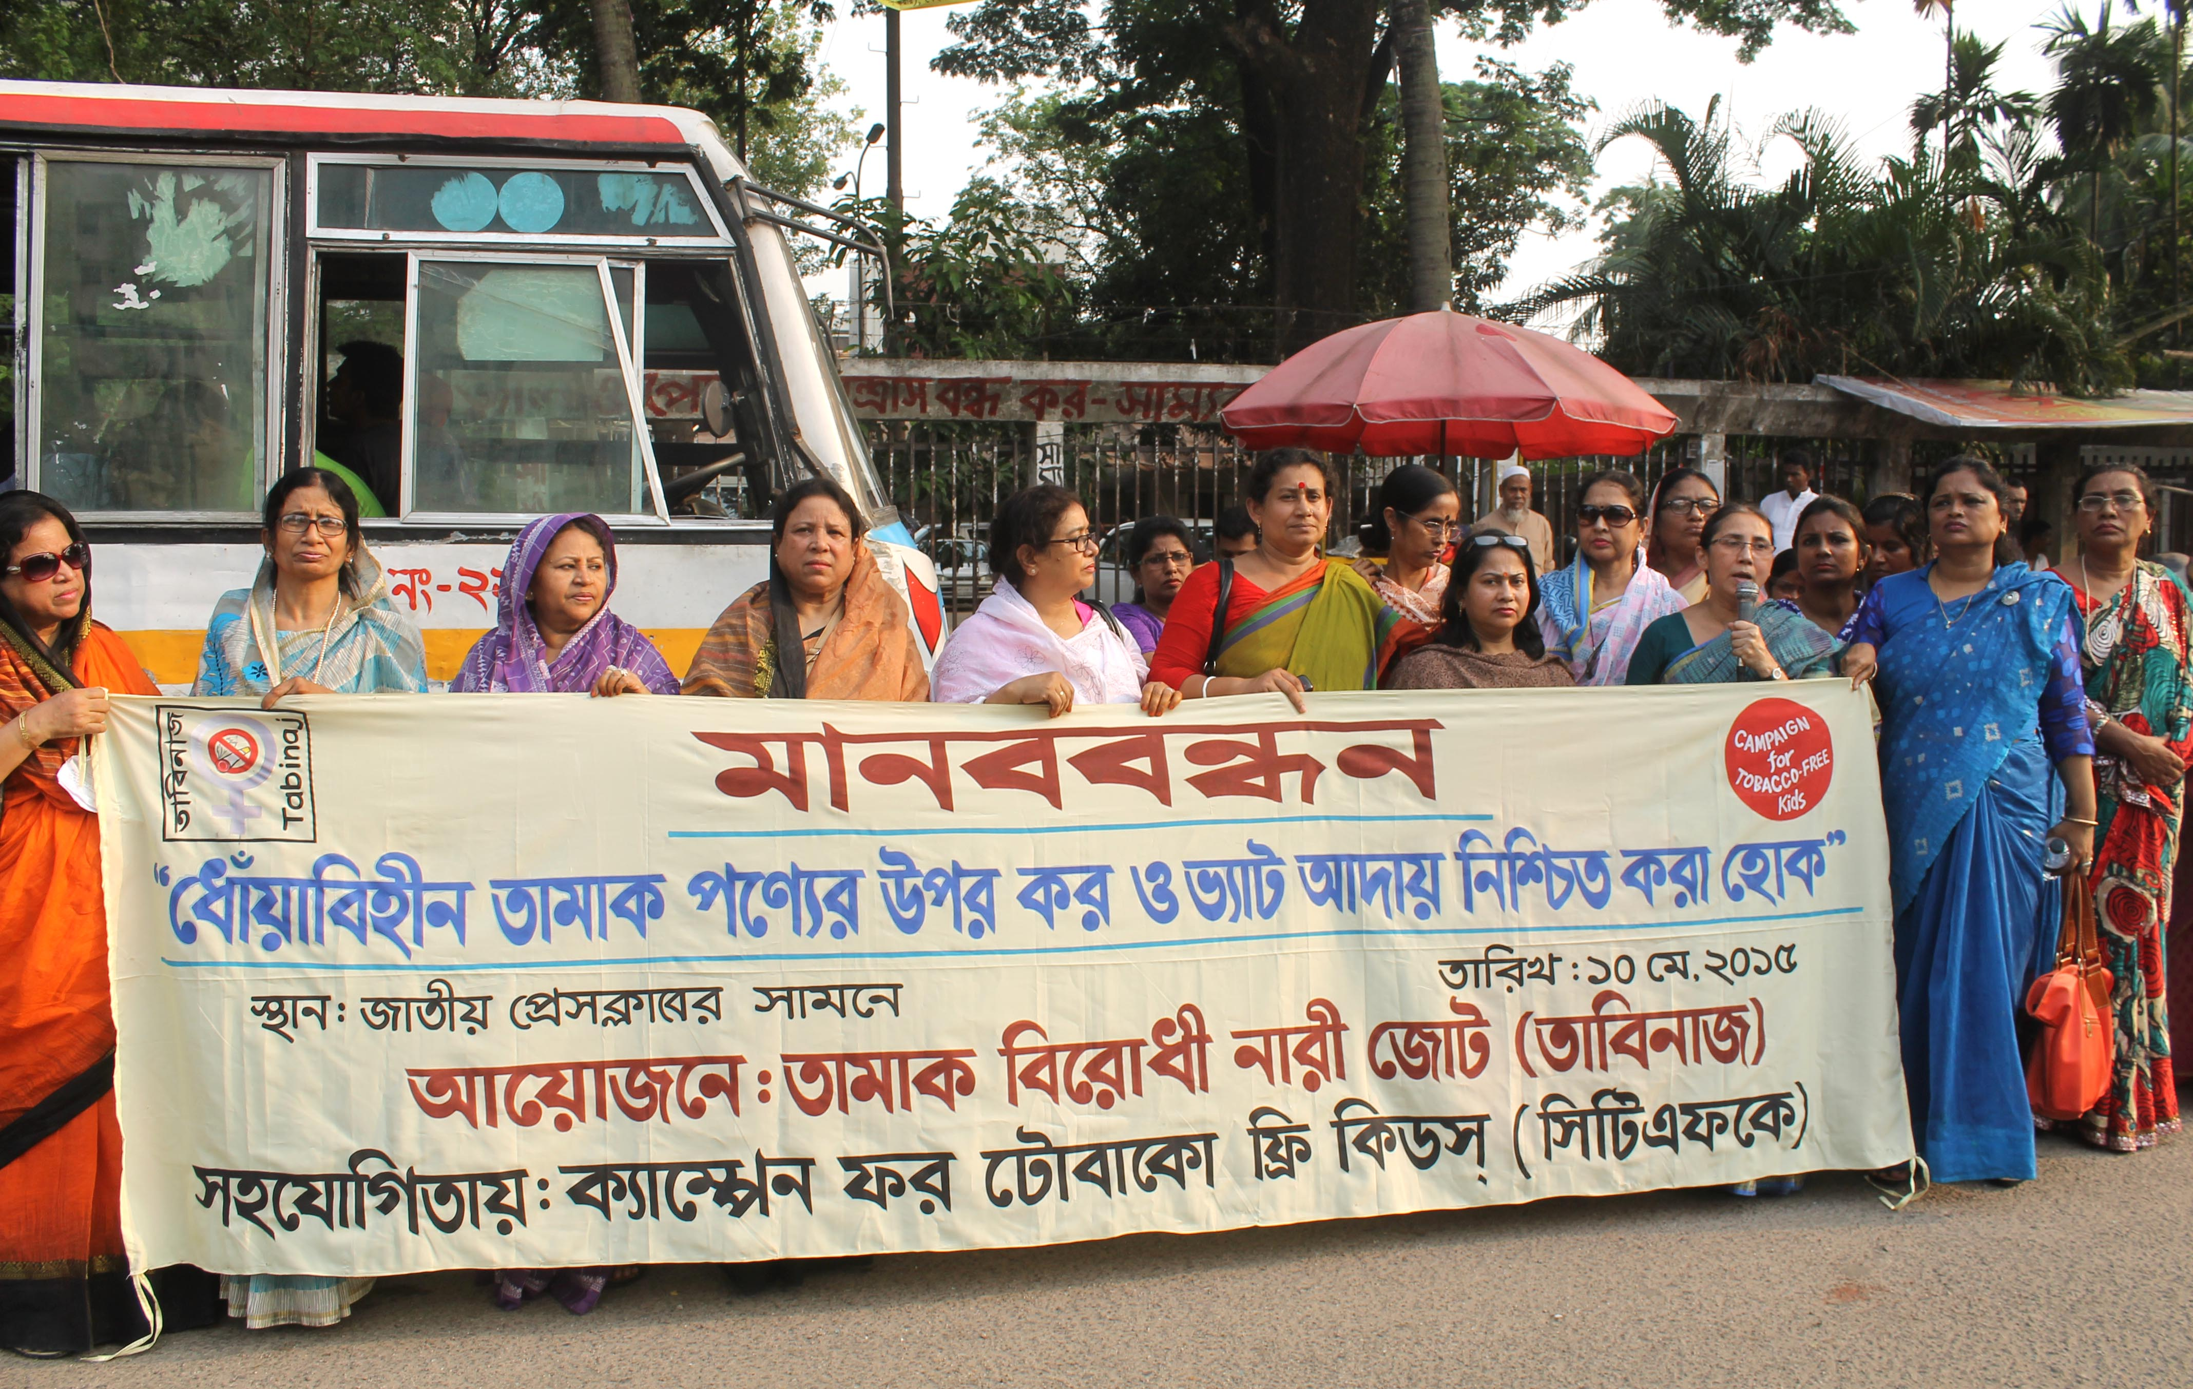
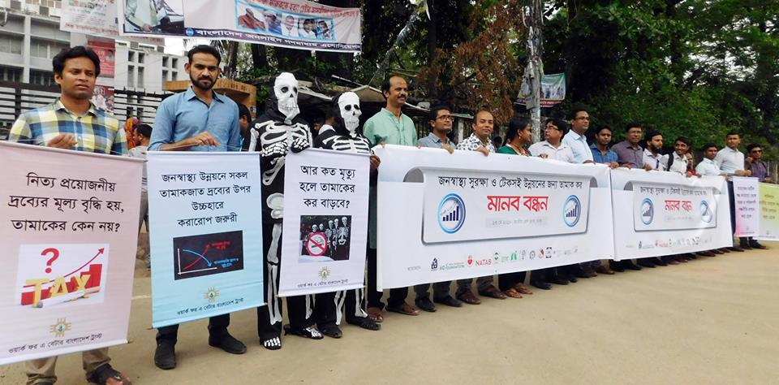

Slide 18
CSOs are successful in tobacco control, but face challenges as well
Success
Challenges
CSOs could raise demand for reducing the Tier-system in taxation on cigarettes
Establish the need for specific tax on smokeless tobacco
Health Development Surcharge Management Policy
Company interference in taxation process
Absence of Tobacco Taxation Policy
Need for taxation on tobacco leaf exports
Lack of resources

Slide 19
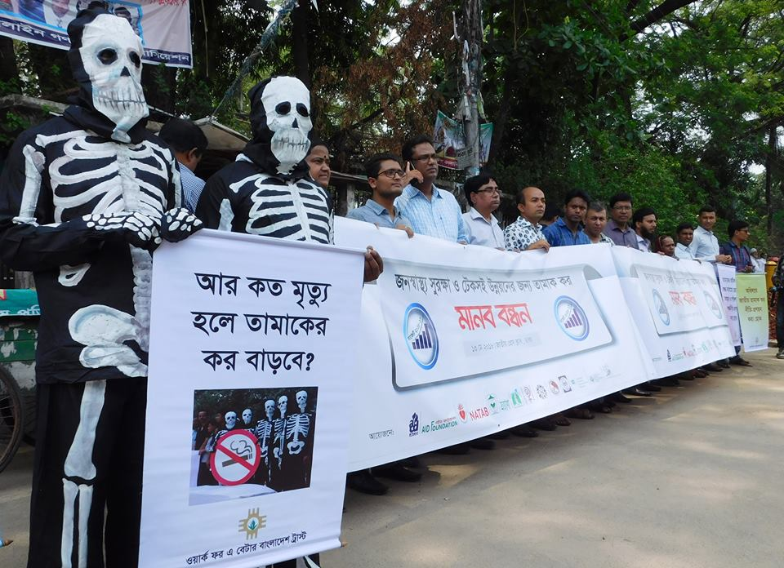
Thank you

