Slide 1
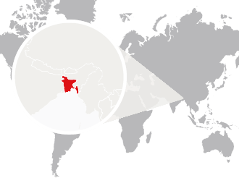
Tobacco Taxation and Impact on Public Health
Rumana Huque, PhD
University of Dhaka

Slide 2

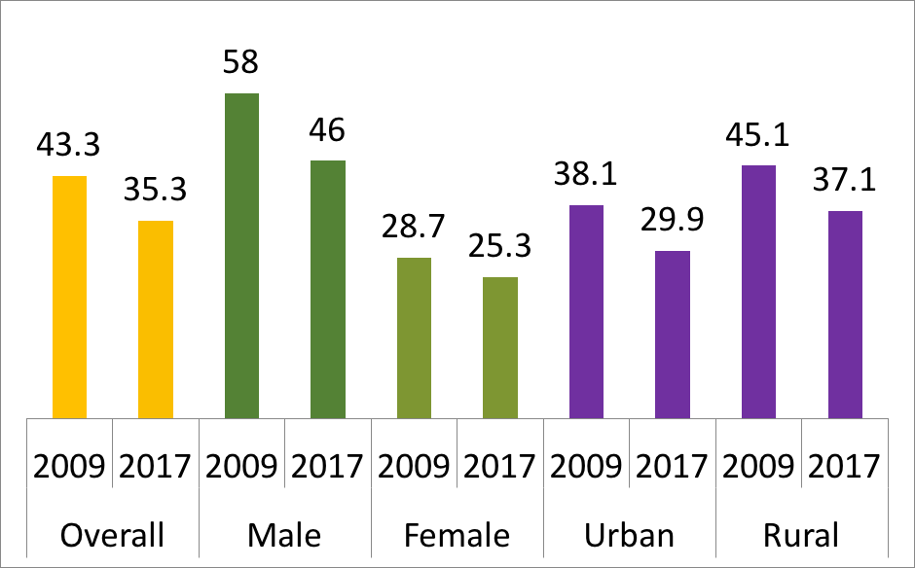
Tobacco Use in Bangladesh
One of the largest tobacco consuming countries in the world
58% of all men and 29% of all women consume some form of tobacco, whether smoked or smokeless.
Over 35% adults consuming cigarettes, bidis, smokeless tobacco, or other tobacco products.
28% of women and 26% of men use smokeless tobacco.
Nearly 7% of 13-15 year olds use tobacco products.

Slide 3

Tobacco causes premature death
It is a leading risk factor for disease and premature deaths.
In 2018, tobacco use killed almost 126,000 people.
The total economic cost of tobacco use is much higher than tobacco tax collection.
Premature!

Slide 4
Disease burden of SLT use
Estimates based on GATS 2009 data suggests that 12,511 lives and 324,020 DALYs were lost in Bangladesh due to SLT related diseases.
Estimates based on global disease burden 2017, suggests that at least 16,947 lives and 403,460 DALYs were lost across Bangladesh due to oral, pharyngeal, oesophageal cancers and ischemic heart diseases that can be attributed to SLT.

Slide 5
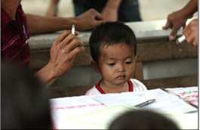
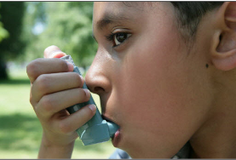
Health hazards of SHS for children
Sudden infant death syndrome
Acute respiratory illnesses
Chronic respiratory symptoms
Asthma and exacerbation of asthma symptoms
Repeated ear infection
Neuro-behavioral deficits
Neurodevelopmental deficits
childhood cancer

Slide 6
Demand reduction …
Article 6: Price and tax measures
Article 8: Protection from exposure to tobacco smoke
Article 11: Packaging and labelling of tobacco products
Article 12: Public awareness
Article 13: Banning tobacco advertising, promotion and sponsorship
Article 14: tobacco cessation

Slide 7
Supply reduction …
Article 15: Illicit trade in tobacco products
Article 16: Sales to and by minors
Article 17: support for economically viable alternative activities

Slide 8
Cigarette
 | 2020-21 |  | 2021-22 |  | What has been changed?
Tier | Retail price (BDT) | SD | Retail price (BDT) | SD | - There is No change in prices on Low and Medium tiers. - SD remains unchanged in all four tiers that will benefit tobacco industry while government will lose revenue. - Did not introduce tiered specific excise tax.
Low | 39 | 57% | 39 (No change) | 57% ( No change)
Medium | 63 | 65% | 63 (No change) | 65% (No change)
High | 97 | 65% | 102 (5.2% increase) | 65% (No change)
Premium | 128 | 65% | 135 (5.5% increase) | 65% (No change)

Slide 9
Biri
 | 2020-21 |  | 2021-22 |  | What has been changed?
Category | Retail price (BDT) | SD | Retail price (BDT) | SD | There is No change in prices and taxes on biri
Filter | BDT 19 per 20 sticks | 40% | BDT 19 per 20 sticks (unchanged) | 40% (No change)
Non-filter | BDT 18 per 25 sticks | 30% | BDT 18 per 25 sticks (unchanged) | 30% (No change)

Slide 10
Smokeless tobacco (SLT)
 | 2020-21 |  | 2021-22 |  | What has been changed?
Category | Retail price (BDT) | SD | Retail price (BDT) | SD | There is No change in prices and taxes on SLT
Zarda | BDT 40 per 10 gm | 55% | BDT 40 per 10 gm (No change) | 55% (No change)
Gul | BDT 20 per 10 gm | 55% | BDT 20 per 10 gm (No change) | 55% (No change)

Slide 11
CURRENT Tax Structure 2020-2021 |  |  | PROPOSED Tax Structure 2021-2022
Tier | MRP | SD (Ad Valorem-% of Retail Price) | Tier | MRP | SD (Specific - BDT) | SD Share in Retail Price
Cigarette (10 stick)
Low | 39+ | 57% | Low | 50+ | 32.50 | 65%
Med | 63+ | 65% | Med | 70+ | 45.50 | 65%
High | 97+ | 65% | High | 110+ | 71.50 | 65%
Prem | 128+ | 65% | Prem | 140+ | 91.00 | 65%
Biri (Without filter 25 stick and with filter 20 stick)
Without Filter | 18+ | 30% | Without Filter | 25+ | 11.25 | 45%
With filter | 19+ | 40% | With filter | 20+ | 9.00 | 45%
Smokeless tobacco (10 gram)
Zarda | 40+ | 55% | Zarda | 45+ | 27.00 | 60%
Gul | 20+ | 55% | Gul | 25+ | 15.00 | 60%

Slide 12
Expected economic and health impact
 | 2020-2021 | 2021-2022 (partner proposal) | 2021-2022 (budget proposal)
Average price change (inflation-adjusted) |  | 20.4% | -0.7%
Cigarette sales (Crore packs) | 640 | 540 | 620
Tax revenue (Crore BDT) | 27,180 | 30,520 | 27,960
Industry revenue (Crore BDT) | 5040 | 4350 | 4950
Cigarette smoking prevalence | 15.1% | 13.9% | 14.8
Reduction in number of current smokers from 1 Crore 80 Lac (18 million) |  | 1 Crore 40 Lac (1.4 million) | 269 thousand
Reduction in number of future smokers from 65 Lac (6.5 million) |  | 988 thousand | 194 thousand
Number of lives saved |  | 974 thousand | 191 thousand

Slide 13
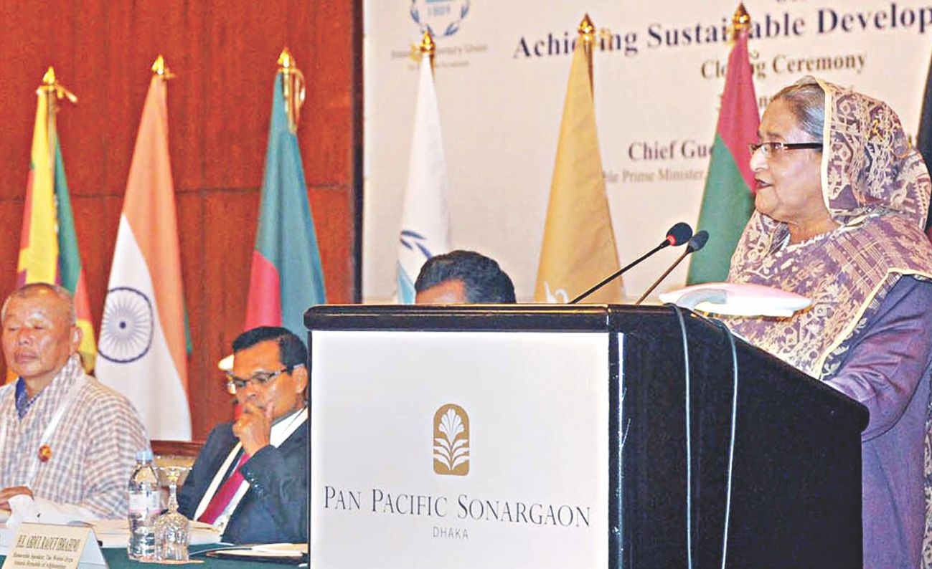
“Tobacco is a hindrance to achieve SDGs”
PM Statements
FCTC implementation is a pre-condition

Slide 14
Tobacco Tax Structure and Administration
Source: WHO Report on the Global Tobacco Epidemic, 2019, https://www.who.int/teams/health-promotion/tobacco-control/who-report-on-the-global-tobacco-epidemic-2019

Slide 15
Recommendation
Impose specific tax
Consider the recommended price and tax proposal of experts and tobacco control advocates
Adopt a comprehensive tobacco tax policy

Slide 16

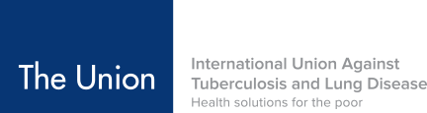

Thank You

