Slide 1
Tobacco Taxes: Country Experiences
Dr. Nasiruddin Ahmed
Project Lead
Tobacco Tax Research and Dissemination Project
BIGD, BRAC University
November 2018

Slide 2
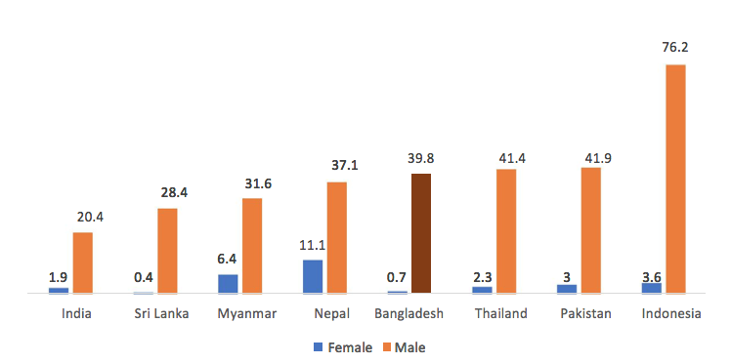
1. Prevalence of tobacco products
Figure 1. Prevalence of smoking any tobacco product, individuals aged ≥15 years
Source: WHO 2015a

Slide 3
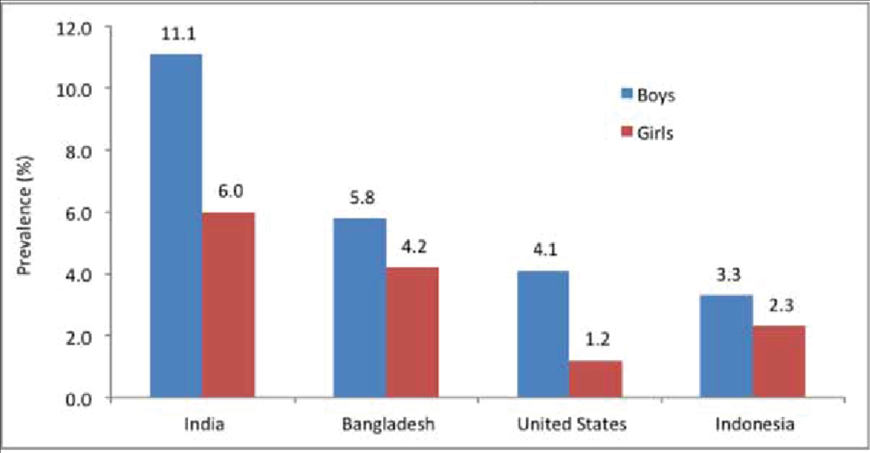
Figure 2. SLT use in four of the world’s most populous countries
Source: National Cancer Institute and Centers for Disease Control and Prevention, 2014

Slide 4
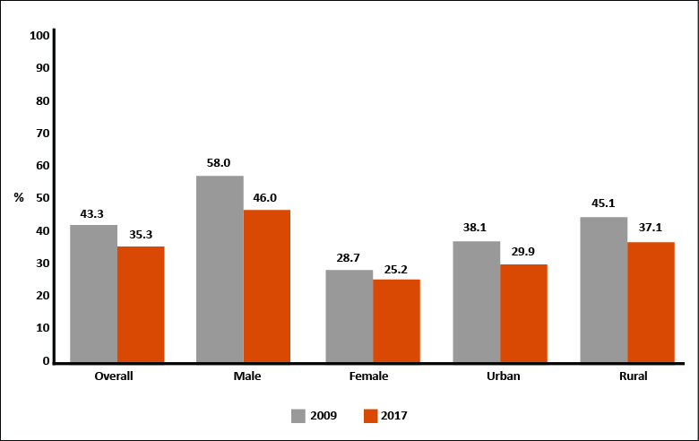
Figure 3. Prevalence of tobacco in smoking and/or smokeless form
Source: WHO, GATS 2017

Slide 5
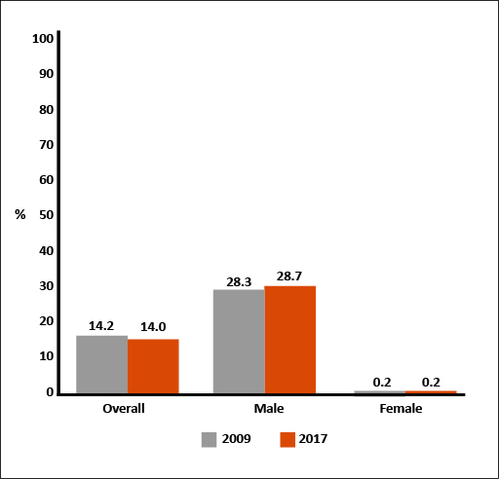
Figure 4. Prevalence of smoked cigarettes
Source: WHO, GATS 2017

Slide 6
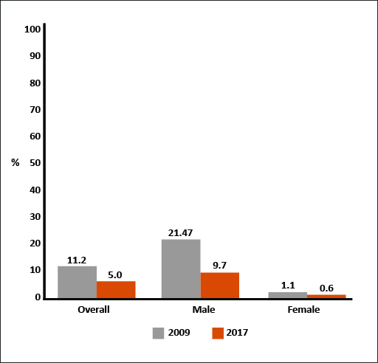
Figure 5. Prevalence of smoked biri
Source: WHO, GATS 2017

Slide 7
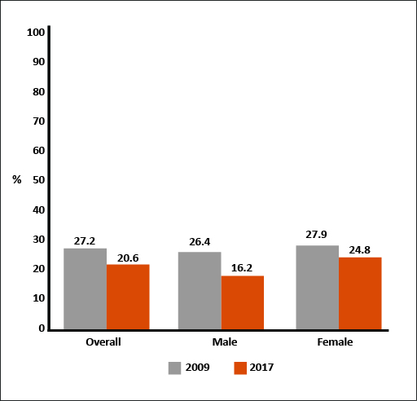
Figure 6. Prevalence of smokeless tobacco
Source: WHO, GATS 2017

Slide 8
2. Tobacco tax structure
Complex tax structure
A complex multi-tiered ad-valorem excise tax (VAT, SD)
Large variations in tax bases and tax rates, both between cigarette brands (taxed under different tiers or slabs) and between tobacco products (cigarettes, biris, and smokeless)
A standard VAT of 15% is imposed on all tobacco products.
A health development surcharge (HDS) of 1% is imposed on all tobacco products.
A surcharge of 2.5% is imposed on tobacco company’s income.
Tariff value replaced ex-factory price as the tax base for SLT

Slide 9
Table 1. Total tax incidence of cigarette tiers, FY 2018-19
Source: NBR data

Slide 10
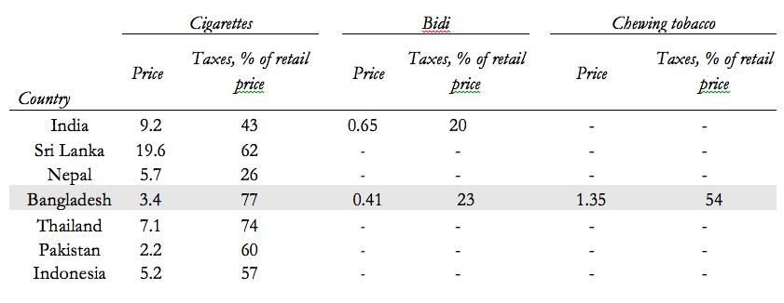
3. Tobacco prices and taxes
Table 2. Tobacco prices and taxes, Bangladesh and selected countries
Source: WHO 2015b, 2017

Slide 11
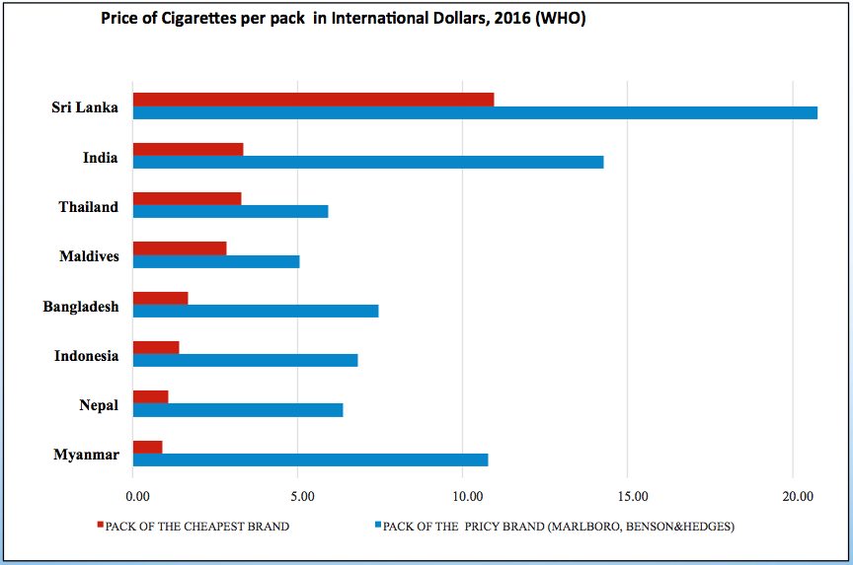
Figure 7. Price of cigarettes per pack in international dollars, 2016

Slide 12
4. Differential tax treatment leads to product substitution Figure 8. Market shares of medium and low tiers of cigarettes (%)
Source: Based on NBR data

Slide 13
Figure 9. Revenue shares of different tiers of cigarettes (%)
Source: Based on NBR data

Slide 14
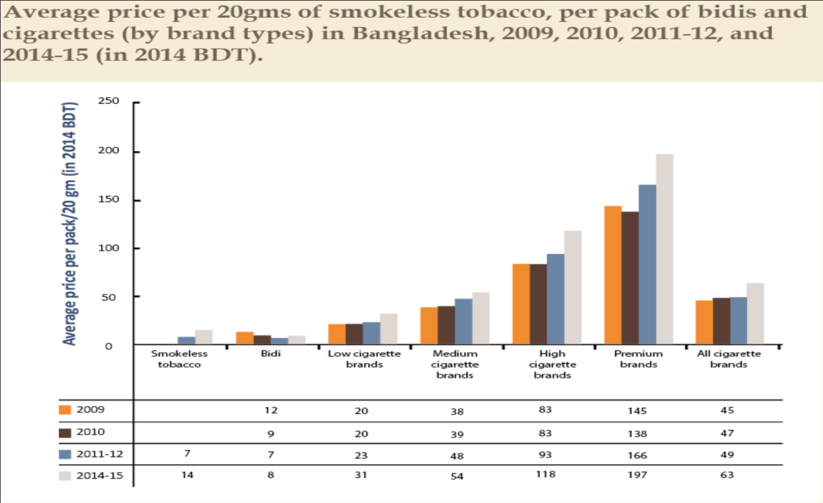
5. Affordability of tobacco products
Figure 10.
Source: Nargis and Chaloupka, 2018

Slide 15
6. Tobacco taxation and revenue
Sources: Based on NBR and BBS data

Slide 16
Figure 12. Revenue Shares of Tobacco Products (%), FY 2016-17
Source: Based on NBR data

Slide 17
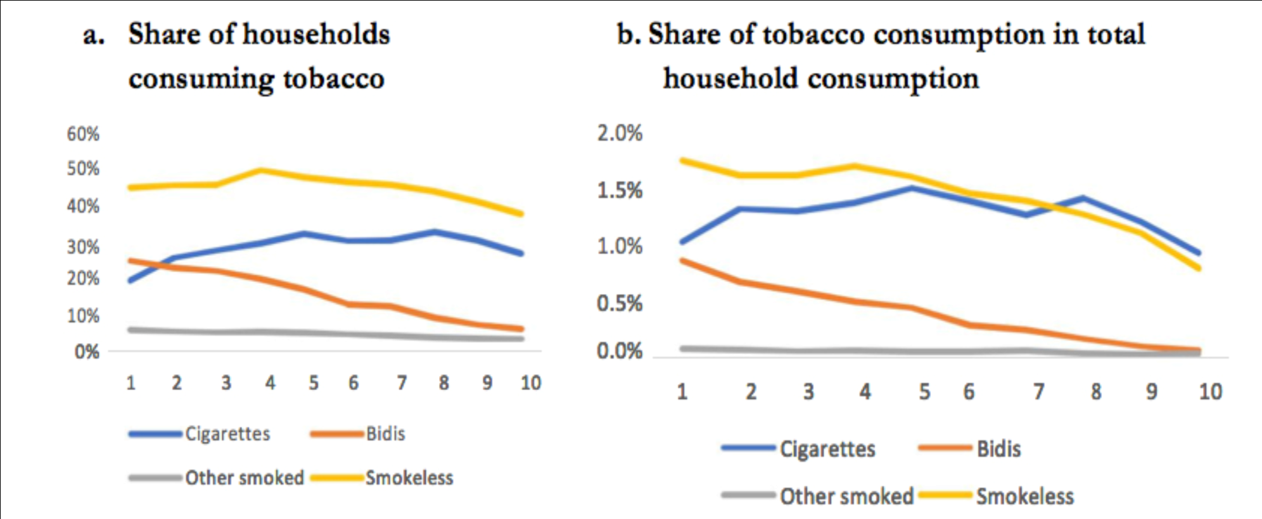
7. Spotlight: Smokeless Tobacco
Figure 13. Tobacco Consumption, by Type of Product and Per Capita Consumption Decile
Source: Based on BBS HIES 2016

Slide 18
8. Challenges
Adopting a pragmatic tobacco taxation policy which will bring a balance between the two priority areas of the government -revenue mobilization from tobacco (about 10% of the NBR revenue) and protecting public health.
SLT is an area of growing concern for public health and potential for revenue mobilization. However, the NBR receives only about Taka 33 crore as revenue from SLT.
There exists conflict of interest among policymakers and government officials pertaining to tobacco taxes which seriously impedes sound tobacco tax policy.
There are concerns about unemployment and the opportunities of alternative livelihoods for tobacco cultivators and workers.
Strengthening tax administration.

Slide 19
9. Way Forward
Drawing a roadmap of tobacco tax policy reform with the WHO target of reducing the prevalence of tobacco use 30% by 2025.
Increase in tobacco prices through taxation must outpace inflation and income growth.
A committee may be formed to work on the roadmap.

Slide 20
Thank You!

