Slide 1
Tobacco Tax Structure
and Tobacco Use
Frank J. Chaloupka
Chair, WHO Collaborating Centre on the Economics of Tobacco & Tobacco Control
Distinguished Professor, UIC
The Economics of Tobacco Control in Africa:
Linking Research and Advocacy
Singapore, March 20, 2012

Slide 2
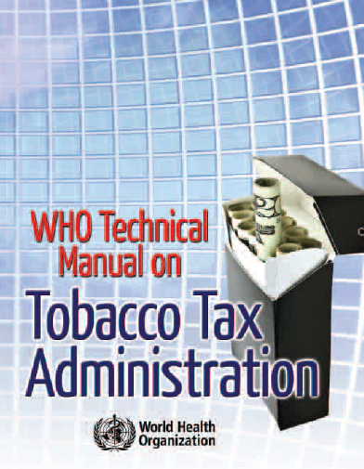
Best Practices in Tobacco Taxation

Slide 3
WHO’s Best Practices in Tobacco Taxation
Simpler is better
Complex tax structures more difficult to administer
Greater opportunities for tax evasion and tax avoidance under complex tax structures
Where existing structure is more complex, simplify over time with goal of achieving single uniform tax

Slide 4
WHO’s Best Practices in Tobacco Taxation
Rely more on specific tobacco excises as the share of total excises in prices increases
Greater public health impact of specific excises given reduced opportunities for switching down in response to tax/price increases
Sends clear message that all brands are equally harmful
Where existing tax is ad valorem, adopt a specific tax and increase reliance on specific tax over time

Slide 5
WHO “Best Practices” for Tobacco Excise Taxes
Adopt comparable taxes and tax increases on all tobacco products
Maximizes public health impact of tobacco tax increases by minimizing opportunities for substitution
Harm reduction?

Slide 6
Types of Tobacco Taxes
Tobacco Excise Taxes
Two types of excises
Specific Taxes: excises based on quantity or weight (e.g. tax per pack of 20 cigarettes)
Ad Valorem taxes: excises based on value of tobacco products (e.g. a specific percentage of manufacturer’s prices for tobacco products)
Some countries use a mix of specific and ad valorem tobacco excises, differential taxes for different products of given type, minimum taxes, etc.
Many countries apply different types of taxes and/or tax rates on different types of tobacco products (e.g. manufactured cigarettes vs. bidis)

Slide 7
Cigarette Taxation Globally
 | Excise System on Cigarettes
Income Group | Only specific | Only ad valorem | Both specific and ad valorem | No Excise | Total countries *
High | 11 | 2 | 25 | 7 | 45
Upper Middle | 16 | 11 | 9 | 6 | 42
Lower Middle | 18 | 19 | 12 | 3 | 52
Low | 10 | 28 | 2 | 3 | 43
By Region
AFRO | 14 | 29 | 1 | 2 | 46
AMRO | 13 | 16 | 2 | 3 | 34
EMRO | 1 | 7 | 5 | 7 | 20
EURO | 10 | 3 | 36 | 0 | 49
SEARO | 3 | 2 | 2 | 1 | 8
WPRO | 14 | 3 | 2 | 6 | 25
All Countries | 55 | 60 | 48 | 19 | 182
* Countries for which data are available
Source: WHO calculations using WHO GTCR 2009 data

Slide 8
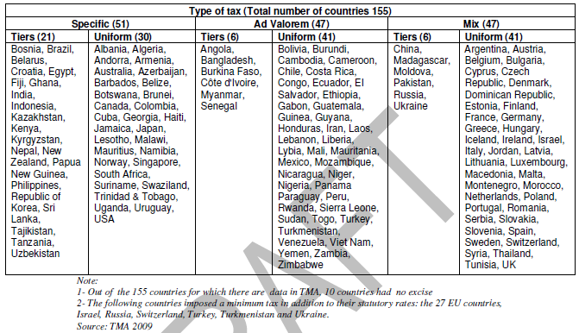
Cigarette Taxation Globally

Slide 9
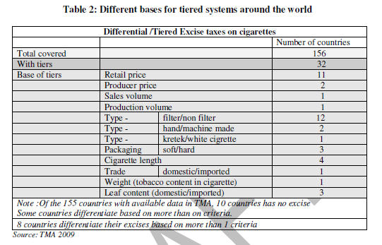
Cigarette Taxation Globally

Slide 10
Cigarette & Bidi Taxes, India,2009
 |  | BED | NCCD | AED | Total
Unfiltered Cigarette (Rs. Per 1000) | length≤ 60 mm | 659 | 90 | 70 | 819
 | length 60-70mm | 1068 | 145 | 110 | 1323
Filtered Cigarette (Rs. Per 1000) | length ≤ 70 mm | 659 | 90 | 70 | 819
 | length 70-75 mm | 1068 | 145 | 110 | 1323
 | length 75 -85mm | 1424 | 190 | 145 | 1759
 | length>85 mm | 1748 | 235 | 180 | 2163
Bidis from producer making <2million sticks/year |  |  |  |  | 0
Bidis other than paper rolled, manufactured without machines (Rs per 1000) |  | 12 |  |  | 12
All Other Bidis (Rs per 1000) |  | 30 |  |  | 30
BED: Basic Excise Duty; SED: Special Excise Duty; NCCD: National Calamity Contingency Duty;

Slide 11
Types of Tobacco Taxes
Specific taxes:
Easier to administer
No valuation issues
Real value falls with inflation
Smaller price gap between high/low priced brands
Generally produce more stable stream of revenue
Promote higher “quality” products
Producers keeps all of additional price from higher quality products

Slide 12
Types of Tobacco Taxes
Ad valorem taxes:
More difficult to administer given variety of different prices
Valuation problems, abusive “transfer” pricing
May require minimum price policies
More likely to keep pace with inflation
More unstable revenues
Government subsidizes industry price cuts but benefits from industry price increases
Larger price gap
Greater potential for “switching down” in response to tax increase
Favor low “quality” products
Less incentive to invest in quality given price rises by more
May be protective for domestic industry
if imports or foreign-owned brands tend to be higher quality/price
More “equitable”
Absolute amount of tax higher on higher priced brands

Slide 13
Types of Tobacco Taxes
Mixed systems
More difficult to administer given variety of different prices
Valuation problems, abusive “transfer” pricing
Better able to keep pace with inflation
Somewhat less stable revenues
Government still subsidizes industry price cuts and benefits from industry price increases, just not as much
Reduced price gap
Relative to pure ad valorem
More protective for domestic industry
Relative to pure specific
Somewhat more “equitable”

Slide 18
Tax Structure and Tobacco Use
EU Analysis:
Cigarette prices
Cigarette tax revenues
Tax paid cigarette sales
Smoking Prevalence
Mostly 1997-2008
Control for:
Economic conditions (real GDP per capita, unemployment rate)
Market structure (Herfindahl-Hirschman Index)
Country, year fixed effects

Slide 20
Conclusions
Greater reliance on specific tobacco excises:
Reduced gap in prices between high and low priced cigarette brands
Produced more stable, predictable stream of cigarette excise tax revenues
Had greater impact on cigarette smoking
Effects vary with market structure

Slide 21
Global Adult Tobacco Survey
CDC/WHO Partnership
Nationally representative, face-to-face household survey of adult (15+) population
14 BGI countries; most complete and released
New countries in field or planning stages
Data on:
tobacco use, cessation, knowledge/attitudes, exposure to tobacco smoke, media influences, economics
Key measures:
Price, brand choice, tobacco use

Slide 22
International Tobacco Control Policy Evaluation Surveys
Multiple researchers and funders
Cohort surveys of smokers/tobacco users
23 countries; varying start dates, waves
Mix of high, middle, low income countries; covers all regions; most of the world’s tobacco users
Data on:
tobacco use, cessation, knowledge/attitudes, exposure to tobacco smoke, media influences, economics; key policy mediators
Key measures:
Price, brand choice, other purchase behaviors, tobacco use

Slide 23
National Cancer Institute UO1
Assess impact of differential tobacco product taxes
Most states tax other tobacco products below cigarettes
Specific cigarette taxes in all states, ad valorem taxes on other tobacco products in most
In recent years, industry pushing states to move from ad valorem to specific, weight based taxes
5 states and Federal smokeless taxes currently weight based
Taxation of new generation of tobacco products unclear

Slide 24
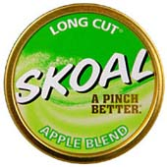
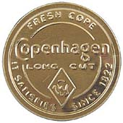
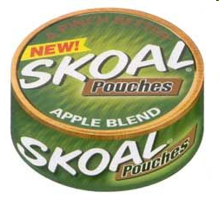
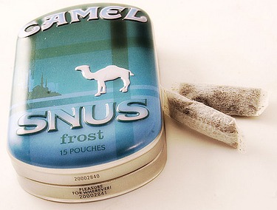
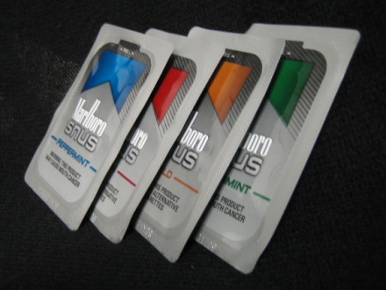
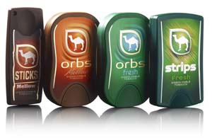
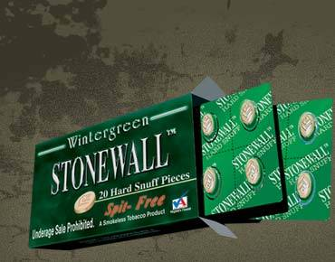
Traditional vs. New Non-Combustible Products
Traditional Moist Snuff Smokeless
1 tin = 1.2 to 1.5 oz.
Skoal Pouches
1 tin (20 pouches) = 0.82 oz
Camel Snus
1 tin (15 pouches) = 0.32 oz.
Marlboro Snus
1 “foil pack” (6 pouches) = 0.1 oz.
Stonewall Hard Snuff
1 box of 20 “Pieces” = 0.335 oz.
Camel Orbs
1 box of 15 “Pieces” = 0.12 oz.
Source: Eric Lindblom, Campaign for Tobacco-Free Kids
Notes:
Low-weight products can be less than a quarter to as little as one-tenth of the weight of traditional moist snuff products. That means that with weight-based taxes, revenues will be less than one-quarter to one-tenth less.

Slide 25
Data
Key data components include:
Policy surveillance – original legal research building on past & ongoing research for BTG/ImpacTeen state tobacco policy database; data for 2002 through 2013
Observational data collection - expand tobacco component of ongoing Bridging the Gap Community Obesity Measures Project in MTF communities; current data for 2010 and 2011; expanded data for 2012
Adult tobacco use survey – adaptation of International Tobacco Control Policy Evaluation Project’s adult smoker survey; conducted in BTG-COMP communities in 2012
Existing data - numerous surveys, commercial databases, and archival data sources

Slide 26
For more information:
fjc@uic.edu
Notes:
26

