Slide 1
Rationale of Tobacco Economics
AKM Ghulam Hussain
Professor Dr. Mohiuddin Faruque

Slide 2
Story line
Tobacco impact on
Death
DALY loss
Second hand smoking
Environmental cost
Benefits of tobacco
Revenue
Employment
Psychological outlet
Cost benefit ratio
Rationale
Solution-
Taxation
Advocacy
Total Ban
Limitation of taxation
Affordability adjustment
Affordability revisited
Final solution
Conclusion

Slide 3
Components of Tobacco Economics
Tobacco and its epidemic
Cost analysis
Benefit Analysis
Policy Instrument design
Policy Evaluation
Microfoundation of tobacco economics

Slide 4
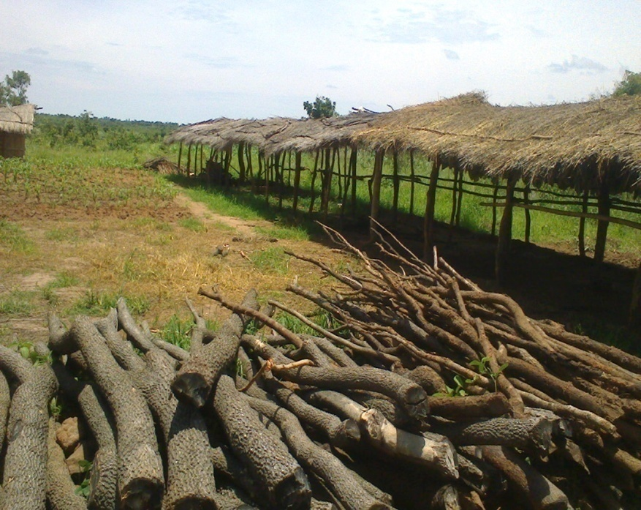
Environmental cost of Tobacco cultivation
AKM Ghulam Hussain
Professor Dr. Mohiuddin Faruque
Maruf Ahmed
Dr. Iftekharul Huq

Slide 5
Tobacco Work and Health (Ref: Tobacco’s Profit, Workers’ Loss? )
About 33 million people worldwide work in tobacco cultivation
270000 Acres are under tobacco cultivateion
Up to 16 applications of pesticides are required for tobacco production
About 25 million pesticide poisonings occur every year in developing countries.
Tobacco farmers suffer from diseases, such as, bronchial asthma, lung cancer, acute breathing problem, nausea, dizziness and green tobacco sickness (GTS)
Notes:
Tobacco workers are vulnerable to the same kinds of injuries and diseases encountered by any other agricultural worker—accidents with farm machinery or tools, heat exhaustion and heat stroke from working in fields, acute and chronic health effects associated with mixing and applying pesticides, and espiratory problems including asthma and silicosis resulting from inhalation of field and tobacco dust and fungal spores. The one environmental health
problem peculiar to tobacco work is green tobacco sickness (GTS), a form of nicotine poisoning that results from workers brushing against wet tobacco leaves. But the most controversial and serious environmental health issue in tobacco agriculture is pesticide use.

Slide 6
Comparison of clinical symptoms reported by Pakistani farmers suffering from pesticide poisoning (2010)
Notes:
(Degree of depression after spraying pesticide. The horizontal axis measures the intensity of depression). Study done in Pakistan. The farmers involved in pesticide application on tobacco crop were classified into : normal (<20% reduction), mild (20-40% reduction) and moderate (>40% reduction)

Slide 7
Background
Tobacco cultivation in Bangladesh has gained an alarming upward trend in recent years.
Bangladesh stands 11th in the world in tobacco production thus exposing the country to a severe environmental threat.
A 74 percent increase over seven years from 2008 to 2015 (Ministry of Finance, 2016).
Unofficial figure of tobacco farming land is 270,000acres (2014-15)

Slide 8
Background (Cont.)
Who Works:
A significant number of women and children are engaged in tobacco cultivation and tobacco leaf processing.
How Risky:
High risk of becoming infected with diseases, such as, bronchial asthma, lung cancer, acute breathing problem, nausea, dizziness and green tobacco sickness (GTS) .
What Else:
Besides creating health hazards, tobacco cultivation leaves detrimental effect on the bio-diversity of the country including degradation of soil fertility, pollution of river water and adverse impact on surrounding trees and animals.

Slide 9
Estimation of the Cost of Deforestation
Facts
Total Area under cultivation is 270,000 acre
Production of tobacco/acre of land is 1MT on average
Biomass required to process 1MT of tobacco is 6MT on average
Cost/ MT of carbon emission is 740USD
Biomass density is 100Cu. M/Hectare
Biomass weight is 500kg/Cu M on average
Biomass /Hectare is 100CuM x 500kg=50MT /Hectare
Carbon emission/Hectare: 900Mt/20 years/Hectare=45Mt/Year/Hectare
Calculation
Total wood required for curing: 270,000x6=1,620,000 MT
Carbon emission from burning: 50% x 1620000=810,000MT
Total area equivalent to deforestation: 1,620,000MT/50=32,400 Hectare
Carbon emission from deforestation: 32,400 x 45=1,458,000MT
Total carbon emission: 1,458,000+810,000=2,268,000Mt
Total cost: 2,268,000 x740=600,858,000USD=5,107,29,30,000Taka/Annum

Slide 10
Alternative Crop Case Studies
Tobacco need more nutrients. For example,
tobacco consumes
2.5 times nitrogen,
7 times phosphorus and
8 times potassium compared to maize¹.
Tobacco cultivation leads shrinkage of cultivable land for food grains.

Slide 11
Experimental (continued)
Parameter to be Studied -
Nitrogen (N)
Phosphorous (P)
Kallium (K)
Organic Carbon
pH of Water
DO
BOD
COD

Slide 12
Tobacco Use & Affordability
Impact

Slide 13
Prevalence

Slide 14
Prevalence
 | 2009 |  | 2012 |  | 2017 (GATS)
 | Male | Female | Male | Female | Male | Female
Any | 53.0 | 32.8 | 45.6 | 25.5
ST | 42.0 | 1.8 | 36.3 | 0.9
SLT | 26.4 | 32.1 | 18.5 | 25.2

Slide 15
Increasing cigarette excise taxes can prevent a huge number of smoking-related deaths
50% increase in cigarette excise tax →10.8 m lives saved
Rationale of taxation of tobacco
2.9 m
3.1 m
1.5 m
0.8 m
0.4 m
2.2 m
Source: Yurekli, Nargis, Goodchild, et al. Economics of Tobacco Control and Health. Vol.2, Health Determinants and Outcomes, in (editor) Scheffler RM, World Scientific Handbook of Global Health Economics and Public Policy. World Scientific, 2016.

Slide 16
WHO FCTC Article 6 Guidelines
Taxation and Affordability
“When establishing or increasing their national levels of taxation Parties should take into account – among other things – both price elasticity and income elasticity of demand, as well as inflation and changes in household income, to make tobacco products less affordable over time in order to reduce consumption and prevalence. Therefore, Parties should consider having regular adjustment processes or procedures for periodic revaluation of tobacco tax levels.”
Note:
Above recommendation ignores the brand switching which could dampen tax effect keeping consumption intact especially in developing country where tax is based on tier and there exists several tiers like Bangladesh.

Slide 17
Tracking affordability of tobacco products
Price of 100 cigarette packs
Relative Income Price
(RIP)
=
Per capita GDP
Affordability: inversely related to RIP

Slide 18
Relative Income Price by price categories of cigarettes in Bangladesh (PC GDP)
Source: Based on price data from National Board of Revenue and per capita GDP from World Development Indicators Database.

Slide 19
Relative Income Price by price categories of cigarettes using per capita household income
Contradiction
Source: Authors’ calculation using ITC Bangladesh Data.

Slide 20
Income mobility by monthly household income categories in ITC BD Surveys Waves 1-4.

Slide 21
Brand switching by wave due to price (and /or income ) change using ITC Data
Price movement of cigarette by brand over time
Percentage of smokers by cigarette brand

Slide 22
Distribution of affordable consumption remains more or less unchanged over time when individual level measures & brand choice are considered
Distribution of affordable cigarette consumption by wave and income
1
.8
.6
.4
Proportion of affordable consumption of cigarette
.2
0
0
.2
.4
.6
.8
1
Proportion of sample population arranged in ascending order of affordability
W1(2009)
W2(2010)
W3(2011-12)
W4(2014-15)
Equality line

Slide 23
Fluctuates over time using a single brand price
Distribution of affordable cigarette consumption using a single brand
1
.8
.6
.4
Proportion of affordable consumption by all smokers
.2
0
0
.2
.4
.6
.8
1
Cumulative proportion of smokers in ascending order of consumption power
2009
2010
2011-12
2014-15
Equal line

Slide 24
Taxation

Slide 25
Disease Profile in Bangladesh

Slide 26
Methodology
where is the prevalence of exposure to category i of the risk factor
is the corresponding relative risk for category i of the risk factor relative to the reference category, and
i=0 is the reference (non-exposed) category.

Slide 27
Methodology (Cont.)
The following formula is used to estimate the tobacco attributable burden from the global burden of disease for a country:
Tobacco attributable burden =PAF _{Tobacco} x GBD
PAF_{tobacco} is the population attributable fraction related to active smoking.

Slide 28
List of potential Interventions
No. | Description of intervention | Population coverage
1 | Current Scenario (tax at current rates)
2 | Increased taxation | 95%
3 | Comprehensive advertising ban | 50%
4 | Clean indoor air laws | 50%
5 | Information and labelling | 80%
6 | Nicotine Replacement therapy | 10%
7 | Brief advice | 10%
8 | Counselling | 10%

Slide 29
Cost per capita and cost per DALY information
 |  |  | Ethiopia |  | Kenya
No. | Description of intervention | Population coverage | Cost per year per capita (US$) | ACER (US$ per DALY saved) | Cost per year per capita (US$) | ACER (US$ per DALY saved)
1 | Current Scenario (tax at current rates) |  | 0.05 | 56 | 0.1 | 154
2 | Increased taxation | 95% | 0.05 | 34 | 0.1 | 84
3 | Comprehensive advertising ban | 50% | 0.03 | 117 | 0.07 | 321
4 | Clean indoor air laws | 50% | 0.03 | 106 | 0.06 | 278
5 | Information and labelling | 80% | 0.07 | 150 | 0.13 | 386
6 | Nicotine Replacement therapy | 10% | 0.2 | 7,019 | 0.19 | 8,444
7 | Brief advice | 10% | 0.01 | 229 | 0.02 | 677
8 | Counselling | 10% | 0.01 | 309 | 0.02 | 826
Notes:
Cost effectiveness is measured by the average cost per DALY saved called ‘average cost effectiveness ratio (ACER). it is evident that there is a wide range of ACER across different interventions for each country. For Ethiopia, it varies from US$34 to US$7,019. The estimates of ACER indicate that increased tobacco taxation is the cheapest intervention while NRT is the most costly intervention for saving healthy life. This difference in cost-effectiveness results from the fact that while taxation is population level intervention, NRT is intervention at the individual level.

Slide 30
Role of taxation

Slide 31
Tobacco Taxation: Single most effective tobacco control measure
↑
taxes
↑
prices
↓ affordability
↓ consumption
More effective when implemented within a comprehensive
tobacco control program
Notes:
Tobacco taxation is the single most effective tobacco control measure.
The relationships are straightforward.
If you raise tobacco taxes sufficiently, those selling tobacco products will need to increase prices to stay in business.
When prices increase, they become less affordable.
When products become less affordable, consumers buy less of them.
Raising tax on a product discourages the consumption of the product through its positive effect on its price. Tobacco, despite being an addictive product, is no exception to that principle. However, it is not as price sensitive as other normal products. As such, it has significant potential to increase revenue in the event of a tax and price increase and reduction in overall consumption.
Tax is a fiscal policy instrument available at the hand of the government of each country primarily to generate revenue that finances government expenditures. In addition, taxes are employed to redistribute income and wealth, to channel resources to desired use, to divert resources from undesirable uses, to protect domestic industries from foreign competition and to stabilize national income through demand management. Tobacco products are taxed with the objectives of discouraging its consumption and generating revenue. It serves the dual goals of improvement in public health and increase in government revenue.
There is no denying the fact that the non-price tobacco control interventions are very effective in reducing tobacco consumption. As a matter of fact, tobacco taxation can be even more effective in reducing tobacco consumption when implemented within a comprehensive tobacco control program that includes smoke-free laws, packaging and labelling provisions, marketing bans, and cessation programs.

Slide 32
Cigarette tax system
Tier | Retail price/pack of 10 sticks (BDT) | Excise tax rate (% of retail price) | Total tax share in retail price (excise + VAT)
2009-10
Low | 7.25-8.75 | 32% | 47%
Medium | 16.25-17.25 | 52% | 67%
High | 23.25-29.25 | 55% | 70%
Premium | 46.25+ | 57% | 72%
2017-18
Low: Local | 27.00 | 53% | 68%
Low: International | 35.00 | 56% | 71%
High | 45.00+ | 64% | 79%
Premium | 70.00+ | 66% | 81%

Slide 33
Cigarette price is increasing in Bangladesh

Slide 34
Then why is cigarette sale increasing?

Slide 35
PRICE INCREASE IN LOW TIER HAS FAILED TO STOP THE INCREASE IN CHEAP CIGARETTE CONSUMPTION
 | NOMINAL PRICE (BDT) | INFLATION-ADJUSTED PRICE (IN 2018 BDT) | TOTAL CIGARETTE SALE (BILLION STICKS) | CIGARETTE SALE IN LOW TIER (BILLION STICKS) | MARKET SHARE OF LOW TIER CIGARETTES (%)
2009-10 | 7.25 | 12.78 | 66.0 | 33.6 | 51%
2016-17 | 23.00 | 24.51 | 84.3 | 66.8 | 79%
% CHANGE |  | 91.8% | 27.7% | 99.0%
ABSOLUTE CHANGE |  |  | 18.3 | 33.2

Slide 36
How do we explain increasing cigarette consumption?
Growing number of cigarette smokers
Prevalence might be going down, but population is increasing
Current smokers switching to low-priced brands
Higher income leading to higher cigarette consumption

Slide 37
Both the number of smokers and consumption per smoker are increasing
 | Number of adult smokers (million) | Number of cigarette smokers (million) | Number of cigarettes per smoker (sticks) | Number of cigarettes per adult person (sticks)
2009 | 21.90 | 10.95 | 6,028 | 498
2017 | 22.35 | 11.17 | 7,544 | 586

Slide 38
Market share of low tier brands (%) is growing
UPPER TIER
LOW TIER

Slide 39
Per capita GDP is growing rapidly

Slide 40
What is the way forward?
Price increases in small annual increments allow people to gradually adjust their purchase behavior (choice of brands)
INCREASE THE PRICE AT THE LOW TIER DRASTICALLY IN ONE YEAR BY
AT LEAST 70%
PRICE SHOCK

Slide 41
What is the way forward?
Reduce the price gap between brands
Larger increase in low tier
Simplify the tax structure
Reduce the number of tiers to make it uniform
Introduce specific tax
Reduce the reliance on ad valorem system

Slide 42
Who are paying for protecting the interests of tobacco industry?
Smokers in Bangladesh are buying 84 billion cigarettes and paying approximately 194.39 billion BDT in taxes a year.
These smokers are also bearing the cost of an estimated 212 billion BDT in health expenditures and loss of productivity a year from deaths and diseases caused by smoking.

Slide 43
Family falls into poverty
Higher prevalence and consumption of tobacco
Breadwinner gets sick due to tobacco use
FOREGONE INCOME 2: Due to treatment cost and loss of work days
FOREGONE INCOME 3: Due to premature death
FOREGONE INCOME 1: Due to tobacco expenditure, less money spent on education, nutrition, etc.
Increased vulnerability to tobacco use
Vicious cycle of tobacco use and poverty
Where do we break this vicious cycle?

Slide 44
Uniform specific tax is preferred over ad valorem system
Administratively simple
Generates predictable revenue flow
Reduces price gap between brands/ products
Increases price more than ad valorem tax
Desirable from public health perspective

Slide 45
Roadmap for tobacco tax policy
Increase price significantly in the first year and then increase every year adjusting for inflation and income growth
Simplify tax structure—uniform tax per unit across brands/products
Transition from ad valorem to specific tax system

Slide 46
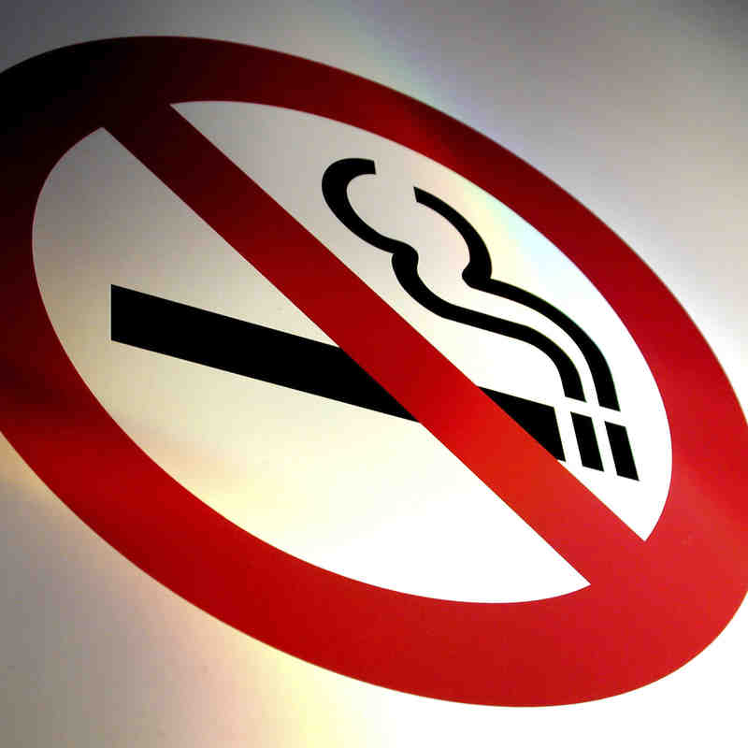
Thank you

