Slide 1
Effectiveness of tobacco taxation: Global and Bangladesh Experience
Shariful Alam, Lead Consultant, CTFK Bangladesh

Slide 2
Why Taxing Tobacco?
The poor quits more
Saves lives
Reduces Consumption
The young start less
Higher Tobacco Taxes
Tobacco industry loses
Reduced sales
Increases govt revenues
More tax revenues
Savings in health costs

Slide 3
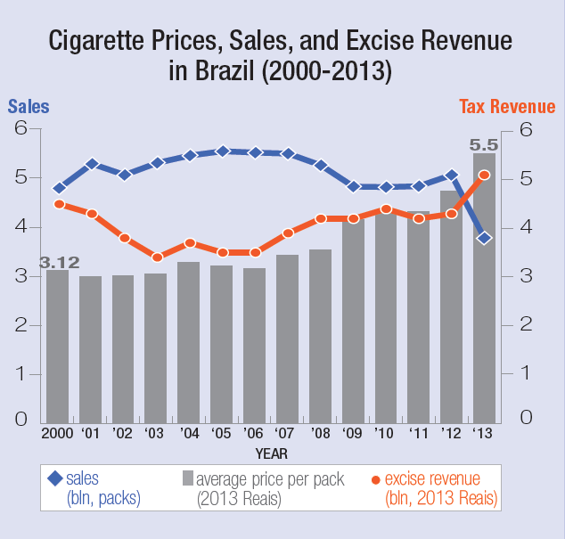
International Experience: Brazil
Between 2006 and 2013, excise tax increased by 116%
Real price increased by 74%
Cigarette sales decreased by 32%
Despite drop in sales, revenue increased by 48%.

Slide 4
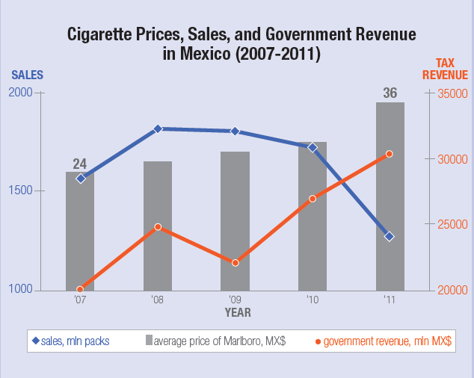
International Experience: Mexico
Between 2009 and 2011, tax per pack of 20 was increased to 7 pesos
69% increase in retail price
Sales dropped by 30%
Govt. revenue increased by 38%.

Slide 5
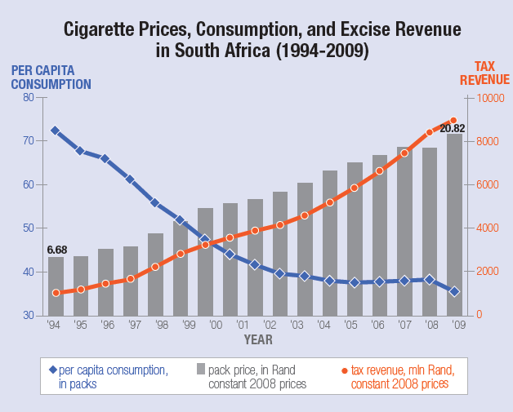
International Experience: South Africa
Between 1993 and 2009, total cigarette taxes increased from 32% to 52% of retail price
Cigarette sales declined 30%
Smoking rate decreased 25%
Govt. revenue increased 800%.

Slide 6
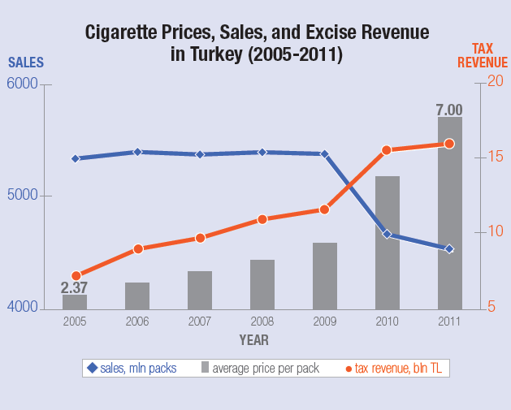
International Experience: Turkey
Between 2005 and 2011, cigarette price increased by 195%
Sales dropped by 15.5%
Govt. revenue increased by 124%.

Slide 7
The Case of Bangladesh

Slide 8
Cheap Tobacco Getting Cheaper
Real price of tobacco falling
Price not increasing as much as other products
Per capita income increasing significantly
Result: tobacco getting more and more affordable.

Slide 9
Price of Tobacco in BD
Price of Cigarettes per pack in International Dollars, 2014 (WHO)

Slide 10
Percentage of per capita GDP (BDT) required purchasing 5000 sticks of bidi: BD
*Bidi tariff values taken from government declared SRO data FY 2008-2009 to FY 2013-2014
* Per capita GDP (in BDT) taken from Bangladesh Bureau of Statistics (BBS) published Statistical Year Book Bangladesh 2014, page 397

Slide 11
Tobacco products become cheaper compare to other basic commodities: BD
* The CPI basket for Bangladesh includes Scissor brand cigarette. Three other essential items (Rice, Hen egg and Milk) have been taken for comparison.

Slide 12
Taxing Tobacco: Implementation of FCTC Article 6 & Sustainable Source of Finance
In South Africa, between 1993 and 2009, total taxes on cigarettes were increased from 32% to 52% of the retail price. This contributed to reduce tobacco consumption from about 4 to 2 cigarettes per-adult-per-day over a decade, and generated a nine-fold increase in government tobacco tax revenue.

Slide 13
Tobacco Taxes: win-win-win-win
Reduce consumption substantially
Greater reduction among the poor and the young
Raise government revenue more than the normal increase
Industry will lose gradually but surely
Big WIN for public health
Likely to increase government’s popularity
81% people of Bangladesh support tobacco taxation (GATS 2009).

Slide 14
BUT industry agrees as well!
“Jeffrey Harris of MIT calculated that … the [US] 1982-83 round of price increases caused two million adults to quit smoking and prevented 600,000 teenagers from starting to smoke … We don’t need to have that happen again” (Philip Morris 1987).
“Of all the concerns, there is one – taxation – that alarms us the most. While marketing restrictions on public [sic] and passive smoking do depress volume, in our experience taxation depresses it much more severely. Our concern for taxation is, therefore, central to our thinking about smoking and health (Philip Morris 1985).
Notes:
Understanding Demand Supply and Their Applications
07 January 2009
Unnayan Shamannay
14

