Slide 1
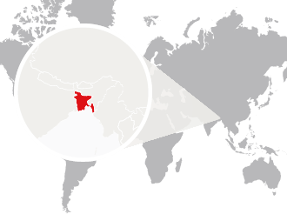
Tobacco Tax:
Rumana Huque, PhD

Slide 2
Outline of Presentation
Understanding the tax base
Different structures, different effects
Recommendations

Slide 3
Tobacco Use in Bangladesh
One of the largest tobacco consuming countries in the world
58% of all men and 29% of all women consume some form of tobacco, whether smoked or smokeless.
Over 46 million (43%) adults consuming cigarettes, bidis, smokeless tobacco, or other tobacco products.
28% of women and 26% of men use smokeless tobacco.
Nearly 7% of 13-15 year olds use tobacco products.

Slide 4
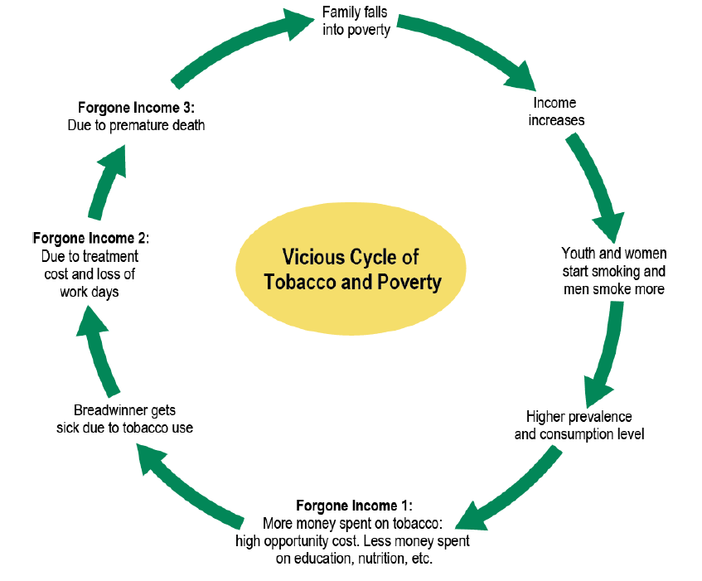
The Reality
In most countries, more of the poor smoke than the rich and thus bear cigarette tax disproportionately
But…
The poor are more responsive to tax increases
Possible to reduce net regressivity by dedicating portion of tax to smoking prevention or cessation programmes
Tobacco control policies can help break the cycle of tobacco use and poverty
Notes:
Source: NCI Monograph (2017)

Slide 5
“Tobacco is a hindrance to achieve SDGs”
PM Statements
FCTC implementation is a pre-condition

Slide 6
Rationale for tobacco tax
The challenge: Design the tax system in such a way that it will:
Be effective in reducing tobacco consumption and smoking prevalence, especially among the youth
Generate much government revenue
Improve public health outcomes
Be administratively simple

Slide 7
Tobacco tax types
Tobacco tax types:
Consumption taxes (indirectly placed on consumer)
Excise tax
Value added tax
Customs duties (a.k.a. tariffs)
Taxes levied on imports (sometimes exports)
Notes:
VAT,%retail%sales%taxes%and%excise% duties%have%different% characteristics:% Value% added% tax% is% a% general% consumption% tax% that% applies,% in% principle,% to% all% commercial% activities% involving% the% production% and% distribution% of% goods% and% theprovision of services.
The most common single-­stage tax is
the retail sales tax which is charged
only on the sale of an item to its final
end user (e.g. the United States
Various tax options
Taxes on value of tobacco crop
Customs duties on tobacco leaf imports and/or exports (becoming less important)
Customs duties on tobacco product imports and/or exports (becoming less important)
Sales taxes
Value added taxes
Implicit taxes when government monopolizes tobacco product production and/or distribution
Tobacco excise taxes
Many of these are applied to variety of agricultural and/or consumer goods and services
Excise taxes are of most interest given specificity to tobacco products (and a few others products – e.g. alcoholic beverages, motor vehicle fuel)
In contrast to VAT, excise duties
are usually levied at the stage of
production or importation—and not
distribution—and they target the
consumption or the use of specific
products. The most commonly applied
excise duties are those on alcoholic
beverages, manufactured tobacco
products and energy products (motor
fuels and heating fuels, such as petrol
and gasoline, electricity, natural gas,
coal and coke).
Excisable goods have the
following common characteristics:
demand is price inelastic;; production,
distribution and sales can be closely
supervised by the government;;
and they are associated with
negative externalities (e.g. health or
environmental) or are considered
luxury goods.
There are two types of excise
duties on tobacco products: specific
and ad valorem. A specific excise
duty is a fixed monetary amount of
tax per quantity, volume, or weight
of tobacco products (e.g. per piece,
pack, carton, kilogram). An ad
valorem excise duty, on the other
hand, is levied as a percentage of
some measure of value of the tobacco
products (e.g. the manufacturer’s
price or the retail selling price).
Excises on tobacco are levied
in most countries around the world.
Only a few countries do not levy an
excise on tobacco products (e.g.
Benin, Cook Islands, Maldives, Saudi
Arabia, Grenada) (World Health
Organization, 2009). However, the
type (specific versus ad valorem),
rates and base of the tax vary
considerably across countries.
.
Customs duties (also called tariffs)
are taxes levied on imports of goods
(and, sometimes, on exports) by the
customs authorities of a country,
mainly to raise state revenue, and/
or to protect domestic industries
from more efficient or predatory
competitors from abroad. Again, the
duty may be specific or ad valorem.
Specific customs duties are based
upon the weight, dimensions, or
some other criteria of the item
(such as the size of the engine in
the case of automobiles). The ad
valorem customs duties are levied
on importer’s CIF (cost, insurance
and freight) value, as opposed to
ad valorem excise duties which are
levied on the manufacturer’s price or
the retail selling price. Consequently
the impact of a customs duty on the
final consumers’ price will be less
than that of an excise duty, because
the CIF value at importation can be
considerably lower than the e.g. the
final retail selling price. For example,
total tax as percentage of retail price
is 50% in Saudi Arabia, Bahrain, and
Qatar despite 100% import duties
(World Health Organization, 2010).

Slide 8
Introduction to excise taxes
What is an excise tax?
Indirect tax charged on sale of particular good
Government often imposes excise taxes on goods that have a high social cost, which is not taken into account by consumer → Sin Taxes
Two categories of excise tax structures:
Ad Valorem (literally means “according to value”)
Specific
Notes:
Indirect means the tax is not directly paid by an individual consumer; instead, the government levies the tax on the producer or merchant, who passes the tax onto the consumer by including it in the product's price.
Two categories of excise tax structures:
Ad Valorem (literally means “according to value”)
Fixed percentage of net-of-tax price (or other definition of the price)
Taxes vary depending on value of product
Specific
Fixed amount per unit sold

Slide 9
Specific vs. ad valorem excise tax
Specific excise tax:
Fixed monetary amount of tax per quantity, volume, or weight of tobacco products (e.g., $1.50 per pack regardless of price or brand)
Tax base: The unit of the product
Ad valorem taxes:
Excise tax is levied as a percentage of the price (or some definition of value) of the tobacco products.
E.g. value of the product is measured by the manufacturer’s price (e.g., 80% of the manufacturer’s price, or ex works price, or CIF value) or by the price paid by consumers (e.g., 70% of pre-tax retail price).
Tax base: The value of the product
Notes:
specific
excise tax is a fixed monetary amount
of tax per quantity, volume, or weight
of tobacco products.
Generally produce more stable stream of revenue
Real value falls with inflation
Promote higher “quality” products
Easier to administer

Slide 10
Specific vs ad valorem excise tax
Specific tax:
Advantages:
Government revenue predictable
Raises all product prices
Easy to determine the amount of tax
Easier to administer
Disadvantages:
Inflation erodes its value
Can be reduced by changing product characteristics
Notes:
when determining taxation policy,
governments will take into account
other, at times competing, political,
social or economic considerations.
Because specific duties are the
same for all cigarettes, independent
of the price, they will reduce the
relative price differentials between
high-­ and low-­taxed cigarettes. This
may lead consumers to switch to
higher-­priced cigarettes, assuming
that more expensive cigarettes are
considered to be of a higher quality
(and thus more appealing). They
have an upgrading effect that favours
high quality, which may lead to a
higher average price. Ad valorem duties are a
percentage of the price of cigarettes
and will maintain the relative (pre-­tax)
price differentials between high-­ and
low-­taxed cigarettes. Consequently
there will be more price competition
under an ad valorem system, which
may entail a lower average price.
They have a multiplier effect that
favours low quality.

Slide 11
Specific vs ad valorem excise tax
Ad valorem:
Advantages:
Automatic adjustment for inflation
Disadvantages:
Less predictable revenue stream
Difficult to determine the amount of tax
Low prices
Leads to large price differences between products
Susceptible to price undervaluation depending on the choice of the tax base
Notes:
Tobacco free kids document
problems, especially if the tax base is the manufacturer’s price. That is, under ad valorem taxation tobacco manufacturers have the potential to sell their products to a related marketing company at an artificially low price, in order to reduce the excise tax liability (transfer pricing). Consequently, the government revenue from ad valorem tax declines due to the reduction in tax base. It is just this valuation problem that led the Philippines to abandon ad valorem taxes on cigarettes in favour of specific excises and the Russian Federation to impose specific excises on imported cigarettes instead of ad valorem taxes in 1996.

Slide 12
Global trends
Structure | 2008: Number of countries (total 182) | 2014: Number of countries (total 180)
Purely specific system | 55 | 57
Purely ad valorem system | 60 | 45
Mixture of both excises | 48 | 61
No excise | 19 | 18
 | Source: WHO report on Global Tobacco Epidemic 2009: implementing smoke-free environments. Geneva, WHO | Source: WHO report on Global Tobacco Epidemic 2015: implementing smoke-free environments. Geneva, WHO
Notes:
tax applies.
Only 55 countries rely on
specific duties only;; most (108)
apply at least to some extent an
ad valorem duty (see Table 2.2)
(World Health Organization, 2009).
No complete data are available as
concerns the number of countries
applying a minimum tax. Twenty-­
four EU Member States (European
Commission, 2010a) as well as
the Russian Federation and the
Ukraine combine a mixed structure
with a minimum tax. Turkey applies
an ad valorem system combined
with a minimum tax (World Health
Organization, 2010).
The preference of countries for a
particular structure shows similarities
by income groups. Most low-­income
countries rely on ad valorem taxes.
Conversely, almost all high-­income
countries apply purely specific or
mixed systems. Within the high-­
income countries, the European
Region (except Norway) relies on
a mixed system, and almost all
other countries on a purely specific
system (inter alia, the United States
of America, Canada, Australia, New
Zealand, Japan, Singapore).
There are also similarities by
region. Most countries in Latin
America and the Caribbean region
as well as in Africa apply purely ad
valorem systems. North America
and a large number of countries in
the East Asian and Pacific region
rely on purely specific systems.
Mixed systems are mainly applied
in Europe, and in China, Indonesia,
Pakistan, Malaysia and Thailand
(World Health Organization, 2009).

Slide 13
Specific vs ad valorem excise tax
If reducing tobacco use is primary goal, specific tax is generally preferred
Should be regularly adjusted for inflation
Generally not included in tobacco tax legislation or done in practice through regular increases
Regular increases above inflation if goal is to further reduce consumption
Tax increases should be comparable across tobacco products
Reduce opportunities for substitution in response to changes in relative prices.
Can be somewhat offset by industry response
e.g. per stick taxes may result in greater availability of longer cigarettes.

Slide 14
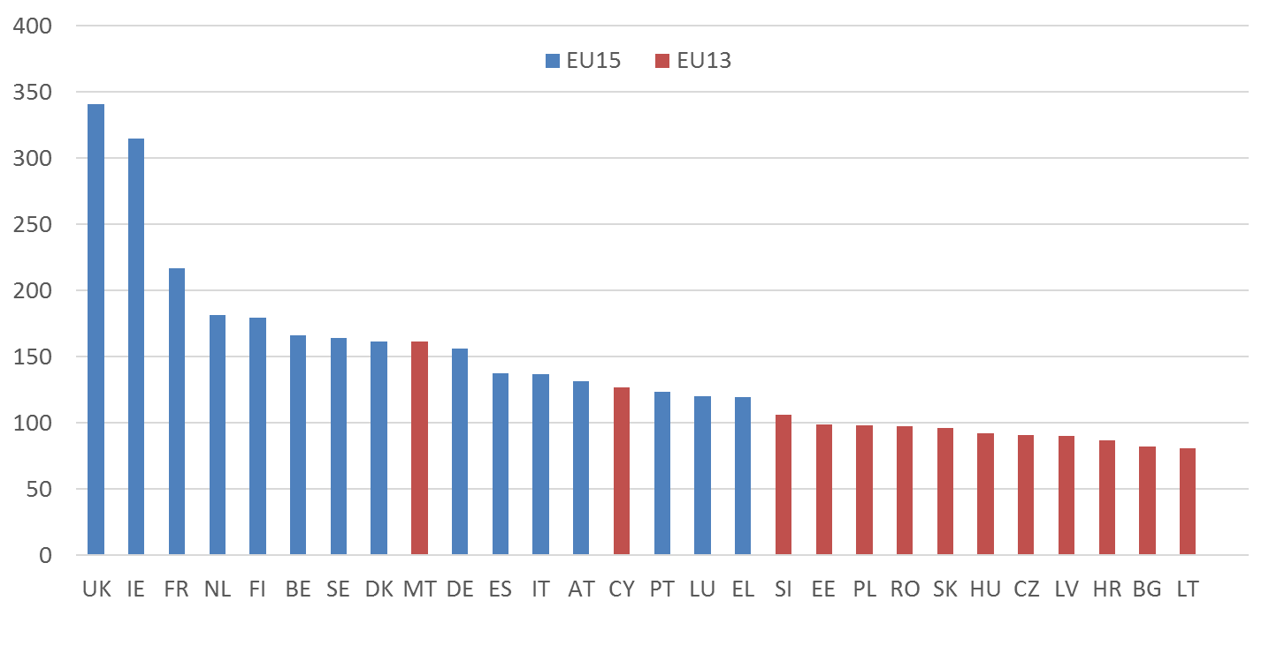
Tax Structure Affects Tax Revenue
Excise Tax Collected per 1000 WAP Cigarettes in Euros, Jan 2016
Notes:
Source: Excise Duty Tables, European Commission, January 2016. Revenue is a function of prevalence, smoking intensity, tax rate, the level of illicit consumption, the tax structure – i.e. substitution.
UK and Ireland have the highest taxes, the higher prices and the highest tax revenue, but not the highest consumption in the EU.

Slide 15
Some case studies in tobacco tax administration: bad practices
Very complicated excise tax structures
Example: Jamaica’s excise tax structure in 2005
Special consumption tax (SCT):
J$128.61 per 100 cigarettes, increased to J$ 192 per 100 cigarettes on 14 April 2005;
An ad valorem tax of 39.9 % on cigarettes in excess of a benchmark value of J$252.39 per 100 cigarettes. The benchmark value was increased to J$433.81 on 14 April 2005;
“Excise levy” payable to the National Health Fund: 23 % of the sum of the ex factory price and the SCT, payable by the cigarette manufacturers since April 2003; and
General Consumption Tax (GCT): 15 %, which was increased to 16.5 % on 14 April 2005.
Result: tobacco industry exploited the complexity of the tax system to its own advantage
In 2008 Jamaica switched from this very complicated tax structure to a uniform specific tax

Slide 16
Cigarette
 | 2011-12 |  | 2012-13 |  | 2013-14 |  | 2014-15 |  | 2015-16
Tier | MRP (10 stick) | SD | MRP (10 stick) | SD | MRP (10 stick) | SD | MRP (10 stick) | SD | MRP (10 stick) | SD | VAT
Low | 11.00-11.30 | 36% | 12.10-12.30 | 39% | 13.69-13.91 | 39% | 15.00-16.50 | 43% | 18.00 | 48% | 15%
Medium | 22.50-23.00 | 55% | 24.75-25.25 | 56% | 28.00-30.00 | 56% | 32.50-35.00 | 60% | 21.00 -42.00* | 60%
High | 32.00-36.00 | 58% | 35.20-39.50 | 59% | 42.00-45.00 | 59% | 50.00-54.00 | 61% | 44.00 – 69.00 | 61%
Premium | 60.00+ | 60% | 66.00+ | 61% | 80.00+ | 61% | 90.00 + | 61% | 70.00 + | 63%
100.00+
* Actually there is no cigarette within this price brand at present financial year.

Slide 17
Cigarette
Tier | Maximum Retail Price of 10 sticks (Taka)/ FY 2017-2018 | Supplementary Duty for FY 2017-2018 * | VAT * | Health Development Surcharge*
Low – local brand | 27 | 52% | 15% | 1%
Low – international brand | 35 | 55% | 15% | 1%
High | 45.00 + | 63% | 15% | 1%
Premium | 70.00 + | 65% | 15% | 1%
* Tax base is Maximum Retail Price

Slide 18
Bidi
 | 2011-12 |  | 2012-13 |  | 2013-14 |  | 2014-15 |  | 2015-16
Tier | Tariff Value (Taka) | SD* | Tariff Value (Taka) | SD* | Tariff Value (Taka) | SD* | Tariff Value (Taka) | SD* | Tariff Value (Taka) | SD* | VAT*
Without filter, 25 stick pack | 3.1579 | 20% | 3.1579 | 20% | 3.8842 | 20% | 4.27 | 25% | 4.91 | 25% | 15%
Without filter, 12 stick pack | 1.5158
 |  |  | 1.5158 |  | 1.8644 |  | 2.05 |  | 2.36
Without filter, 8 stick pack | 1.0105 |  | 1.0105 |  | 1.2429 |  | 1.37 |  | 1.58
With filter, 20 stick pack | 3.43 | 25% | 3.43 | 25% | 4.2189 | 25% | 4.64 | 30% | 5.34 | 30%
With filter, 10 stick pack | 1.7150 |  | 1.7150 |  | 2.1094 |  | 2.32 |  | 2.69
* Tax base: Tariff Value

Slide 19
Bidi
Tier | Maximum Retail Price (Taka)/ FY 2017-18 | Supplementary Duty/ FY 2017 - 18* | VAT * | Health Development Surcharge*
Without filter, 25 stick pack | 12.50 | 30% | 15% | 1%
Without filter, 12 stick pack | 6.00
Without filter, 8 stick pack | 4.00
With filter, 20 stick pack | 12.00 | 35%
With filter, 10 stick pack | 6.00

Slide 20
Smokeless tobacco (gul, jarda)
Product | Tax base (Taka) | 2012-13 | 2013-14 | 2014-15 | 2015-16 | 2016-17
 |  | Supplementary Duty* |  |  |  |  | VAT*
Jarda | Ex-factory price | 30% | 30% | 60% | 60% | 100% | 15%
Gul | Ex-factory price | 30% | 30% | 60% | 60% | 10%
* Tax base: Ex-factory price

Slide 21
Health Development Surcharge
A non-tax revenue of 1% as ‘health development surcharge’ was imposed for the first time in Bangladesh in 2014-15 on tobacco products

Slide 22
Observations
Complex tax structure
Different tax base & tiers
Cigarette: MRP and multiple tier (low, middle, high and premium)
Bidi: Tariff value
Smokeless: Ex factory price
Very poor tax base
Ad valorem tax pattern (SD)
Yet to utilize the fund generated from surcharge

Slide 23
Switching from ad valorem to specific
Specific taxes are a more successful strategy for increasing government revenue and improving public health
Effect of switching:
the tax burden on the lower-­priced cigarettes would be increased, but the change to specific taxation would result in a reduction of the tax burden on higher priced brands.
This may have undesired effect on (1) consumer prices of premium brand and (2) competitive positions of tobacco manufacturers.
Notes:
Note from Corne: The Kenya example: Mastermind was very upset when Kenya removed tiers and introduced a single uniform tax because their cigaretets were at the bottom end of the price range and they were hit harder than BAT. BAT was quite happy with the change because they could benefit relatively over Mastermind.
This might
have undesired effects on consumer
prices of premium brands and on the
profits and competitive positions of
tobacco manufacturers. Producers
of premium brands would get a tax
subsidy, while their competitors
would potentially face a significant
increase of the tax burden on their
products. To avoid these effects, a
switch to a more specific tax structure
could be done in the context of tax
increases, i.e. by increasing the
specific element while leaving the ad
valorem unchanged. Another option
is the introduction of a minimum tax
floor that does not affect the tax
burden on higher priced brands.

Slide 24
Recommendations
Cigarettes:
remove the differential tax on local and MNC brands in the lowest tax tier
combine the middle and top tax tiers
set the minimum price for the lower tier at 50 taka per 10 cigarettes
set the minimum price for the higher tier at 100 taka per 10 cigarettes
raise the ad valorem on the lower tier to 60%
keep the ad valorem on the higher tier at 65% (which is an increase on brands currently in the middle tier)
add a 5 taka/10 sticks specific tax
Notes:
Note from Corne: The Kenya example: Mastermind was very upset when Kenya removed tiers and introduced a single uniform tax because their cigaretets were at the bottom end of the price range and they were hit harder than BAT. BAT was quite happy with the change because they could benefit relatively over Mastermind.
This might
have undesired effects on consumer
prices of premium brands and on the
profits and competitive positions of
tobacco manufacturers. Producers
of premium brands would get a tax
subsidy, while their competitors
would potentially face a significant
increase of the tax burden on their
products. To avoid these effects, a
switch to a more specific tax structure
could be done in the context of tax
increases, i.e. by increasing the
specific element while leaving the ad
valorem unchanged. Another option
is the introduction of a minimum tax
floor that does not affect the tax
burden on higher priced brands.

Slide 25
Recommendations
Bidis:
eliminate the distinction between filtered and non-filtered bidis
set the minimum price at 30 taka per pack of 25
raise the ad valorem tax to 45%
add a 6 taka per pack of 25 specific tax

Slide 26
Recommendations
Smokeless tobacco:
change the tax base to the retail price
set a minimum retail price of 50 taka per 20 grams
raise the ad valorem tax to 45%
add a 10 taka per 20g specific tax

Slide 27
Summary
The excise tax structure is as important, if not more important than the level of the excise tax
In a country with low excise taxes and poor excise tax structure, first clean up the structure, then raise the excise tax
The tobacco industry typically likes complicated tax structures
If the tobacco industry strongly opposes a tax structure or increase, it is usually a sign that it works!

