Slide 1
Overview of local laws and the current situation in using health development surcharge in Bangladesh
Syed Mahbubul Alam,LL.M
Technical Consultant, The Union

Slide 2
Health Development Surcharge
In 2014-15 financial budgets, 1% surcharges on all tobacco products is a milestone initiative of the Government of Bangladesh to protect public health.
In 1st July 2014 National Board of Revenue (NBR) pass passed rules to collect surcharge from all tobacco products

Slide 3
Govt. Initiative
Ministry of Health and Family Welfare formed a committee to prepared draft proposal to use of health development surcharge.
Committee members are
Additional Secretary, (Public Health & WHO) MOH
Deputy Secretary ( WHO) MOH
Deputy Secretary, MOPA & MOCAT
Deputy Secretary, (Budget) MOH
Representative, NCDC Line Director.
Representative, WHO
Representative, The Union
Representation, CTFK
Committee reviewed of different law, policies and formation of existing foundations in Bangladesh. Prepared a initial draft document.

Slide 4
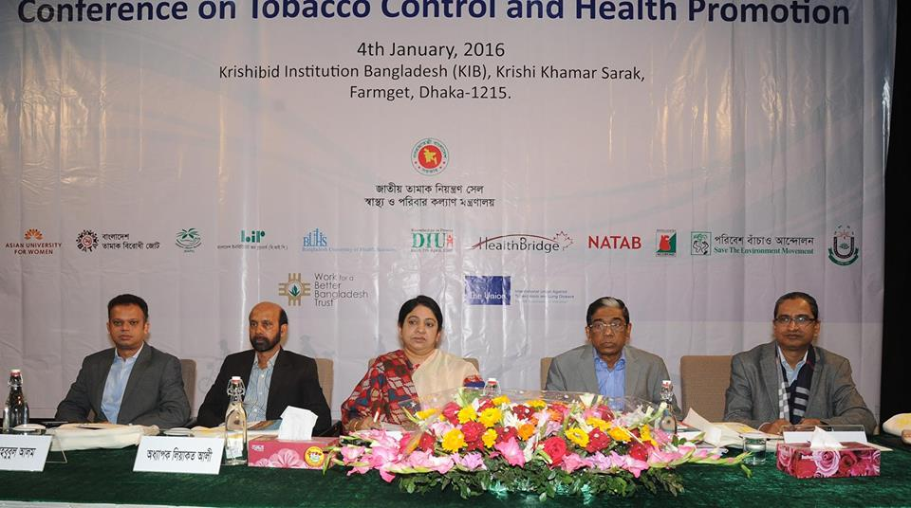
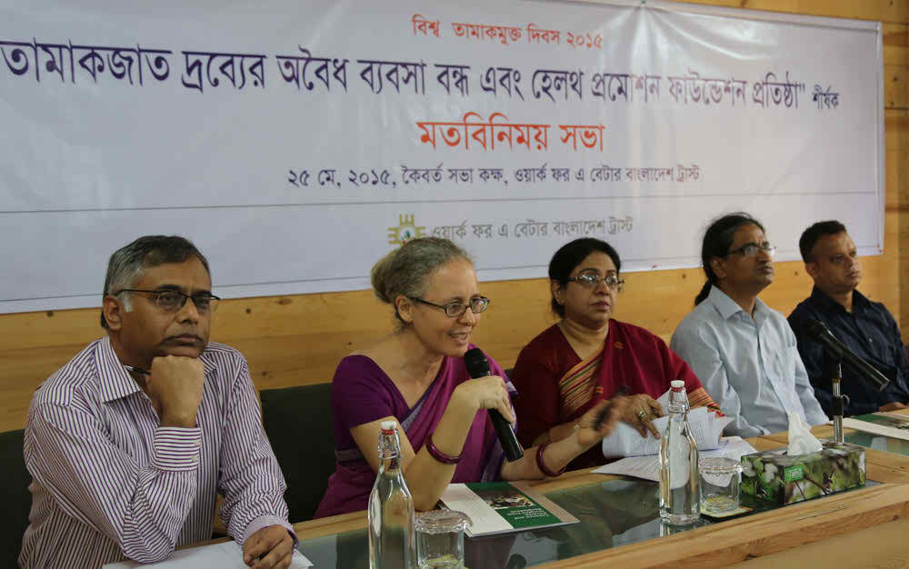
Capacity Building
Around 210 NGOs’ representative are highly orientated about the Sustainable funning issues during the 7 Divisional workshops organized by WBB Trust
Organize National Level Conference on Sustainable Funding.

Slide 5
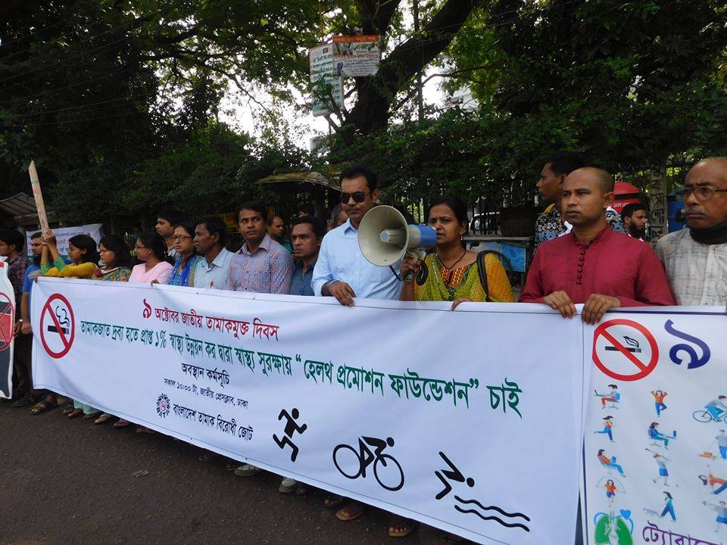
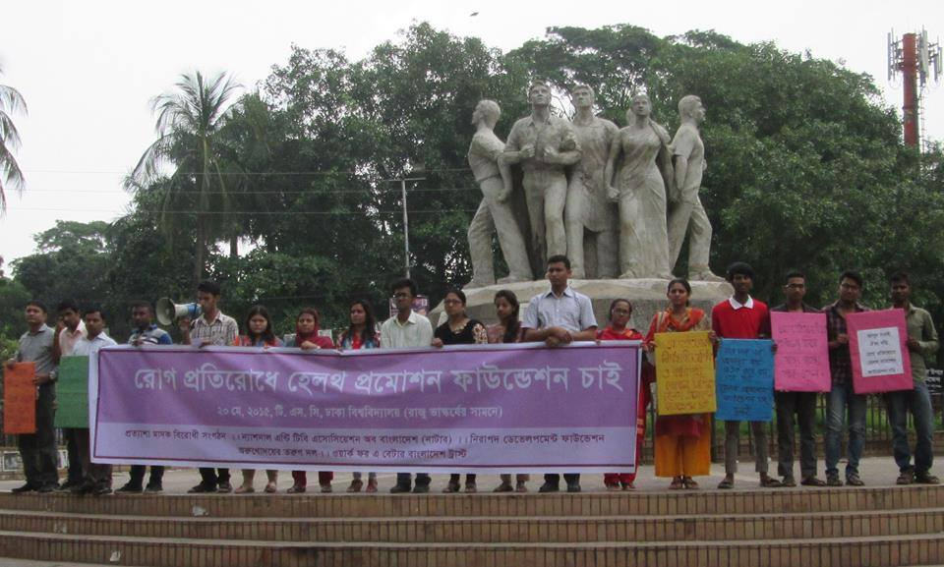
Public Support Campaign
During WNTD 2015, over 60 organizations organized various programs and demanded to establish a Health Promotion Foundation to ensure sustainable funding for TC.

Slide 6
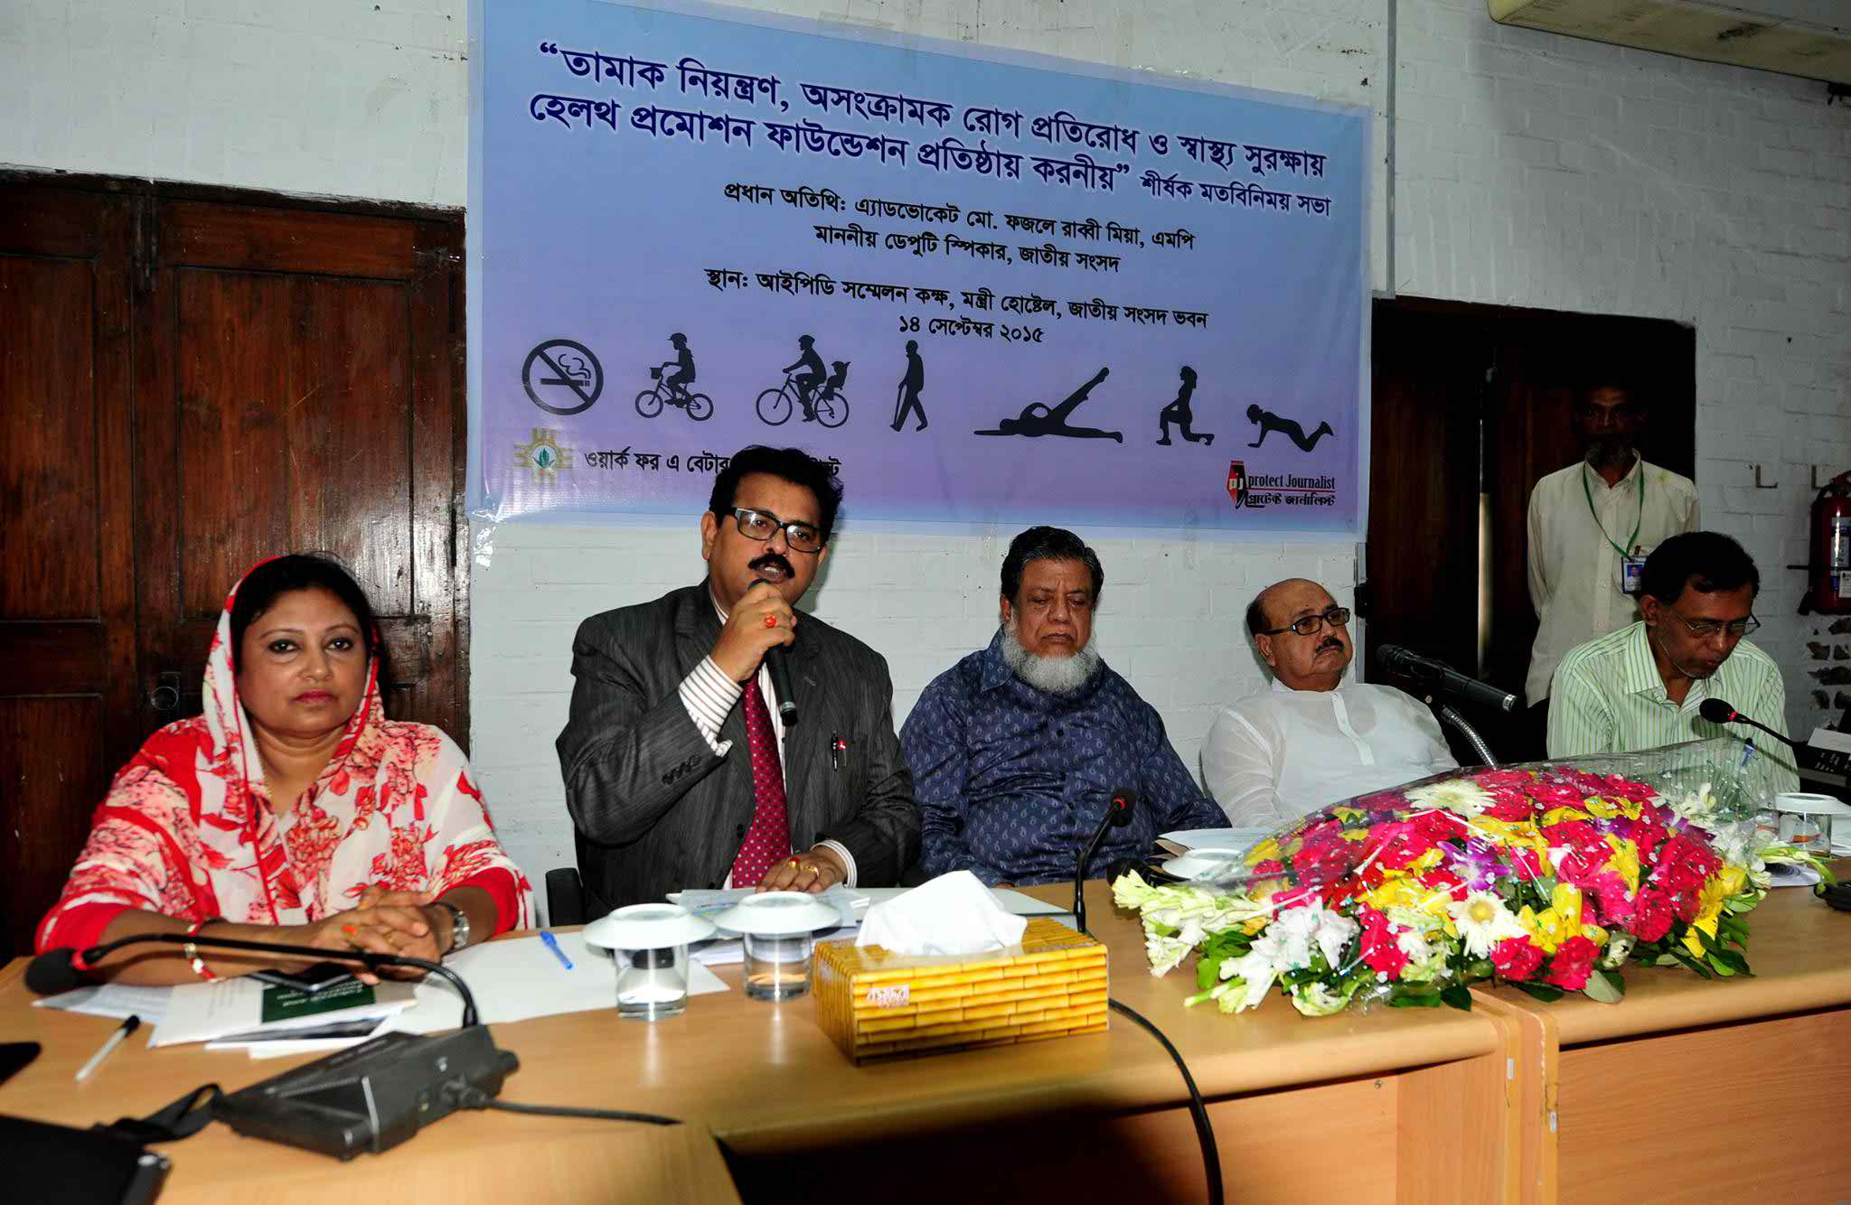
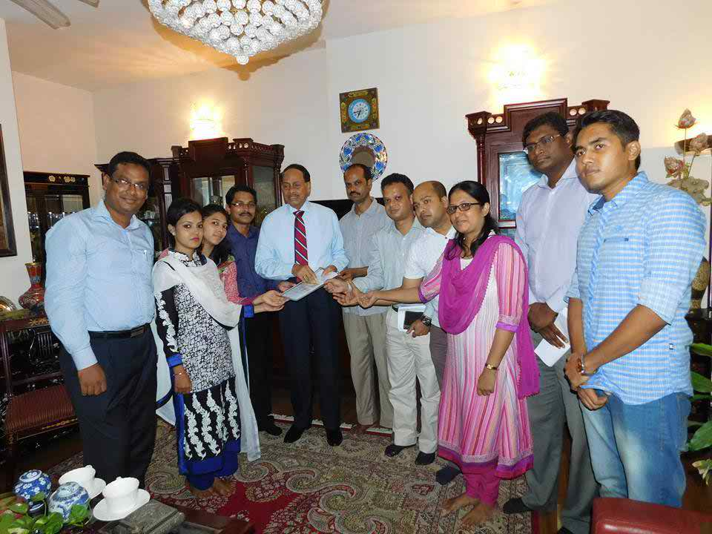
Sensitize Policy Makers
Parliamentary members and policy makers has sensitized about sustainable funding issues

Slide 7
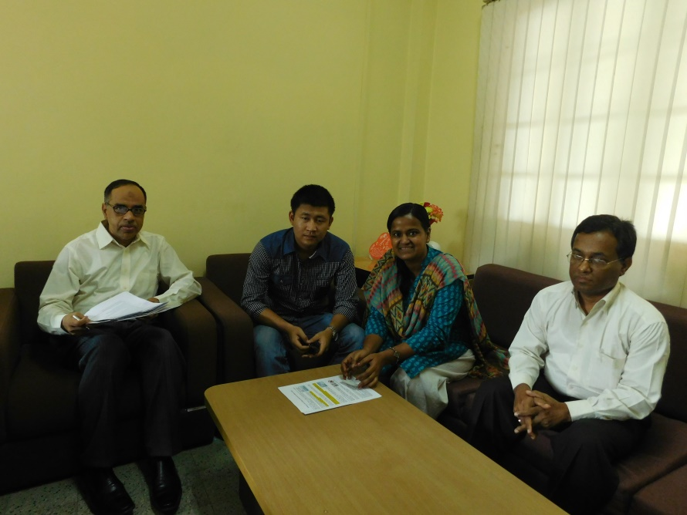
Govt. Institution
Sharing meeting with government organizations

Slide 8
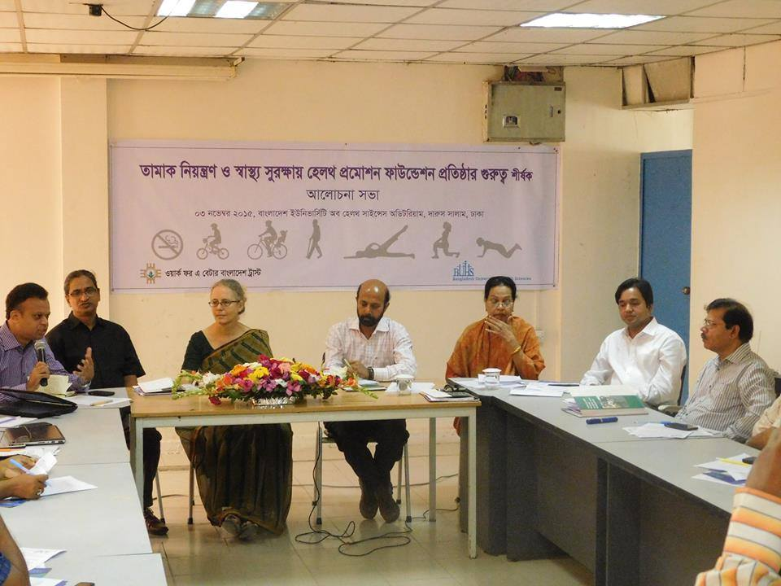
CSO and Academy
Leading CSO such as POBA, BAPA, Public Health Foundation support to establish a institute for sustainable funding.
Bangladesh University and Health Science and Dhaka International University actively working on HPF issue.

Slide 9
Media Work

Slide 10
Thanks

